Slide 1
BBC THREE INFORMATION SYSTEM AUDIT
This document presents a comprehensive audit of the information systems at BBC Three, focusing on the critical area of information systems controls and control objectives. The audit aims to provide a detailed analysis of the existing controls, identify potential weaknesses, and offer recommendations for improvement.
by Ssendi Samuel

Slide 2
Introduction: Definition of Controls
Controls are defined as "The policies, procedures, practices and organizational structures designed to provide reasonable assurance that business objectives will be achieved and that undesired events will be prevented or detected and corrected".
The primary purpose of information system controls is to ensure that business objectives are achieved and undesired risk events are prevented or detected and corrected. This is accomplished through a well-designed information control framework, encompassing policies, procedures, practices, and organizational structure, which provides reasonable assurance that business objectives will be met.
1
Objective of Controls
2
Need for Control and Audit of Information Systems
Information systems control objectives aim to ensure the confidentiality, integrity, and availability of information assets, safeguarding data, protecting business process application programs, and ensuring continued computer operations.
Technology has significantly impacted business operations, enabling organizations to capture, store, analyze, and process vast amounts of data and information. This has led to a greater need for control and audit of information systems to ensure data integrity, prevent unauthorized access, and maintain operational efficiency.

Slide 3
Factors Influencing Control and Audit
Several factors influence an organization's approach to control and audit of information systems. These factors highlight the critical importance of a robust control framework in today's technology-driven business environment.
Organizational Costs of Data Loss
Incorrect Decision Making
Costs of Computer Abuse
Accurate data is essential for effective decision-making. Incorrect decisions based on inaccurate or incomplete data can lead to significant financial losses, operational inefficiencies, and reputational damage.
Unauthorized access, computer viruses, physical access to computer facilities, and unauthorized data copies can result in asset destruction (hardware, software, documentation), financial losses, and reputational damage.
Data is a critical resource for an organization's present and future processes, enabling adaptation and survival in a changing environment. Data loss can have significant financial and operational consequences, making data protection a top priority.

Slide 4
Factors Influencing Control and Audit (Continued)
The factors influencing control and audit of information systems extend beyond the immediate risks to encompass the value of computer resources, the potential for errors, and the need to protect privacy.
Value of Computer Hardware, Software, and Personnel
High Costs of Computer Error
Maintenance of Privacy
In a computerized environment, data errors during entry or processing can have significant consequences, leading to financial losses, operational disruptions, and reputational damage. Implementing robust controls to prevent and detect errors is crucial.
Modern business processes collect sensitive personal data, raising concerns about privacy. Organizations must implement controls to ensure that personal data is collected, stored, and used ethically and in compliance with relevant regulations.
Computer hardware, software, and personnel are critical resources that significantly impact an organization's infrastructure and business competitiveness. Protecting these assets is essential for maintaining operational efficiency and ensuring business continuity.

Slide 5
Factors Influencing Control and Audit (Continued)
The final factors influencing control and audit of information systems relate to the need for controlled evolution of computer use and the importance of information systems auditing.
Controlled Evolution of Computer Use
Information Systems Auditing
Technology use and reliability of complex computer systems cannot be guaranteed. The consequences of using unreliable systems can be destructive. Implementing controls to manage the evolution of computer use is crucial for ensuring system stability and security.
Information systems auditing is the process of attesting to objectives, including asset safeguarding, data integrity, system effectiveness, and efficiency. It plays a critical role in ensuring that information systems are operating effectively and securely.

Slide 6
Classification of Controls
Controls are central to the concept of an information systems audit. They define points of action in a work process where decisions are made about subsequent actions. Information systems controls are classified into several categories, each addressing specific aspects of control within an organization.
General Controls
Business Process / Application Controls
General controls are policies and procedures that apply to all or a large segment of an organization's information systems, ensuring their proper operation. They safeguard data, protect business process application programs, and ensure continued computer operations in case of unexpected interruptions.
Business process controls are automated or manual controls applied to business transaction flows, ensuring the completeness, accuracy, validity, and confidentiality of transactions and data during application processing.
Objective-Based Control
User Controls
Objective-based controls are classified based on the objective with which they are designed or implemented. These categories include preventive, detective, corrective, directive, and recovery controls.
User controls are implemented by individuals interacting with information systems to ensure system effectiveness and efficiency. These controls include boundary, input, processing, output, and database controls.

Slide 7
General Controls
General controls are essential for establishing a foundation of security and reliability across an organization's information systems. They provide a framework for ensuring the integrity and availability of data, protecting against unauthorized access, and maintaining operational efficiency.
1
Organizational Controls
2
Management Controls
3
Financial Control Techniques
Organizational controls are concerned with the decision-making processes that lead to management authorization of transactions. They ensure that responsibilities and authorities are clearly defined and documented, promoting accountability and preventing conflicts of interest.
Management controls ensure that information systems function correctly and meet strategic business objectives. They involve establishing high-level IT policies, procedures, and standards, and creating a sound internal controls framework within the organization.
Financial control techniques are procedures exercised by system user personnel over source documents before system input. They ensure the accuracy and completeness of transactions, including authorization, budgeting, cancellation of documents, documentation, dual control, input/output verification, safekeeping, segregation of duties, sequentially numbered documents, and supervisory review.

Slide 8
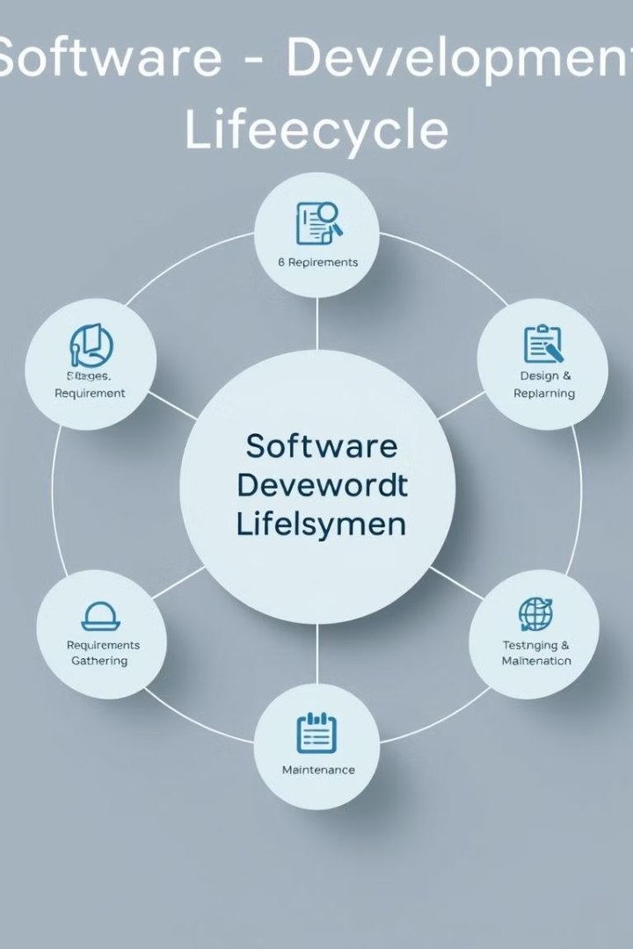
General Controls (Continued)
General controls encompass a wide range of measures, including those related to systems development and documentation, hardware and system software, and business continuity.
1
Systems Development and Documentation Controls
2
Business Continuity Controls
Systems development and documentation controls ensure the proper review, testing, and approval of new and modified systems. They also control program and parameter changes, document procedures, and manage hardware and system software.
Business continuity controls ensure that an operational and tested IT continuity plan is in place, aligned with the overall business continuity plan and related business requirements. This ensures IT services are available as required and minimizes business impact in the event of a major disruption.

Slide 9
Application Controls
Application controls are designed to ensure the completeness, accuracy, validity, and confidentiality of transactions and data during application processing. They provide a layer of security and integrity specific to individual applications and business processes.
1
Application Level General Controls
2
Business Process Controls
Application level general controls are dependent on general controls operating at the entity-wide and system levels. They help entity management assure the confidentiality, integrity, and availability of information assets, and provide reasonable assurance that application resources and data are protected against unauthorized modification, disclosure, loss, and impairment.
Business process controls are automated or manual controls applied to business transaction flows, ensuring the completeness, accuracy, validity, and confidentiality of transactions and data during application processing. They typically cover the structure, policies, and procedures that operate at a detailed business process (cycle or transaction) level and operate over individual transactions or activities across business processes.
3
Interface Controls
4
Data Management System Controls
Interface controls ensure the timely, accurate, and complete processing of information between applications and other feeder and receiving systems on an ongoing basis, and complete and accurate migration of clean data during conversion.
Data management systems use specialized software that may operate on specialized hardware. They include database management systems, specialized data transport/communications software, cryptography used in conjunction with data integrity controls, data warehouse software, and data reporting/data extraction software.

Slide 10
Auditing Application Controls
Auditing application controls involves assessing the effectiveness of controls in each of the four control categories to the extent they are significant to the audit objectives. The auditor's assessment has two main aspects: testing the effectiveness of controls and evaluating the results of testing.
Understand Information Systems
The auditor should understand information systems relevant to the audit objectives, building on identification of key areas of audit interest and critical control points.
Determine Relevant IS Control Techniques
For each relevant IS control technique, determine whether it is suitably designed to achieve the critical activity and has been implemented — placed in operation (if not done earlier).
Perform Tests
Perform tests to determine whether such control techniques are operating effectively.
Identify Potential Weaknesses
Identify potential weaknesses in IS controls (weaknesses in design or operating effectiveness).
Consider Compensating Controls
For each potential weakness, consider the impact of compensating controls or other factors that mitigate or reduce the risks related to the potential weakness.

