Slide 1
MAKERERE UNIVERSITY MAKERERE UNIVERSITY BUSINESS SCHOOL FACULTY OF COMPUTING AND INFORMATICS DEPARTMENT OF APPLIED COMPUTING AND IT
SEMESTER: ONE, ACADEMIC YEAR:
INFORMATION COMMUNICATION TECHNOLOGY I *PR

Slide 2
Computer Hardware
Learning Objectives & Outcome
Define a Computer
Characteristics of Computers
Classification/Types of Computers
Qualities/Features of Computers
Basic Computer System Concepts
Computer Specifications
Computer Acquisition
Computer Evaluation factors

Slide 3
Computer defined
A computer is an electronic device operating under the control instruction stored in its own memory unit accepts and stores data, performs arithmetic and logical operations on that data (without human interventions) and produces output.
Its hardware components include input & output devices, CPU, communication, and primary and secondary storage devices.

Slide 4
Characteristics of Computers
It comprises of electronic elements like transistors, resistors, disorders etc.
Has an internal storage or memory for storing both the instruction and data being processed.
Uses programs or set of instruction with specific procedure of operation to be followed.
The programs uses can be modified when need arises. This is distinguishing the feature of a computer.
Computers exist in varying sizes, speed of processing, memory capacity, use and cost.

Slide 5
Classification/Types of Computers
Super computer systems
Mainframe computer systems
Mini or Midrange computer systems
Micro computer systems

Slide 6
Other Classifications
Size: Mainframe; Mini & Micro
Process: Analogue; hybrid & digital
Purpose: Special & General

Slide 7
Super Computers
The largest, fastest, most powerful and most expensive computer systems.
Designed specifically for high-speed numeric computation needed in very complex applications such as weather forecasting, engineering and other business applications requiring quick processing of lots of data.
They are extremely fast computers that can perform hundreds of MIPS.

Slide 8
Mainframe Computers
These are large, powerful computers, often filling an entire room, with very large primary storage capacities, normally from 64 megabytes to several gigabytes of RAM.
This feature helps mainframes process information very quickly at 10 to 200 MIPS. The computers are larger and more powerful than most midsize computers.
They are faster, with more memory capacity and usually support more network users and peripheral devices.
Mainframe computers can also be categorized into enterprise systems, superservers, transaction processors, and also supercomputers and so forth.

Slide 9
Midrange Computer Systems
They are categorized into network servers, minicomputers, Web servers, multiuser systems etc.
They are general-purpose computers that are larger & more powerful than most microcomputers but are smaller & less powerful than the mainframe.
The use of minicomputers grew rapidly because of their relatively low cost, ease of operation and support, and the ready availability of software to solve business problems. Thus managers had to make significant shift from the large, central mainframe to end users.

Slide 10
Micro Computers
These are the smallest computer systems, ranging in size from handheld personal digital assistants (PDAs) or even ‘‘computer on a chip’’ to laptops, personal computers (PCs) and workstations.
Most microcomputers are designed for single-user application but can be linked via telecommunications to network servers.
They are most favorable for business people, civil servants and other professional consumers, all known as knowledge workers.

Slide 11
Categories of Microcomputers
Handheld PC & information appliances.
Notebook computers.
Desktop Computers.
Workstation Computers.
Network Servers.
Note: Classifications can also be by process, size and purpose.

Slide 12
Basic Computer System Concepts
A computer is a system of hardware devices organized according to the following system functions:
Input devices / technologies
Processor
Main memory and secondary storage
Output devices / technologies
Communication devices

Slide 13
Computer System: Input
An input device is used to enter data and instructions into the CPU.
Some of the input devices of a computer system include keyboards, microphone, bar code reader, touch screens, pens, electronic "mice," optical scanners, and other peripheral hardware components that convert data into electronic machine-readable form.

Slide 14
Output Technologies
These are devices used to send data out of the system in a variety of forms. Video displays and printed documents have been, and still are, the most common forms of output from computer systems.
Output devices include video display units, speakers, printers, audio response units, and other peripheral hardware components specialized in this function.

Slide 15
Communication Devices
The computer system also uses communication devices such as the MODEM.
However, most computers today have network cards in-built.

Slide 16
Main Memory
The memory is the physical internal medium that holds data. Main memory is as vital as the processor chip to a computer system because it stores data and program instructions temporarily during execution.
The two basic types are RAM and ROM.
RAM in microcomputers is “volatile” which means that the contents of the memory are erased when the computer’s power is switched off.
ROM is “non-volatile” memory, which means that it’s contents, do not disappear when the computer’s power source is switched off.

Slide 17
Secondary Memory
Secondary memory is where programs and data are kept on a long-term or permanent basis therefore cost effective. Common secondary storage devices are the hard disk, memory sticks and floppy disks.
Some of the characteristics of secondary memory include; the hard disk has enormous storage capacity compared to main memory.

Slide 18
The Central Processing Unit
The CPU also referred to as the processor or microprocessor is the brain of any computer, and therefore, the most important part of the computer system. It carries out all the processing in the computer.
The CPU itself consists of three main subsystems, namely; a sophisticated CU, large number of registers, and a sophisticated ALU.

Slide 19
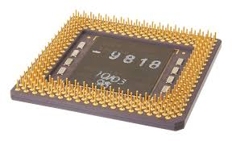
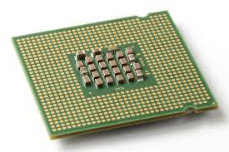
Processors

Slide 20
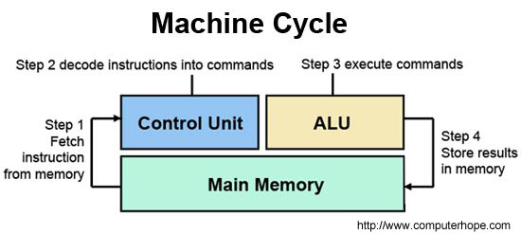
Computer Components

Slide 21
Arithmetic Logic Unit (ALU)
The ALU performs the arithmetic and logic functions required in computer processing. The ALU contains the circuitry that performs data manipulation.
This unit performs all mathematical and logical functions. Mathematical functions include multiplication, division, subtraction, addition and advanced mathematics such as logarithms, trigonometry & other specialized operations.

Slide 22
Control Unit
The CU interprets computer program instructions and transmits directions to the other components of the computer system.
The CU can be thought of as the ‘‘brain’’ of the CPU itself.
The CU performs the tasks of fetching from memory the next instruction to be executed, decoding it by determining what is to be done, managing stored program execution and then storing results.

Slide 23
Register & Cache Memory
The CPU also contains circuitry for devices such as registers and cache memory, used for high speed temporary storage of data and instructions.
The registers are special purpose temporary storage locations. They hold data needed quickly or frequently prior to execution and stores information about status of CPU and currently executing program.

Slide 24
Cache Memory
Cache Memory on the other hand is used to reduce the time or energy required to access data from the main memory. The cache is a smaller, faster memory and stores copies of the data from frequently used main memory locations. Most CPUs have different independent caches, including instruction and data caches, usually organized in cache levels (L1, L2, etc.).

Slide 25
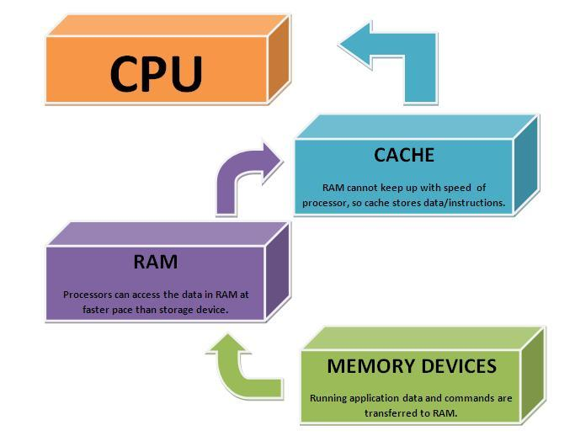
How they work

Slide 26
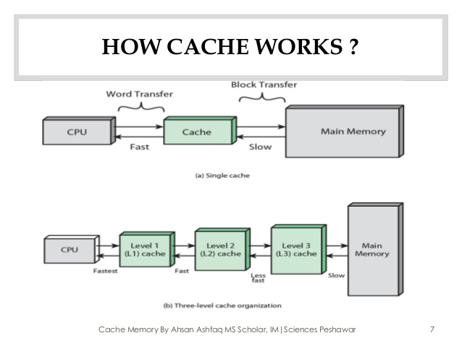
How Cache Works

Slide 27
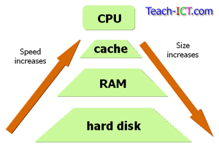
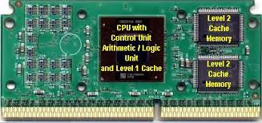
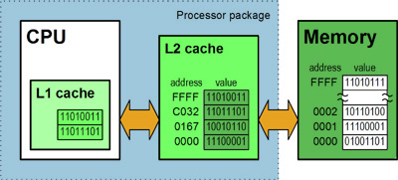
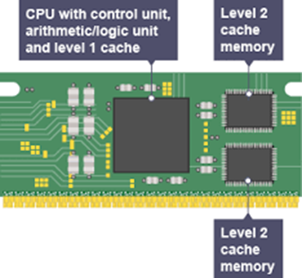
Visit link below to see CPU simulation video.

Slide 28
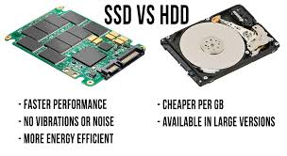
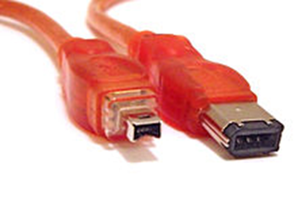
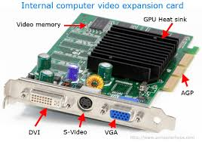
Computer Specifications
Processor.
Hard drive disk (HDD/SSD/SSHD).
Universal serial bus (USB).
FireWire. (an interface standard for a serial bus for high-speed communications and isochronous real-time data transfer.)
Video/Graphic cards.
DVD/CD drives
("digital versatile disc" or "digital video disc").
Monitor size and shape.
computer specifications comparison

Slide 29
Cont’ Computer Specifications
Warranties.
Backup systems.
Printers.

Slide 30
Computer Acquisition
This refers to the way or method ICT products and services can be acquired for use by individuals or organizations.
There are several ways for example through:
Outright purchase
Leasing (residual value paid at the end)
Renting computer facilities (No residual)
Using an Application Service Provider (ASP)

Slide 31
Computer Acquisition | Advantages | Disadvantages
Buying | Cheaper than leasing or renting over the long run Ability to change system Provides tax advantages of accelerated depreciation Full control | Initial cost is highRisk of obsolescence Risk of being stuck if choice was wrong Full responsibility
Leasing | No capital is tied up No financing is required Leases are lower than rental payments | Company doesn’t own the system when lease expires Usually a heavy penalty for terminating the lease Leases are more expensive than buying
Renting | No capital is tied up No financing is required Easy to change systems Maintenance and insurance are usually included | Company doesn’t own the computer Cost is very high because vendor assumes the risk (most expensive option)

Slide 32
Computer Acquisition
Students are advised to read and prepare own notes in Computer Acquisition as a topic.

Slide 33
Computer Hardware Evaluation Factors
Your budget
Laptop or Desktop?
The Processor
RAM (Computer Memory)
Hard Drive
Graphics
Computer Software
Anti-Virus Software
Your Computer Lifeline, Internet

Slide 34
Business Benefits of Computer Hardware
Reduce costs by automating routine tasks, such as record-keeping, accounting and payroll
Improve customer service or supplier relationships
Develop more effective communication within the business or with customers
Increase business efficiency and staff productivity
Increase employee morale
Expand your business offer or reach new markets - eg through an online shop
Develop competitive advantage by implementing the right business technology

Slide 35
References
For detailed materials, students are advised to read: ICT in Business Text 2012 Edition By Sonny Nyeko & Musa Moya and Revision Kit
THANK YOU

