Slide 1
Business Intelligence and Data Warehousing
TOPIC 3
EXTRACT, TRANSFORM, LOAD (ETL)
BUC 2225

Slide 2
Topic Outline
Detailed exploration of Extract, Transform, Load (ETL) processes
Hands-on practice with ETL tools such as Talend
Strategies for data extraction and transformation
Loading data into a data warehouse efficiently

Slide 3
ETL
ETL,
Stands for Extract, Transform, Load,
Is a crucial process in data management and analytics.
Involves extracting data from various sources, transforming it into a suitable format, and loading it into a target database, data warehouse, or data mart for analysis, reporting, or other purposes.
ETL processes are fundamental in enabling organizations to derive insights from their data efficiently.

Slide 4
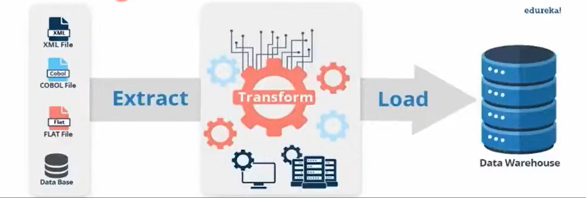
ETL

Slide 5
Data Warehouse Architecture
Notes:
Data marts are subsets of a data warehouse that focus on specific business functions or departments within an organization. They are smaller, more focused repositories of data that are designed to serve the needs of particular user groups or departments. Data marts are typically created to provide faster access to relevant data for decision-making and analysis within a specific area of the business.

Slide 6
ETL
Notes:
OLTP (Online Transaction Processing) systems are designed for real-time transactional processing, handling a large number of short, simple transactions with a focus on data integrity and efficient processing for day-to-day operations. In contrast, OLAP (Online Analytical Processing) systems are optimized for complex analytical queries performed on large volumes of historical data. They facilitate multidimensional analysis and reporting for decision-making purposes.

Slide 7
Extract:
In the extraction phase,
Data is gathered from different sources such as databases, flat files, APIs, web services, or other systems.
The data could be structured (e.g., relational databases), semi-structured (e.g., JSON, XML), or unstructured (e.g., text documents, images).
Extraction methods can vary depending on the data sources and formats, and they may involve querying databases, reading files, or accessing APIs.

Slide 8
Transform:
Data is transformed to meet specific requirements such as cleaning, filtering, aggregating, or joining datasets.
Transformation tasks can include:
Data validation, normalization, deduplication, standardization of formats, and calculations.
Transformation logic is applied to ensure that the data is accurate, consistent, and ready for analysis.
This step is crucial for ensuring data quality and making it suitable for downstream processes.

Slide 9
Load:
Data is finally loaded into a target system such as a data warehouse, data mart, or operational database.
Loading involves
Inserting new records,
Updating existing ones, or
Appending data to existing datasets.
The target system is optimized for querying and analysis
Data should be organized in a way that facilitates efficient retrieval and processing.

Slide 10
ETL Tools
Numerous ETL tools are available to facilitate the ETL process.
These tools provide graphical interfaces and pre-built connectors to simplify data extraction, transformation, and loading tasks. Some popular ETL tools include:
Informatica PowerCenter:
A widely used ETL tool known for its scalability, flexibility, and comprehensive feature set.
It supports various data integration and transformation capabilities and provides a user-friendly interface for designing and executing ETL workflows.
Talend Open Studio:
Offers an open-source ETL tool that provides a wide range of connectors, components, and pre-built templates for ETL tasks.
It supports both on-premises and cloud-based data integration and offers a graphical interface for designing ETL jobs.

Slide 11
ETL Tools
Microsoft SQL Server Integration Services (SSIS):
SSIS is a component of the Microsoft SQL Server database platform that provides ETL capabilities.
It includes a visual development environment for building data integration workflows and supports connectivity to a variety of data sources and destinations.
Apache Spark:
Apache Spark is a distributed computing framework that includes libraries for ETL, machine learning, and data analysis.
Spark's DataFrame API and SQL capabilities enable users to perform ETL tasks on large-scale datasets in a distributed environment.

Slide 12
Importance of ETL
Data Integration:
ETL enables organizations to integrate data from disparate sources such as databases, applications, files, and web services into a unified format.
This integrated view of data provides a comprehensive understanding of business operations and customer behavior.
Data Quality:
ETL processes often include data cleansing, validation, and standardization techniques to ensure data quality and consistency.
By identifying and rectifying errors, duplications, and inconsistencies, organizations can rely on accurate and reliable data for decision-making purposes.

Slide 13
Importance of ETL
Data Transformation:
ETL facilitates data transformation by applying business rules, calculations, and mappings to raw data, making it suitable for analysis and reporting.
Transformation processes may involve aggregating, filtering, joining, and enriching datasets to derive meaningful insights and actionable intelligence.
Scalability and Performance:
ETL tools and techniques are designed to handle large volumes of data efficiently.
By optimizing data extraction, transformation, and loading processes, organizations can achieve scalability and performance improvements, ensuring timely access to critical information.

Slide 14
Importance of ETL
Decision Support and Business Intelligence:
ETL plays a crucial role in supporting decision-making and business intelligence initiatives.
Data from multiple sources is consolidated and transformed it into actionable insights such as market trends, customer behavior, and operational performance.
Regulatory Compliance:
ETL processes help ensure compliance with data privacy, security, and governance requirements in regulated industries such as finance, healthcare, and government.
Organizations can establish data lineage, audit trails, and access controls, maintain data integrity and meet regulatory obligations.

Slide 15
Challenges in ETL Processes:
Data Quality Issues:
Poor data quality can significantly impact the effectiveness of ETL processes.
Challenges include missing values, inaccuracies, inconsistencies, and duplications.
Ensuring data quality requires comprehensive data profiling, cleansing, and validation techniques to identify and rectify errors.

Slide 16
Challenges in ETL Processes:
Scalability:
As data volumes grow, ETL processes may struggle to handle the increased workload efficiently.
Scalability challenges include resource constraints, processing bottlenecks, and performance degradation.
Implementing scalable architectures, parallel processing techniques, and distributed computing frameworks can help address scalability issues.

Slide 17
Challenges in ETL Processes:
Performance:
Slow ETL performance can lead to delays in data processing and reporting, affecting business agility and decision-making.
Performance challenges may arise due to inefficient data processing algorithms, suboptimal hardware configurations, or inefficient data transfer mechanisms.
Optimizing query performance, indexing, data partitioning, and caching can improve ETL performance significantly.

Slide 18
Challenges in ETL Processes:
Data Security:
Protecting sensitive data from unauthorized access, breaches, and cyber threats is a critical concern in ETL processes.
Challenges include data encryption, access control, data masking, and compliance with regulatory requirements such as GDPR and PCI DSS.
Implementing robust data security measures, encryption protocols, and access controls can mitigate data security risks.

Slide 19
Challenges in ETL Processes:
Complexity and Maintenance:
ETL workflows can become complex and difficult to manage over time, especially in large-scale environments with diverse data sources and business requirements.
Challenges include maintaining data lineage, version control, and documentation, as well as managing dependencies and interdependencies between ETL jobs.
Adopting modular design principles, reusable components, and automation tools can simplify ETL development and maintenance.

Slide 20
Best Practices for Designing Efficient and Reliable ETL Workflows:
Define Clear Requirements:
Clearly define business requirements, data sources, transformation rules, and target system specifications before designing ETL workflows.
Understanding stakeholders' needs and expectations is essential for building effective ETL solutions.
Data Profiling and Analysis:
Perform thorough data profiling and analysis to understand the structure, quality, and relationships within the data.
Identify data anomalies, patterns, and outliers that may impact ETL processes and data quality.

Slide 21
Best Practices for Designing Efficient and Reliable ETL Workflows:
Incremental Loading:
Implement incremental loading techniques to process only the changed or new data since the last ETL run.
Incremental loading reduces processing time and resource utilization, especially in scenarios with large datasets and frequent updates.
Parallel Processing:
Utilize parallel processing techniques to distribute data processing tasks across multiple threads or nodes, improving scalability and performance.
Parallel processing means dividing ETL task int smaller chunks and working on them simultaneously for example load data from multiple files simultaneously.
Parallelizing data transformation and loading operations can leverage the computing resources effectively and reduce processing latency.

Slide 22
Best Practices for Designing Efficient and Reliable ETL Workflows:
Error Handling and Logging:
Implement robust error handling mechanisms to capture, log, and handle errors encountered during ETL execution.
Use logging and monitoring tools to track job status, record processing metrics, and diagnose issues proactively.
Data Partitioning and Indexing:
Partition large datasets and create appropriate indexes to optimize data retrieval and processing performance.
Partitioning data based on key criteria such as date ranges, regions, or categories can improve query performance and reduce processing overhead.

Slide 23
Best Practices for Designing Efficient and Reliable ETL Workflows:
Testing and Validation:
Conduct comprehensive testing and validation of ETL workflows to ensure accuracy, completeness, and reliability of data transformations and loading processes.
Use test datasets, mock environments, and automated testing frameworks to validate ETL logic and business rules.
Documentation and Governance:
Maintain detailed documentation of ETL workflows, data mappings, dependencies, and configurations to facilitate knowledge transfer and troubleshooting.
Establish governance policies and standards for ETL development, deployment, and maintenance to ensure consistency and compliance with organizational guidelines.

Slide 24
Extract, Transform, Load
Practical Session

Slide 25
ETL Practical Session
Create a folder on the desktop in your names and reg. number.
Open PowerBI and save the new file inside your folder.
Extract and load data from various sources provided (Sample Store Data, Northwind Access Database).
Open Power Query Editor to make the following transformations on the extracted data.
Rename users table to managers.
Rename columns from column 1 and column 2 to region and manager.
Add last name to the managers details by duplicating the manager column. Rename this column to last Name.
Replace values in the last name column.
In the orders dataset, remove columns: row id, product base margin, order priority and quantity ordered new.
Only data for the following states should be retained: Arizona, California, Florida, New Jersey and New York.
Rename column State or Province to State. Sort the data therein in ascending order.

Slide 26
ETL Practical Session
Merge information from the managers table into orders table. They both have a common field (region field).
Filter out data of the central region from the data set and after sort the new dataset basing on the manager.region.
Rename the new merge query as Order by region.
Assignment.
-----
Merge the orders and returns tables into a new query. All data in the orders table must be returned. Show the returned data.
Ensure the merged data is visible. Filter out all the null values.
Rename the new merge query as Returned Orders.
Ensure the data in the discount column is in percentage and in no decimal places.
Make the unit price in dollar currency.
Remove days of the week from the Order date data.
Categorize the following data sets accordingly: state, city, postal code.

Slide 27
Thank you.

