Slide 1
Small Business in International Markets:
Overcoming Barriers and Finding Opportunities

Slide 2
Learning Objectives
Understand how small businesses can begin as global start-ups
Explain how Small businesses can follow the stages of internationalization
Understand how small businesses can overcome barriers to internationalization

Slide 3
Internationalization and the Small Business
Two models
- Small business stage model: process of following incremental stages of internationalization
- Global start-up or Born-global firm: company that begins as a multinational company

Slide 4
Six Stages of internationalization
No | STAGE | DETAILS
1 | Passive exporting | Company fills international orders but does not seek export business
2 | Export management | Specifically seeking exports—usually rely on indirect exporting
3 | Export department | Significant resources dedicated to seek increased sales from exports
4 | Sales branches | High demand justifies setting up local sales office
5 | Production abroad | Use licensing, joint ventures or Foreign direct investment
6 | The transnational | Develop global integrated network

Slide 5
Small Business Global Start-up or Born-Global Firms
Key elements favoring global start-ups
- Dispersed human resources
- International sources of venture capital
- The existence of a global demand
- The lack of a geographically protected market
- The necessity of worldwide sales to support the venture
- The potential to avoid later resistance to internationalization

Slide 6
Small Business E-Commerce
Web sites offer a rapid way to go international
Web site configured for e-commerce is low cost
Quick way to sell across national borders

Slide 7
Advantages of Small-Business E-Commerce
Ability of small firms to compete with other companies
Creates the possibility and opportunity for more diverse people to start a business
Convenient and easy way of doing business
Low cost to compete
Makes domestic products available in other countries
Utilize the Internet have higher revenues

Slide 8
Challenges of Small-Business E-Commerce
Managing upgrades
Language barriers
Shipping and returns
Assuring security for a Web site
Fraudulent activities online
Receiving international payments
Costs required to maintain the site
Finding and retraining qualified employees

Slide 9
Overcoming Small-Business Barriers to Internationalization
Liabilities of newness: a large percentage of new businesses fail within a year
Liabilities of size: lack of scale to produce goods or services as efficiently as larger companies
Managers’ limited international experience
Managers’ negative attitudes
Belief that venture too risky and not profitable
Competition seen as domestic
Ignoring of international opportunities

Slide 10
Developing a Small-Business Global Culture
Global culture: managerial and worker values that view strategic opportunities as global and not just domestic
Characteristics of decision makers affecting development of a global culture
Perceived psychic distance to foreign markets
International experience
Risk aversion
Overall attitudes toward international strategies
Framework to understand international operations
Changing attitudes of key decision makers
Being close in culture and geography
Overcome skepticism regarding the international markets
Positive attitudes more necessary for global start-ups

Slide 11
Size and Small Business Internationalization
Size barrier to internationalization
- Larger firms have more resources to support international operations
Size is an issue only in the internationalization decision, however.
Eventually, international sales intensity of small firms exceed that of big firms.
- International sales intensity: amount of international sales divided by total sales of the company

Slide 12
Small Business Advantage
Speed becomes the small business advantage
- Faster innovation
- Can change products and internal operations faster
- Speed can overcome size disadvantages
- Larger firms must often overcome bureaucratic procedures

Slide 13
The Future: Falling Barriers for Small Businesses
Barriers are becoming easier to overcome
Government support programs for small businesses are increasing
Trade agreements are making trade easier
Increase in small businesses engaged in international operations also makes it easier

Slide 14
When Should a Small Business Go International?
If the following questions are answered positively, small business is ready.
- Do we have a global product or service?
- Do we have the managerial, organizational, and financial resources to internationalize?
- Is there willingness to commit resources to face the risks of internationalization?
Is there a country in which the company feels comfortable doing business?
Is there a profitable market for product or service?
Which country should be entered?
Do we have a unique product/service that is not easily copied by multinationals or local entrepreneurs?
Do location advantages exist upstream in the value chain?
Can we afford not to be a multinational?

Slide 15
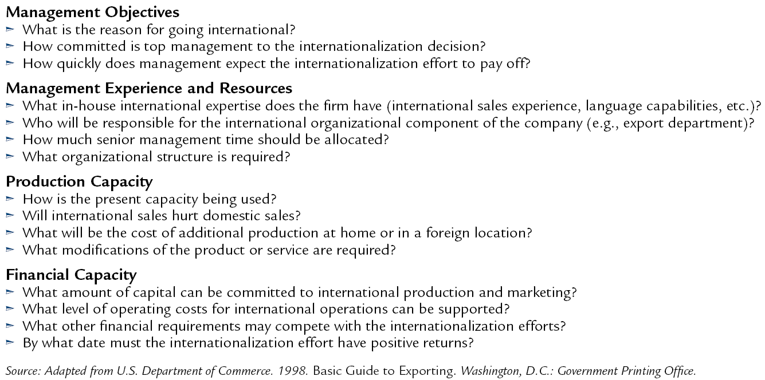
Questions to Consider in the Small Business Decision to Go International

Slide 16
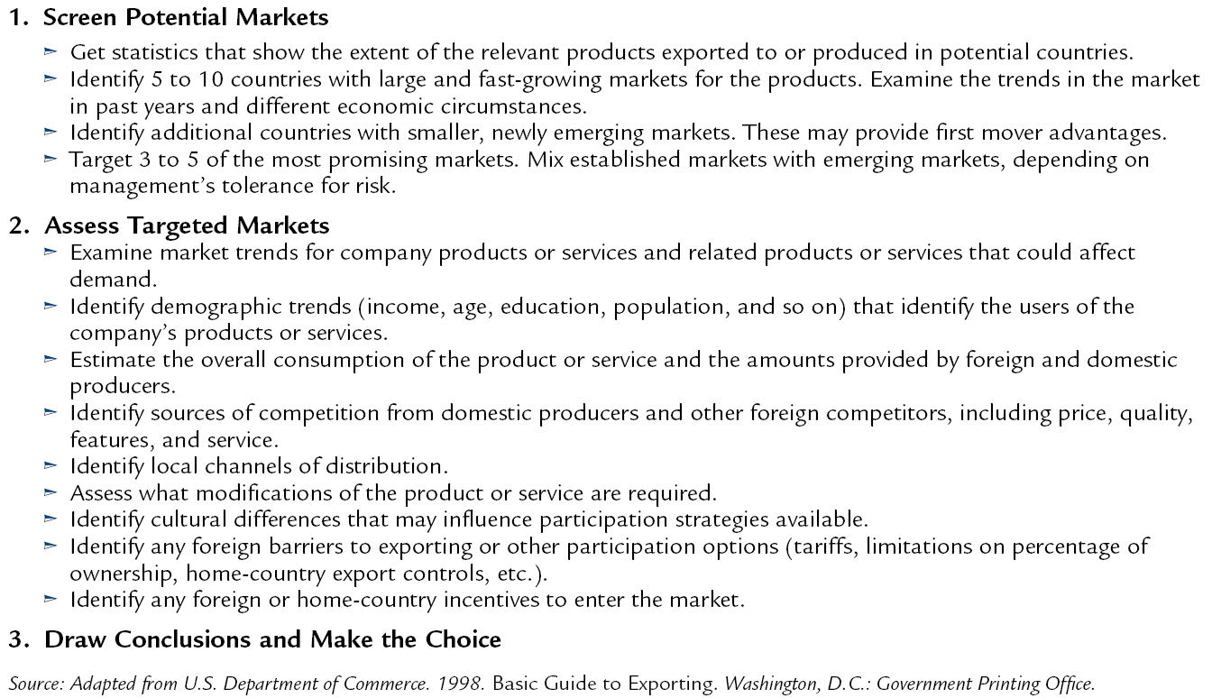
Steps in Picking a Foreign Market

Slide 17
Getting Connected to International Markets
Participation strategies
- Same participation options as larger firms
- Exporting, licensing, joint ventures, and foreign direct investment
Most small businesses often emphasize exporting
Finding Customers and Partners: Customer Contact Techniques
Trade shows
Catalog expositions
International advertising agencies and consulting firms
Government-sponsored trade missions
Direct contact

Slide 18
Ready to Go and Connected: A Synopsis
Finding the right overseas partner: the most important step
Find a good wedge to break into a new market
Entry wedge: company’s competitive advantages for breaking into the established pattern of commercial activity

Slide 19
New Product or Service and First-Mover Advantage
Being the first to introduce a product or service
- Must be innovative
- Must be comprehensive
Must meet customer expectations in areas such as warranty and expected components
Technological leadership—most common source
- Being first to use or introduce a new technology
Have firsts access to natural and social resources
- Can choose the best locations
Can have the best access to social relationships
- Lead to the personal contacts to build effective channels of distribution
Lead to trust and commitment from business partners and customers
Switching costs: occur when customers face some loss in turning to a competitor’s products
- because of brand loyalty, many customers may not want to face the discomfort of switching to another brand of a product or service

Slide 20
Copycat Business
Copycat Business
- The “me too” strategy
- Adopt existing products or services
- Find a niche or slight innovation to attract customers

Slide 21
Successful Copycat Moves
Be the first to a new standard
Go after the toughest customers
Play to different customer needs
Transfer the location
Become a dedicated supplier or distributor
Seek abandoned or ignored markets
Acquire existing business

Slide 22
Conclusion
Small businesses are important aspects of economies of all nations
Small businesses provide jobs, economic growth and innovation
Chapter provides crucial background information on small businesses
Chapter also discusses international entrepreneurship

