Slide 1
ACQUISITIONS
BY JULIET JOY APIO

Slide 2
Definitions
One firm is acquired by another. Acquiring firm retains name and acquired firm ceases to exist
An acquisition is defined as a corporate transaction where one company purchases a portion or all of another company’s shares or assets.
One company consumes another, and the identity of the acquiring firm continues while the that of the acquired company ceases to exist.

Slide 3
Examples of Acquisitions
DFCU acquired Crane Bank in 2017
Stanbic Bank acquired Uganda Commercial Bank in 2001
Airtel acquired Warid Telecom in 2013
PepsiCo acquired Crown Beverages in 2019

Slide 4
Classifications of Acquisitions
Horizontal – both firms are in the same industry
Vertical – firms are in different stages of the production process
Conglomerate – firms are unrelated

Slide 5
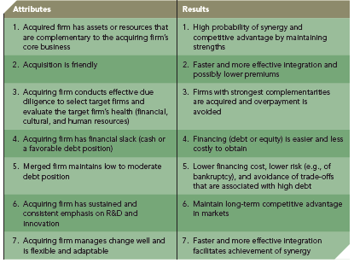

Slide 6
Advantages of Acquistions
Reduced entry barriers
Increased market share
New competences and resources
Access to experts
Access to capital
Reshapes a firms competitive scope
Technological capabilities
Knowledge base
Access to new geographies

Slide 7
Disadvantages of acquisitions
Cultural clashes
Duplication of activities
Conflicting objectives
Brand damage
Employee morale
Legal costs

Slide 8
THINK – REMEMBER!
Assignment
With examples,distinguish between mergers and acquisitions
Do this activity in your groups

