Slide 1
INTRODUCTION TO PASSENGER TRANSPORTATION

Slide 2
Definition of passenger transport
Passenger transport, or travel is concerned with human mobility.

Slide 3
PASSENGER TRANSPORT STRUCTURE AND CHARACTERISTICS

Slide 4
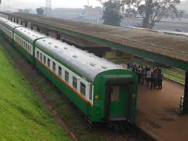
Rail passenger transport
Involves the movement of people by train.

Slide 5
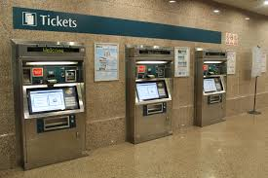
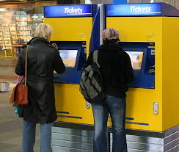
Characteristics of rail transport
High carrying capacity
Cost effective
Safety
Speed and time(they are fast)
Reliable e.g trains arriving and departing within the scheduled time frames
Offer self service when obtaining a travel ticket

Slide 6
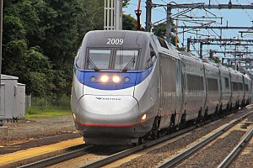
Passenger rail way structure
Intercity rail services:- express passenger train services covering much longer distances than commuter or regional trains e.g moving from Sydney to Brisbane or Melbone or from Kampala to Jinja, Masaka, Arua, Mbarara e.t.c.

Slide 7
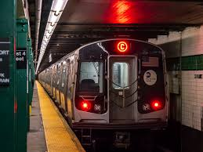
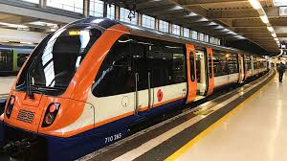
Passenger rail way structure discussion continued
Commuter Rail-Services designed for short-distance travel, often connecting suburban areas to urban centers. Examples include the New York City Subway and the London Overground.

Slide 8
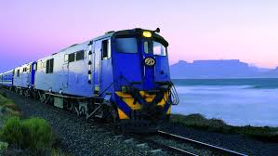
Tourist Railways- Operate in scenic areas or tourist destinations, offering leisurely travel experiences. Examples include the Flam Railway in Norway and the Blue Train in South Africa.

Slide 9
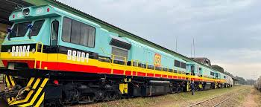
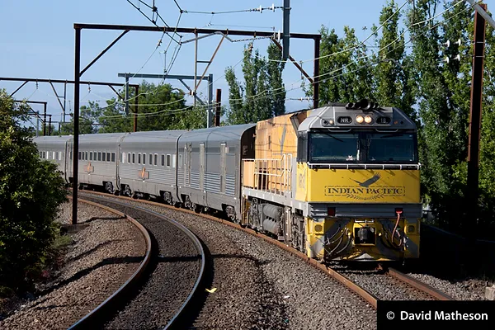
Interstate passenger/Cross-Border Railways-Connect different countries, facilitating international trade and travel.

Slide 10
AIR PASSENGER TRANSPORT
Passenger airline means an airline dedicated to the transport of passengers.
Passenger airline means a person or corporation engaged primarily in the carriage by aircraft of passengers in interstate commerce;
Passenger means any person, except members of the crew, carried or to be carried in an aircraft with the consent of the carrier.

Slide 11
Air passenger transport structure
Domestic passenger flights:- is a form of commercial flight within civil aviation where the departure and the arrival take place in the same country.
International passenger flights:- is a form of commercial flight within civil aviation where the departure and the arrival take place in different countries.

Slide 12
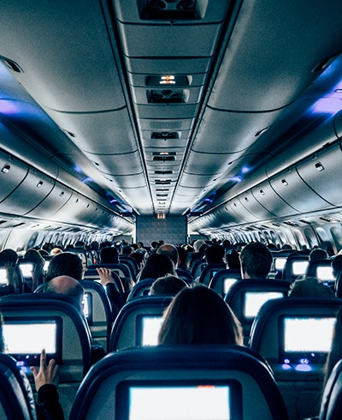
Air passenger transport structure discussion continued
Commercial flights:-A commercial flight is a flight that is operated by an airline and is open to the general public, with passengers able to purchase tickets in advance.
These flights follow a regular schedule and a set route, and are usually operated using larger commercial airliners. Commercial flights are designed for mass transportation and can carry hundreds of passengers.

Slide 13
Charter flights:- A charter flight is a type of private flight in which an entire aircraft is rented for a specific group of passengers, rather than purchasing individual tickets on a scheduled flight. Unlike commercial flights, which operate on fixed schedules and predetermined routes, charter flights offer greater flexibility, allowing passengers to choose the times and destinations that best suit their needs.

Slide 14
Private Jet Charter :-This involves renting an entire aircraft instead of just a seat on a commercial plane.
Public Charter :-Usually operated by tour operators who rent aircraft and are offered on a seasonal basis to popular destinations.

Slide 15
Characteristics of passenger air transport
Speed: Air travel is renowned for its remarkable speed. Airplanes can cover long distances in a fraction of the time it takes other modes of transportation. This characteristic makes air travel particularly appealing for time-sensitive journeys, such as business trips or emergencies
Accessibility: With thousands of airports worldwide, air transportation provides accessibility to even the most remote locations. It allows individuals to reach destinations that would otherwise be difficult or impossible to access by other means of transportation, such as remote islands or mountainous regions.

Slide 16
Safety: Despite occasional high-profile incidents e.g plain crashes, air transportation is considered one of the safest modes of travel. Stringent safety regulations, robust maintenance procedures, and continuous advancements in aircraft design and technology contribute to the high safety standards of the aviation industry.
Capacity: Airplanes have the ability to transport a large number of passengers. This capacity makes air transportation an efficient mode for transporting large groups of people over long distances, contributing to the global economy and facilitating tourism.

Slide 17
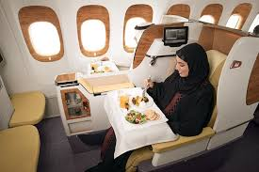
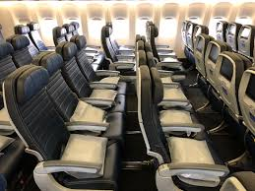
Connectivity: Air transportation facilitates connectivity by providing extensive flight networks and connecting routes. Passengers can easily transfer from one flight to another, reaching their final destinations even if they require multiple connections. This characteristic enhances travel options and improves overall connectivity.
Prestige and Comfort: Air travel is often associated with a sense of prestige and luxury. Airlines strive to provide comfortable cabins, in-flight entertainment, and quality services to enhance the passenger experience. The characteristics appeal to those seeking a more comfortable and enjoyable mode of travel.

Slide 18
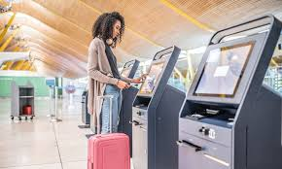
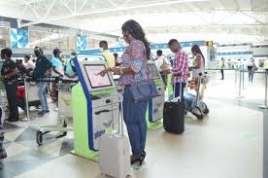
Self check in using airport kioks.
An airport self-check-in kiosk is a stand-alone machine that allows passengers to perform the processes that they would normally perform at a TSA(ticketing service area) check-in counter. These processes include bag check, boarding pass printing, capturing a traveler's face or fingerprint, and verifying the traveler's ID. Self-check kiosks at airports are typically located near the entrance to an airline's ticketing area, near where passengers drop off their bags. It is the frontline device of a border control management system that ensures a smooth immigration pre-check process.

Slide 19
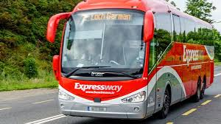
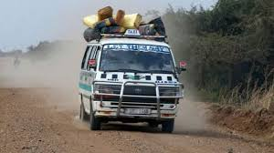
Road passenger transport
Passenger transport refers to the total movement of passengers using road(passenger cars, taxi, buses or coaches)

Slide 20
Road passenger transport structure

Slide 21
Characteristics of passenger road transport
Less Capital Outlay: Road transport requires much less capital Investment
Door to Door Service e.g school buses
Service in Rural Areas
Flexible Service e.g services are provided at different times in a day
Suitable for Short Distance

Slide 22
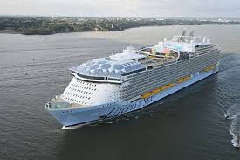
Water passenger transport
Water Transportation is the process of moving people by boat, ship or sailboat over the sea, ocean, lake, river.

Slide 23
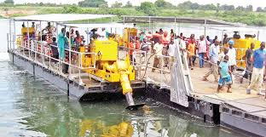
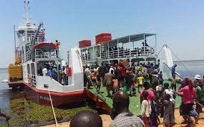
Water passenger transport structure
Inland passenger water transport: involves transportation of passengers via rivers, canals, lakes and other inland waterways, including inside harbours and ports.
In Uganda, Passengers ferries used are operated by UNRA and are a common means of water transport used to connect to various inland destinations. They're used on Lake Victoria, River Nile, Lake Kyoga, Lake Edward, Lake Albert and River Sezibwa.

Slide 24
Overseas/Ocean passenger transport:- Involves movement of passengers across seas or oceans using passenger ships.
Chartering passenger services:-involves shipping services where a shipowner hires out the use of their vessel to a charterer. The contract between the parties is called a charterparty (from the French "charte partie", or "parted document").

Slide 25
Passenger water transport characteristics
Carries a bigger number of passengers
Low cost transport services(Cost effective)
Global Reach: Water transportation provides a global reach, connecting continents and enabling international trade.
Provides access to hard to reach areas such as Island districts.
There is lesser pollution in water transport.

Slide 26
Initial investment on river services as well as expenditure on their maintenance is much lesser as compared to road and rail transport.

Slide 27
THE END

