Slide 1
Managing Innovation & The Innovation Process

Slide 2
Routinizing the innovation process?
Can we really manage innovation?
Tidds et al. (2005) - the role of the management in the process is to implement and routinize the process.
The routines or other established knowledge can come from internal or external sources
Innovation management is a learned capability!

Slide 3
Innovation as a Knowledge-based Process
In the Innovation Process knowledge is used to:
Discover and see innovative opportunities
Exploit new ideas with established knowledge and routines
However, the innovation process is also a knowledge creation process.
A big challenge is to connect and combine the new with the old (important role for the management!)

Slide 4
Innovation Process
Is a trial & Error process
Design an experiment
Predict outcomes based on hypothesis
Measure Outcomes
Compare Outcomes to predictions
Learn from the conclusions
In business, ideal conditions do not exist.
Results are ambiguous, experiments are expensive & influenced by external elements, Makes learning from strategic experiments difficult
There always setbacks and failures in innovation processes: use the knowledge that comes from failures! & Learn to tolerate and manage failures!

Slide 5
Phases of Innovation

Slide 6
Changing Mind-Sets
In a mature business, there is a reasonable predictability of the outcomes, hence needs accountability of management performance
Experiments are designed to explore the future strategies by learning given the unpleasant reality of reliable unpredictability
When future is unknown, the foremost planning objectives must be learning and not accountability. Managers must be accountable but on subjective basis
How fast are they learning & responding to the new information?

Slide 7
Innovators’ Dilemma
“Well-managed companies often fail because because the very management practices that have allowed them to become industry leaders also make it extremely difficult for them to develop the disruptive technologies that ultimately steal away their markets.”

Slide 8
Established companies often do not innovate
Mechanistic, exploitative: set up to execute on existing operations
Short run, unit-focused, execution-oriented
New businesses are different
Exploratory, organic
Different markets, business models/economics
Different people and skills required
Different metrics needed
Solutions need to balance exploration and exploitation

Slide 9
Innovation as a process
Theoretical concept
Technical invention
Commercial usage

Slide 10
The Innovation Process
1
2
3
4
5
6
7
8
9
1. Scientific Suggestion and Perception of Need
2. Theory/Design Concept
3. Verification
4. Laboratory Demonstration
5. Pilot/Prototype - Full Scale Production
6. Commercial Introduction
7. Widespread Adoption
8. Proliferation
9. Death
This is an abstraction to help you think about the process
It won’t fit all situations literally

Slide 11
Key Success Factors
A successful innovation process requires:
An integration of technology push and market pull.
An integration of product innovation and process innovation.
The integration of all the firm’s functions into a cross-functional team.
With a high level of communication and information sharing.
Notes:
2

Slide 12
Concurrent Innovation
In past years firms used the “phased product planning” approach to product development, resulting in products that were:
Difficult to manufacture
Unresponsive to rapidly changing markets
Fatally slow to appear in the market
The approach most widely used by successful firms today is the concurrent or simultaneous innovation approach that combines the product development phases in a parallel or overlapping fashion, using cross-functional teams.
Notes:
2

Slide 13
Push or Pull?
Both!
Management of innovation is about handling the interaction between innovative opportunities (“technology push”) and market demands (“need pull”)

Slide 14
The Dynamic Capabilities of firms
The strategic dimensions for dynamic change and corporate learning in the firm:
The position: its current endowment of technology and intellectual property, its customer base and the external innovation system
The path: strategic alternatives available to the firm and attractivness of the opportunities which lies ahead
The process: the way thing are done in the firm (routines or patterns of current practice and learning)
Teece & Pisano (1994)

Slide 15
What you need to do …
Use an Innovation Value Chain View
Create hybrid structure that separates & integrates
Develop an innovation culture
Support for risk taking, Rewards for innovation, Management role models, Challenge the status quo, Tolerance of mistake , Teamwork, Share common goals, Open information and a sense of urgency
Develop ambidextrous skill sets
Change metrics for new business creations
Innovation champions need to develop political skills

Slide 16
Align all the various “levers”
“Soft”
“Hard”
Culture:
Risk/Failure +
Implementation
Structure:
Separate +
Integrated
Skills:
Ambidextrous
Aligned
Process:
Innovation
Value Chain
Politics/Social:
Use influence
tactics
Metrics:
Hitting milestones,
Not strict financials

Slide 17
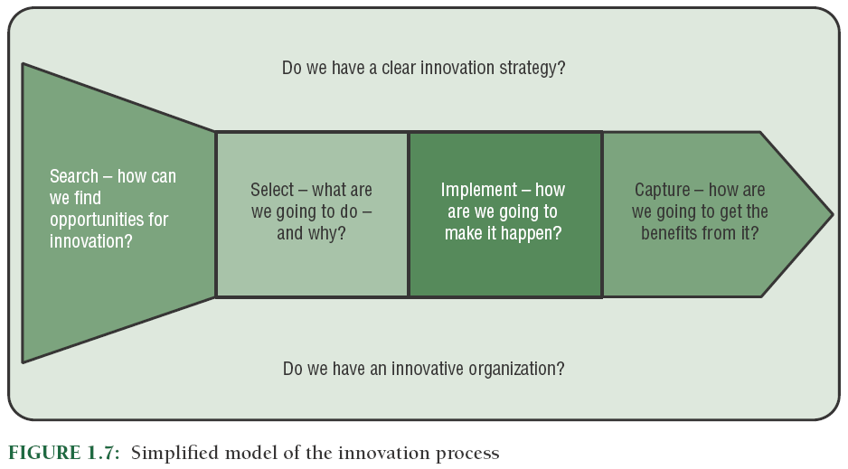
© 2009 John Wiley & Sons Ltd.
www.managing-innovation.com

