Slide 1
Fault Tolerance and Propagation
Fault tolerance and propagation are critical concepts in distributed systems. They ensure system reliability and resilience in the face of failures. Understanding these principles is essential for building robust, scalable applications.
Subtitle: Network Structures, Predictable Failure, and Error Propagation

Slide 2
Term | Definition | Example
Fault | A defect in the system that has the potential to cause a malfunction. | A damaged hard drive.
Fault Tolerance | System’s ability to continue operating despite the presence of faults. | A data center with redundant power supplies.
Error | An incorrect state within the system caused by a fault. | Corrupted data due to memory failure.
Error Propagation | The spread of an error from one component to another, potentially causing widespread issues. | A configuration error in a router that disrupts connected devices.

Slide 3
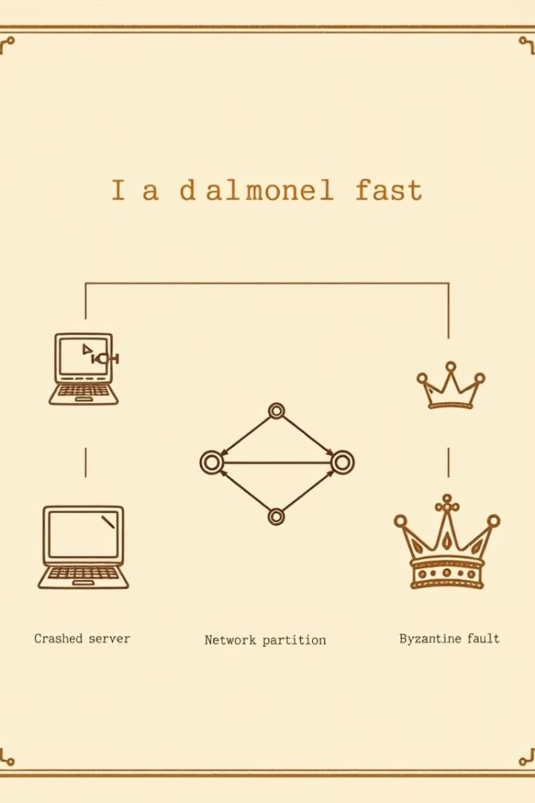
Types of Faults
1
Crash Faults
Nodes stop functioning without warning. Recovery involves detecting and replacing failed components.
2
Network Partitions
Communication breaks between system parts. Strategies like eventual consistency help manage this issue.
3
Byzantine Faults
Nodes behave erratically or maliciously. Complex algorithms are needed to maintain system integrity.

Slide 4
Fault Detection Mechanisms
1
Heartbeat Monitoring
Nodes periodically send signals. Absence indicates potential failure.
2
Gossip Protocols
Nodes share state information. Discrepancies reveal issues in the system.
3
Consensus Algorithms
Nodes agree on system state. Disagreements can signify faults.

Slide 5
Fault Tolerance in Complex Systems
1
Built-in Redundancy
Many systems have redundant components. This design approach enhances overall system resilience.
2
Network Resilience
Networks often have multiple routes between nodes. This structure allows for continued operation even if some connections fail.
3
Webs of Influence
Networks represent abstract links between system components. They illustrate the interconnected nature of complex systems.

Slide 6
Types /Perspectives on System Tolerance
Access Network View
Resource Network View
Complementary Approaches
A poorly connected access network limits problem propagation. This perspective focuses on preventing security breaches.
A well-connected resource network ensures resilience. This approach emphasizes maintaining access to critical resources.
Both viewpoints are valuable for system security. They address different aspects of system vulnerability and resilience.

Slide 7
Fault Isolation Techniques
Circuit Breakers
Prevent cascading failures by isolating faulty components. They automatically cut off problematic services.
Bulkheads
Partition system resources. This limits the impact of failures to specific areas.
Fail-fast Mechanisms
Quickly terminate faulty processes. This prevents resource waste and speeds up recovery.

Slide 8
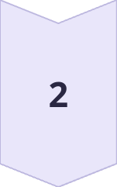
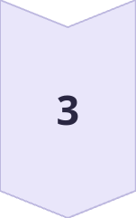
Fault Propagation Patterns
Cascading Failures
One fault triggers a chain reaction. Load redistribution often causes this effect.
Resource Exhaustion
Faults deplete system resources. This can lead to widespread service degradation.
Data Corruption
Errors in data spread through replication. This can compromise system integrity.

Slide 9
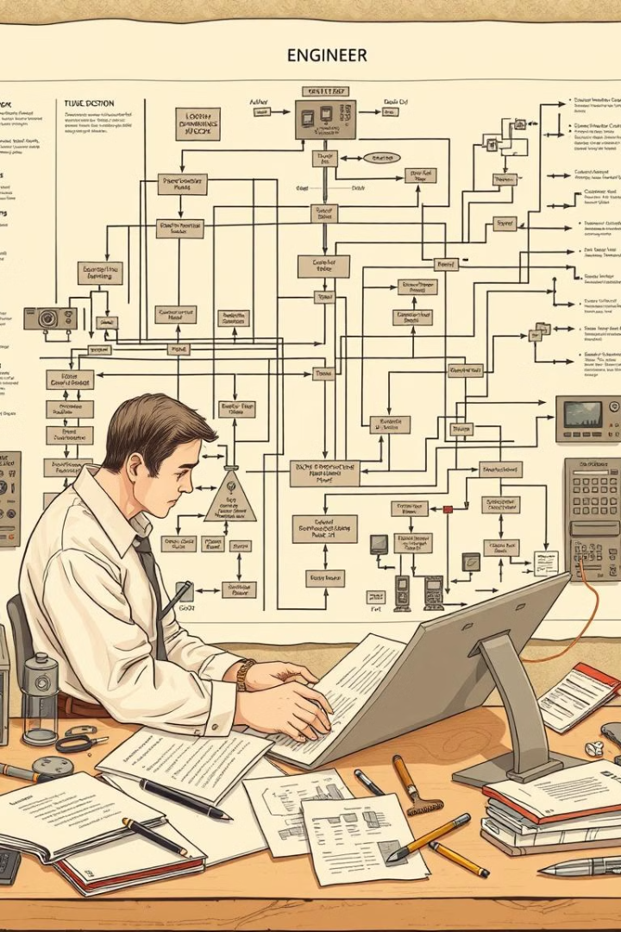
Designing for Fault Tolerance
Redundancy
Implement backup components and data copies. This ensures system availability during failures.
Modularity
Design loosely coupled components. This limits fault propagation and simplifies system maintenance.
Load Balancing
Distribute workload across multiple nodes. This prevents single points of failure.

Slide 10
Testing Fault Tolerance
Technique
Description
Benefits
Chaos Engineering
Intentionally introduce faults
Uncover hidden vulnerabilities
Fault Injection
Simulate specific failure scenarios
Validate recovery mechanisms
Load Testing
Stress system under high load
Identify performance bottlenecks

Slide 11
Network Structures
Network structures refer to the various ways in which nodes (devices, computers, or other entities) are organized and connected within a network
Types of Network Structures
1. Centralized: Single-point dependency.
2. Decentralized: Reduces central points, increasing resilience.
3. Mesh/Distributed: High fault tolerance due to multiple paths.

Slide 12
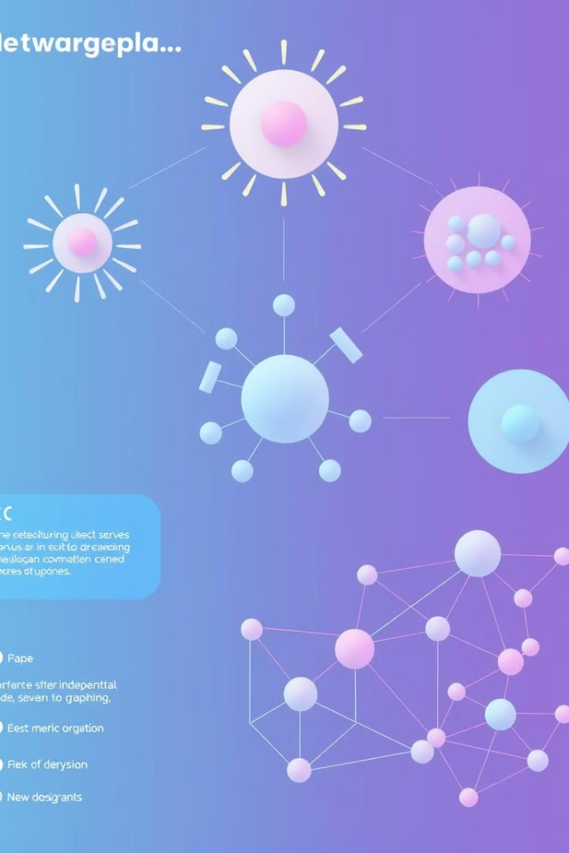
Types of Network Structures & Error Propagation
Network Type
Structure
Error Propagation Risk
Centralized
Highly ordered, single center
High risk at center, low elsewhere
Decentralized
Multiple interconnected centers
Moderate, contained within subnetworks
Mesh
Generalized interconnections
Low, highly distributed

Slide 13
Random Networks and Their Role
Random Networks: Created by randomly linking nodes within a set.
Advantages of Random Networks:
Cover many possibilities efficiently.
High probability of interconnection given sufficient node density.
Unpredictability: Useful for handling unknown or changing faults

Slide 14
Random Networks in System Design
1
Formation
Random networks are created by making arbitrary connections between nodes. This approach covers a wide range of possibilities efficiently.
2
Efficiency
Random connections are effective for unpredictable targets. They can address random faults without exhaustive resource use.
3
Connectivity
With sufficient density, random links have a high probability of connecting all nodes. This property contributes to network robustness.

Slide 15
Small-World Networks Defined
Small-world networks are a class of highly clustered graphs that behave like random graphs. They feature local clustering, creating a centralized structure at the level of small groups. However, the 'small world' phenomenon arises from the existence of a few long-range or 'weak' links that connect distant parts of the network.
These weak links play a vital role in connecting distant clusters, dramatically reducing the degrees of separation between arbitrary nodes in the network. This property has significant implications for information flow, fault propagation, and system behavior in various contexts.
1
2
3
Local Clustering
Weak Links
Small World Effect
Formation of tightly connected small groups within the network.
Few long-range connections between distant clusters.
Dramatic reduction in degrees of separation across the entire network.

Slide 16
Definition of Small-World Network
A small-world network is a highly clustered network that also behaves like a random graph.
Has a centralized structure in small groups but includes "weak links" connecting distant clusters.
Weak links significantly reduce the path length between nodes
Role of Weak Links in Small-World Networks
Weak links (long-range connections) are vital for connecting different clusters.
These links help small clusters achieve connectivity similar to a random network.
Adding a few random long-distance links transforms the network’s structure.

Slide 17
Scale-Free Behavior in Networks
Small-world networks often exhibit scale-free behavior over a wide range of scales. This means that the network's properties appear similar regardless of how one zooms in or out to examine different regions. Scale-free networks form spontaneously when there is preferential attachment - new connections are more likely to form based on existing connections.
This phenomenon is observed in various contexts, such as links to websites in the World Wide Web. Search engines like Google exploit this property to rank the importance of sites, as well-connected sites tend to attract even more connections, leading to a 'rich get richer' effect.
Scale-Free Property
Preferential Attachment
'Rich Get Richer' Effect
Network characteristics remain similar across different scales.
New connections form based on existing connections.
Well-connected nodes attract more connections over time.

Slide 18
Importance of Small-World Networks
Small-world networks are efficient for information flow, fault tolerance, and security.
Scale-free properties are seen in human-computer interactions and online networks.
Real-world applications include social media, biological networks, and system traffic handling.

Slide 19
Causality in Complex Systems
Establishing causal connections in complex systems is crucial for fault analysis and policy effectiveness. The principle of causality states that every change or effect happens in response to a preceding cause. However, in dynamical systems, the relationship between cause and effect is not always straightforward.
Analyzing subsystems within a larger network can be challenging, as conceptual decompositions may not preserve causal relationships. Ignoring important links in the causal web can lead to seemingly unpredictable behavior, highlighting the importance of comprehensive system understanding.
Identify Subsystem
Consider Connections
Analyze Behavior
Establish Causality
Define the specific part of the system to be analyzed.
Observe and interpret subsystem behavior in context.
Determine causal relationships based on comprehensive analysis.
Evaluate links between the subsystem and the larger network.

Slide 20
Causality and Dependency
Causality refers to the relationship between cause and effect within a system. In other words, it is the principle that certain events (causes) lead to specific outcomes (effects).
Principle of Causality
Causality: Every change or effect is triggered by a preceding cause.
Essential for analyzing system faults and assessing program effectiveness.
Helps establish a clear relationship between actions and outcomes in a network.
Challenges in Identifying Causality
In complex systems, cause and effect relationships may not be obvious.
Inadequate analysis can lead to misinterpreting the true cause of an observed behavior.
Important to define subsystems correctly to maintain causal clarity.

Slide 21
Dependency and Its Types
Dependency refers to the relationship where one component or process relies on another to function correctly.
Types of Dependency
Direct Dependency: One element directly depends on another.
Indirect Dependency: One element is influenced through intermediate elements.
Interdependency: Two elements mutually rely on each other.

Slide 22
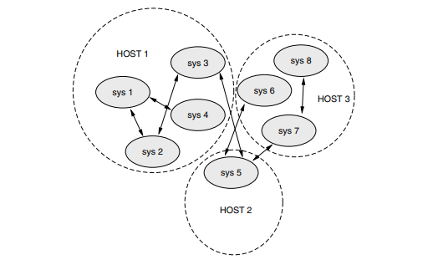
Dependencies in Networked Systems
Dependencies create a causal web, where the state of one node affects others.
Errors can propagate across dependent nodes, impacting system performance.
Recognizing dependencies is crucial for system resilience and fault management.

Slide 23
Causal Analysis
Causal Analysis is the process of identifying and understanding the causes of specific outcomes or events, particularly when investigating faults, errors, or issues in a system.
Common Causal Analysis Techniques
Root Cause Analysis (RCA
Failure Mode and Effects Analysis (FMEA
Fault Tree Analysis

Slide 24
Open vs. Closed Systems in Causal Analysis
A system can be analyzed as “open” if subsystems share variables.
“Closed” systems have isolated subsystems without shared variables.
Treating an open system as closed can lead to an incomplete understanding of causality.

Slide 25
Example of Causal Analysis in Action
Problem: A web application experiences slow response times during peak usage.
Analysis Process:
Define: The problem is slow response times when user traffic is high.
Data Gathering: Collect logs, CPU, memory usage, and database performance metrics.
Identify Possible Causes: High CPU usage, database query latency, inadequate server capacity.
Analyze: Use the 5 Whys:
Why is the response slow? → High CPU usage.
Why is the CPU usage high? → Excessive database calls per request.
Why are there excessive calls? → Inefficient database query structure.
Validate: Run tests with optimized database queries to confirm performance improvements.
Implement: Optimize the database queries to reduce CPU load.
Monitor: Track performance during peak times to ensure response times improve.

Slide 26
Predictable Failure in System Design
Standardized Protocols
Quality Assurance
Controlled Mitigation
Adopting well-understood procedures enhances predictability. This approach facilitates rapid system recovery after failures.
Rigorous design and maintenance processes are crucial. They help identify potential failure modes before they occur.
When failures occur as expected, their effects can be managed. This principle is key to maintaining system stability.

