Slide 1
MAKERERE UNIVERSITY BUSINESS SCHOOL
FACULTY OF BUSINESS ADMINISTRATION
Business Communication Skills
FOR DIPLOMA
©2024 - DEPARTMENT OF COMMUNICATION

Slide 2
TOPIC 2: EFFECTIVE COMMUNICATION
Is a process of exchanging ideas, thoughts, knowledge and information such that the purpose or intention is fulfilled through shared meaning.
In simple words, it is the presentation of views by the sender in a way best understood by the receiver.

Slide 3
Conti……
People remember more a good communicator than an excellent professional who communicates poorly.
Effective communication occurs when the receiver understands the same meaning of the message the sender intended to convey.
To achieve effective communication, one should take into consideration the following:
The communication process
Barriers to effective communication and their solutions
Planning for communication
Basic Business English in relation to Principles of Effective Communication
Each of the above will further be explained in detail in the subsequent sub-topics.

Slide 4
TOPIC 2a: COMMUNICATION PROCESS
The communication process is the guide and a series of steps towards realizing effective communication.
This happens when there is sharing of a common meaning between the sender and the receiver.

Slide 5
Topic Outline
Introduction of communication process.
Stages of communication process.
Explanations of each stage.
Importance of feedback.
Exercise
Video ( link)

Slide 6
Topic Learning Outcomes
By the end of this topic, the student should be able to:
Define Effective Communication
Articulate the various aspects of effective communication
Explain the elements of a communication process
Illustrate the communication process
Demonstrate the communication process that should be followed in any business situation
Explain the role of feedback in effective communication
Assess the effectiveness of communication in various business contexts

Slide 7
The Communication Process

Slide 8
Stages of the Communication Process
Sender: The sender identifies the need to communicate and formulates an idea
Encoding: The sender transforms the thoughts, ideas, or information into a message in form of symbols, words or gestures that can be understood by the receiver.
Channel: The channel is the medium that transmits the message to receivers
Receiver: receiver is the individual or group to whom the message is directed and who interprets or decodes the message.
Decoding: entails the receiver converting the message into thought.
Feedback. Is the response the receiver sends to the sender.

Slide 9
Importance of Feedback
Information obtained from feedback can be used in decision making.
Completes the communication cycle.
Confirmation that the message was received.
Used as a tool to assess whether the communication was successful.
A measure of performance.
Feedback can be used as a motivation tool etc.

Slide 10
Noise
This is any barrier or hindrance to effective communication that arises during the communication process.
It can arise from any stage of the communication process.
There are different types of noise to include:
Physical: It refers to any external or environmental interference that disrupts or distorts the transmission of a message.
Psychological: It refers to internal factors in the mind of a person that can hinder or distort their ability to receive, interpret or respond to a message during communication.
Semantic: It refers to misinterpretations that arise from the use of language in communication.
Physiological: It refers to physical body conditions that can interfere with the effective transmission or reception of a message.
Note: The above divisions will be explained in detail in topic 2b

Slide 11
Exercise
1a) Based on the orientation week that you attended as a first-year student, choose one of the communication sessions you had with any MUBS officials and explain the communication process that took place.
b) Critique the above process.

Slide 12
References
https://youtu.be/q6u0AVn-NUM?si=1OjhmrWPIielIABe

Slide 13
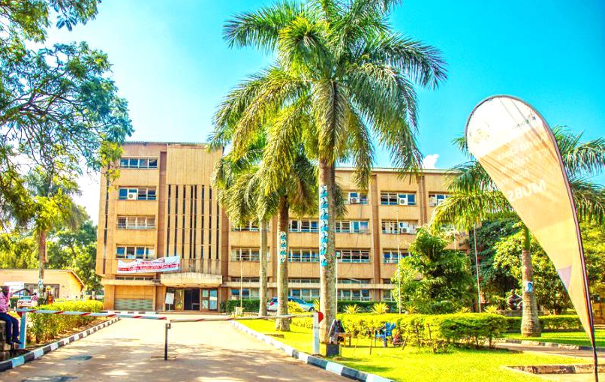
Thank you for being a great audience
Address
Main building , first floor Room 1.0
Contacts
Team leader: +256-777-899-582
Facilitator: +
Email
hodcommunication@mubs.ac.ug /snakyeyune@mubs.ac.ug
©2024 - FACULTY OF BUSINESS ADMINISTRATION, Department of Communication

