Slide 1
Project Stakeholder Management
Project Stakeholder Management
Project Stakeholder Management Process
Project stakeholder management tools and techniques
Stakeholder Mapping
Stakeholder analysis
Stakeholder engagement assessment matrix

Slide 2
Define; stakeholder
What/who is a stakeholder?

Slide 3
Stakeholder defined;
A stakeholder is any individual, group, or organization who may positively or negatively be affected by, or cause an effect on, the decisions, activities, or outcomes of a project.

Slide 4
Project Stakeholder Management-Cont.

Slide 5
Stakeholder management defined;
Stakeholder management is the process of identifying, analyzing, engaging, and maintaining relationships with individuals or groups that have an interest in or can affect a project, organization, or system.
The goal is to balance stakeholder expectations while achieving business or project objectives effectively.

Slide 6
Project Stakeholder Management-Cont.
Stakeholder mgt is an important tool that allows one to identify which stakeholders might have the most influence over the success or failure of the project, and which are the most important supporters and opponents when implementing a project. Based on this, managers can adjust their decisions and, also, can make plans for dealing with stakeholders having different interests and different levels of influence.

Slide 7
Main Categories of Stakeholders and their Interests
Stakeholders can be categorized into two; Internal Stakeholders and External Stakeholders.
Internal stakeholders:
Shareholders — These are key internal stakeholders. As investors, they take a financial stake in the project by purchasing shares and are interested in the best return on investment, usually made in the form of a share of the profits.
Employees
Managers and Board of Directors
Managers are mainly interested in the company value maximization, while the Board of directors prefer to expand the company,

Slide 8
Main Categories of Stakeholders and their Interests
External stakeholders
Customers — These have a real role in helping the business to develop and grow as they are expecting good value, high-quality products and great services.
Suppliers and business partners — These also hold a stake in the company to which they provide materials and services. These entities are mostly interested in developing a long-lasting business relation based on mutual advantage and promotion.
Regulatory Authorities: Government agencies or bodies that enforce laws, regulations, and standards the project must comply with. eg Environmental agencies overseeing a construction project for sustainability compliance.
Community and society — This expects the company to adopt an ethical and moral behavior, to involve and financially support the community life through voluntaries activities, sponsorships, donations, charity fundraising, partnerships, to finance culture, education system etc

Slide 9
Project Stakeholder Management Process
Project stakeholders Management is a five-step process:
Step 1: Identification of project stakeholders
Step 2: Discovery and understanding of project stakeholder interests
Step 3: Analysis and mapping of project stakeholders
Step 4: Management of project stake- holder expectations
Step 5: Evaluation of the project stake- holder management process

Slide 10
Project Stakeholder Management Process-cont.
Identification of Project Stakeholders
Project stakeholder identification is the process of identifying all people or organizations impacted by the project, and documenting relevant information regarding their interests, involvement, and impact on the project’s success. Eg brainstorming, Collecting categories and names of stakeholders from informants in the community, Consulting with organizations that are, or have been, involved in similar projects, If appropriate, advertising.

Slide 11
Project Stakeholder Management Process-cont.
Discovery and Understanding of Project Stakeholder Interests
Potential beneficiaries may wildly support an effort, seeing it as an opportunity or the pathway to a better life…
Analysis and Mapping of Project Stakeholders
Project stakeholder analysis is a process of systematically gathering and analysing quantitative and qualitative information about stakeholders to determine whose interests should be taken into account throughout the project. It identifies the interests, expectations, and influence of the stakeholders and relates them to the purpose of the project. It also helps identify stakeholder relationships that can be leveraged to build coalitions and potential partnerships to enhance the project’s chance of success.

Slide 12
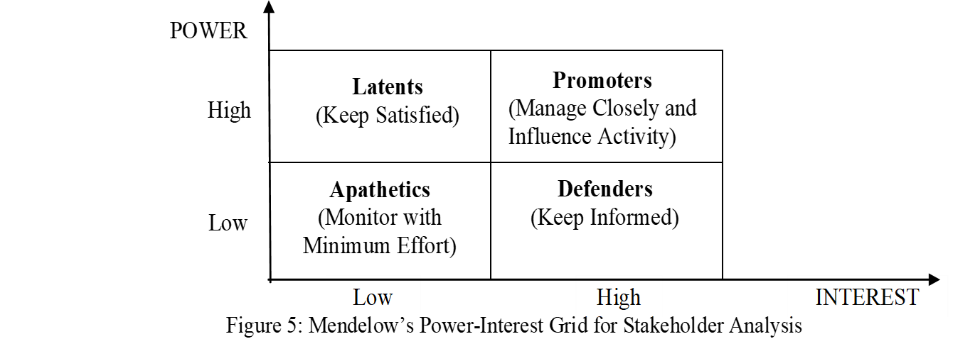
Project Stakeholder Management Process-cont.
Mapping of Project Stakeholders
Project stakeholder mapping is a technique for identifying and prioritizing project stake- holders. It is a powerful diagnostic tool. It helps the project manager to identify his/her current position in relation to the various interest groups, community organizations, economic and financial interests, government agencies, and others who take an interest in or can affect his/her project.

Slide 13
Project Stakeholder Management Process-cont.
Management of Project Stakeholder Expectations
Project stakeholder expectations management is the process of communicating and working with stakeholders to meet their needs and addressing issues as they occur. Project stakeholder expectations management allows using the analysis to gain stakeholders’ support for implementing a project strategy, action

Slide 14
Project Stakeholder Management Process-cont.
Evaluation of the project stakeholders’ management process
Stakeholder Identification & Analysis
Communication Effectiveness
Engagement & Relationship Management
Conflict Resolution & Risk Management
Performance Metrics & Feedback Mechanism (KPIs)
Adaptability & Continuous Improvement (Were lessons learned documented for future projects?)

Slide 15
Project stakeholder management tools & techniques
Effective stakeholder management is a critical component of project success.
There are several tools and techniques that project managers can use to identify, analyze, and manage stakeholders throughout the project lifecycle

Slide 16
Project stakeholder management tools-& techniques-cont.
Stakeholder Identification Tools
Stakeholder Register: A document that lists all stakeholders, including their roles, interests, influence, and contact details.
Brainstorming and Workshops: Collaborative sessions with the project team to identify stakeholders and their potential impact.
Expert Judgment: Consulting with experienced individuals or teams to identify key stakeholders.

Slide 17
Project stakeholder management tools-& techniques-cont.
Stakeholder Analysis Tools
Stakeholder Mapping/Matrix: Visual tools to categorize stakeholders based on interest and influence

Slide 18
Stakeholder Mapping/Matrix
According to the Power-Interest Grid, four categories of stakeholders result:
Apathetics — These are stakeholders with low interest and low power, and may not even know the project exists. They should be monitored with minimum effort.(lower level workers eg cleaners)
Latents — These are stakeholders with low interest (i.e. no particular interest or involvement) in the project and high power (i.e. have the power) to influence it greatly if they become interested. They should be kept satisfied. (lower level managers)

Slide 19
Stakeholder Mapping/Matrix
Promoters — These are stakeholders with high interest in the project and high power to help make it successful (or to derail it). They should be managed closely and the project should be influenced.eg shareholders)
Defenders — These are stakeholders with high interest (i.e. a vested interest) and can voice their support in the community, and low power (i.e. little actual power) to influence the project in any way. They should be kept informed. Eg people in the community

Slide 20
Conclusion
The Project Stakeholder Management process involves summarizing key takeaways, assessing stakeholder satisfaction, Evaluating Communication & Conflict Resolution, Reviewing Project Impact on Stakeholders, identifying lessons learned for future projects, and Formal Closure & Acknowledgment of key stake holders.

Slide 21
END
THANK YOU

