Slide 1
Configuring a Network Operating System
The Cisco IOS
Basic Device Configuration like hostnames, ports, addresses and verifying connectivity

Slide 2
1. Configuring a Network Operating System (NOS)
Key Concepts and Best Practices

Slide 3
Introduction to NOS
A Network Operating System (NOS) is specialized software that controls and manages network resources. It is designed to support networking functionalities such as routing, switching, security, and network services
Purpose:
To manage network traffic effectively.
To ensure the secure and efficient operation of network hardware.
To facilitate the configuration, monitoring, and maintenance of network resources.
Common NOS Examples:
Cisco IOS (Internetwork Operating System): Used in Cisco devices, a widely used NOS in enterprise environments.
Juniper Junos: Used in Juniper Networks hardware.
Linux-based NOS: For example, Cumulus Linux, used in modern data center environments.

Slide 4
Initial Setup and Configuration
Accessing the NOS:
Console Access: Using a physical connection (console cable) and terminal software to connect to the device.
Remote Access: Through SSH or Telnet for secure remote management.
Basic Configuration Steps:
Assigning a Hostname: Use commands like hostname in Cisco IOS to set a recognizable name for the device.
Configuring IP Addresses: Assign IP addresses to network interfaces to enable communication. Example command in Cisco IOS: interface GigabitEthernet0/0 followed by ip address 192.168.1.1 255.255.255.0.
Setting Up Default Gateway: Define the default route using commands like ip route 0.0.0.0 0.0.0.0 [gateway IP] to enable communication outside the local network.
Configuring DNS: Specify DNS servers for domain name resolution using ip name-server [DNS IP].

Slide 5
Configuring Routing Protocols
].
].
What is routing?
Static Routing: Manually configured routes that do not change unless manually updated.
Configuration: Add static routes using the ip route [destination network] [subnet mask] [next-hop address] command in Cisco IOS.

Slide 6
Configuring Routing Protocols
Dynamic Routing Protocols:
RIP (Routing Information Protocol):
A distance-vector routing protocol that uses hop count as a metric. Configuration involves enabling RIP and specifying the networks to include.
Example command: router rip followed by network [network address].
OSPF (Open Shortest Path First):
A link-state routing protocol that uses cost as a metric and supports hierarchical network design.
Configuration: Enable OSPF using router ospf [process-id], and define OSPF areas with network [network address] [wildcard mask] area [area-id].
EIGRP (Enhanced Interior Gateway Routing Protocol):
A Cisco proprietary hybrid routing protocol combining the features of both distance-vector and link-state protocols.

Slide 7
Configuring Security Features
Access Control Lists (ACLs):ACLs are used to control traffic into and out of network interfaces based on IP addresses, protocols, or ports.
Configuration:
Standard ACLs: Restrict based on source IP. Example: access-list 10 permit 192.168.1.0 0.0.0.255.
Extended ACLs: Restrict based on source and destination IP, protocol, and port. Example: access-list 100 permit tcp 192.168.1.0 0.0.0.255 any eq 80.
Network Address Translation (NAT):NAT is used to map private IP addresses to a public IP address, allowing multiple devices on a local network to share a single public IP.
Configuration:
Configure inside and outside interfaces using ip nat inside and ip nat outside.
Define NAT pools and create static or dynamic NAT rules.

Slide 8
Configuring Security Features
Secure Management:
SSH Configuration:
Enable SSH for secure remote access using ip domain-name [domain], generate RSA keys with crypto key generate rsa, and enable SSH with line vty 0 4 followed by transport input ssh.
Password Protection:
Set strong passwords for device access using commands like enable secret [password] for privileged EXEC mode and line console 0 followed by password [password] for console access.
Enable Logging:
Configure logging to monitor and record device activity. Example: logging buffered [size] to log messages in the device’s buffer memory.

Slide 9
Configuring Network Services
DHCP (Dynamic Host Configuration Protocol): DHCP dynamically assigns IP addresses to devices on the network.
Configuration:
Define a DHCP pool using ip dhcp pool [name], specify the network and default gateway, and optionally exclude addresses with ip dhcp excluded-address [start IP] [end IP].
VLANs (Virtual Local Area Networks):VLANs segment a network into separate, isolated subnetworks.
Configuration:
Create VLANs with vlan [vlan-id] and assign interfaces to VLANs using interface [interface-id] followed by switchport access vlan [vlan-id].
DNS (Domain Name System): DNS translates domain names into IP addresses.
Configuration:
Set up DNS server settings with ip name-server [DNS IP].

Slide 10
Monitoring and Maintenance
Monitoring Tools:
Syslog: Centralized logging of events. Configure syslog servers and log levels.
SNMP (Simple Network Management Protocol): For monitoring network devices and managing network performance.
Backups:
Firmware Upgrades:
Redundancy and Failover:
HSRP (Hot Standby Router Protocol):
Performance Tuning:
QoS (Quality of Service):
Troubleshooting:
Common Commands:ping [IP address] to test connectivity.,traceroute [IP address] to trace the path to a destination.

Slide 11
Best Practices in NOS Configuration
Documentation:
Keep detailed records of configurations, changes, and updates.
Security Hardening:
Regularly review and update security settings to protect against new threats.
Regular Audits:
Perform periodic audits of network settings to ensure compliance with organizational policies and industry standards.
Automation:
Utilize automation tools (like Ansible or Cisco’s DNA Center) for repetitive tasks, ensuring consistency and reducing manual errors.

Slide 12
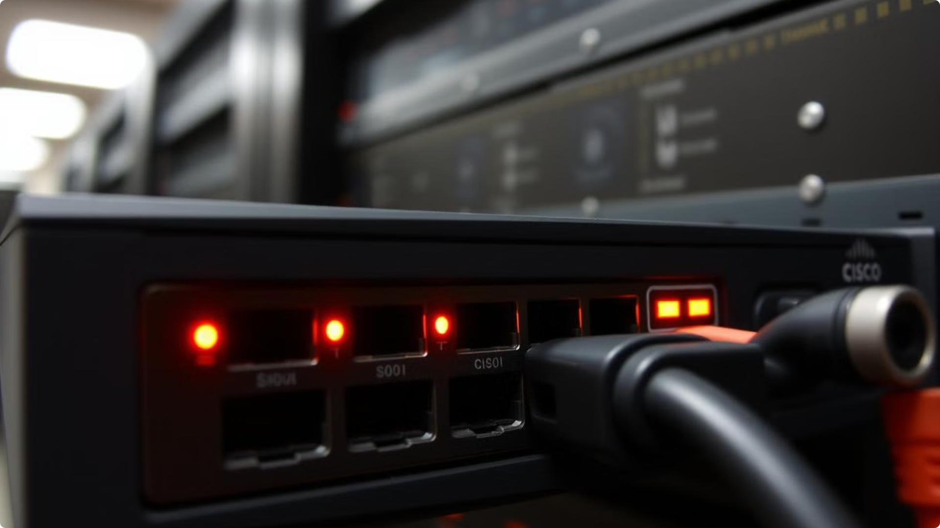
2.The Cisco IOS
This document provides a comprehensive overview of the Cisco IOS, a network operating system widely used in Cisco routers and switches. This document details the architecture, features, and key concepts of the Cisco IOS for network administrators and IT professionals.

Slide 13
Introduction to Cisco IOS
Cisco IOS, the Internetwork Operating System, is a robust network operating system used on Cisco routers and switches. It provides a wide range of features and functionalities to manage and control network devices.
Cisco IOS is responsible for controlling various network functions, including routing, switching, security, and quality of service (QoS).
Cisco IOS offers a command-line interface (CLI) that allows network administrators to configure and manage network devices through a series of commands.

Slide 14
Cisco IOS Versions and Platforms
Cisco IOS comes in various versions, each tailored to specific hardware platforms and networking needs.
Cisco IOS versions are categorized based on the device family, such as the IOS-XE for Nexus switches, IOS-XR for high-end routers, and traditional IOS for older routers.
Cisco IOS platforms vary in their capabilities and features depending on the hardware and software configurations.

Slide 15
Cisco IOS Architecture
The Cisco IOS is a modular operating system built on a layered architecture. The kernel is the core component responsible for managing system resources and handling network traffic. The IOS also includes various modules, which provide specific functionalities such as routing, security, and QoS.

Slide 16
IOS Image Types
IOS image files contain the system code that your router uses to function, that is, the image contains the IOS itself, plus various feature sets (optional features or router-specific features).
The Cisco IOS Software image is either ED, LD, GD, or DF:
ED stands for "Early Deployment." Early Deployment releases offer new features, platform, or interface support. Most non-major releases contain ED releases.
GD stands for "General Deployment." A major release of Cisco IOS software reaches the General Deployment milestone when Cisco feels it is suitable for deployment anywhere in customer networks where the features and functionality of the release are required.
LD stands for "Limited Deployment." A major release of Cisco IOS Software is said to be in the Limited Deployment phase of its lifecycle between its first shipment and the GD milestone.
DF stands for "Deferred." DF releases are not available for downloading because of known defects. These should not be installed on your router.

Slide 17
Early Deployment (ED)
Example: Imagine a company that wants to take advantage of the latest features in network security. Cisco releases a new version of IOS software that includes these features under the Early Deployment label. The company decides to implement this version in a smaller segment of its network to start using the advanced features before they are widely available. Since the ED release is one of the first versions made available, it might be more experimental and only suitable for environments where new features are a priority over stability.
2. General Deployment (GD)
Example: A large enterprise network has been waiting for a stable version of Cisco IOS software that includes enhanced security features and better support for their existing infrastructure. Once the software reaches the General Deployment stage, Cisco has thoroughly tested it, and it's now considered stable and ready for widespread use. The company confidently deploys this version across all of its network devices, knowing that it has been vetted and is supported for broad use in production environments.
3. Limited Deployment (LD)
Example: After Cisco releases a new major version of IOS software, a network administrator wants to try it out but only in a limited scope. The release is currently in the Limited Deployment phase, meaning it's available for select customers who might want to test the new features in a controlled environment. The administrator decides to implement it on a small number of routers to evaluate its performance and compatibility with existing systems before deciding to deploy it more broadly once it reaches the GD phase.
4. Deferred (DF)
Example: An IT team discovers that a new version of Cisco IOS they were considering for deployment has been marked as Deferred. This happens because the version contains a significant defect that could potentially disrupt network operations. As a result, Cisco has pulled this version from availability. The team avoids using this version, opting instead to continue using their current stable release or wait for an updated version that resolves the issues.

Slide 18
IOS Command-Line Interface (CLI)
The Cisco IOS is primarily managed through its command-line interface (CLI). The CLI provides a powerful and flexible way to configure and troubleshoot network devices. Users interact with the IOS using commands, which are organized into a hierarchical structure.
Any commands you have learnt so far?

Slide 19
Cisco IOS Configuration
Configuring the Cisco IOS involves defining network settings, managing security policies, and configuring various functionalities. Configuration tasks can be performed using the IOS CLI or through graphical user interfaces (GUIs) on some platforms.
Cisco IOS configuration is majorly performed through the command-line interface (CLI), which provides a powerful way to manage network devices.
Configuration commands are used to define network settings, such as IP addresses, routing protocols, and security policies.
Cisco IOS offers various modes for configuration, including global configuration mode, interface configuration mode, and line configuration mode.
TASK: read more about these configuration modes

Slide 20
Cisco IOS Configuration Modes
The Cisco IOS CLI supports different configuration modes, each offering specific functionalities and access levels. The "global configuration mode" allows for device-wide configurations, while the "interface configuration mode" is used to configure specific interfaces.
Mode
Description
User Mode
Basic access for viewing information.
Privilege Mode
Elevated privileges for advanced tasks.
Global Configuration Mode
Device-wide configurations.
Interface Configuration Mode
Configuration of specific interfaces.

Slide 21
Cisco IOS Features
The Cisco IOS offers a wide range of features designed to manage and secure networks. Some of the key features include routing protocols, security mechanisms, Quality of Service (QoS), and network management tools.
1
Routing Protocols
2
Security Features
The IOS supports various routing protocols such as RIP, OSPF, and BGP, enabling efficient network routing and data packet delivery.
Security mechanisms like access control lists (ACLs), firewall features, and VPN support are included to protect network resources.
3
Quality of Service (QoS)
4
Network Management Tools
QoS capabilities allow administrators to prioritize network traffic and ensure the smooth delivery of critical applications.
Tools for monitoring network performance, troubleshooting issues, and managing configuration changes are integrated into the IOS.

Slide 22
Cisco IOS Management
Cisco IOS provides various tools for monitoring and managing network devices.
Network administrators can use Cisco IOS commands to collect network statistics, troubleshoot connectivity issues, and update firmware.
Cisco IOS offers advanced management features such as SNMP, syslog, and NetFlow, enabling real-time monitoring and analysis of network traffic.

Slide 23
Cisco IOS Security
Cisco IOS provides robust security features to protect networks from unauthorized access and malicious attacks.
Security features include access control lists (ACLs), firewalls, VPNs, and intrusion detection systems (IDS).
Cisco IOS supports various security protocols, such as IPSec, SSL, and TLS, to encrypt network traffic and protect sensitive data.

Slide 24
Cisco IOS Troubleshooting
Troubleshooting network issues involves analyzing network behavior, identifying problem areas, and implementing corrective actions. The IOS provides various tools and commands to assist in troubleshooting tasks.
Cisco IOS provides several tools and commands for troubleshooting network issues.
Network administrators can use commands such as "show ip route," "show interface," and "debug ip packet" to diagnose problems.
Cisco IOS also offers log files and syslog messages to capture and analyze network events.

Slide 25
Cisco IOS Updates and Upgrades
Cisco periodically releases new IOS versions with bug fixes, security enhancements, and new features. Upgrading the IOS requires careful planning and execution to ensure smooth operation of the network.

Slide 26
3. Basic Device Configuration like hostnames, ports, addresses and verifying connectivity

Slide 27
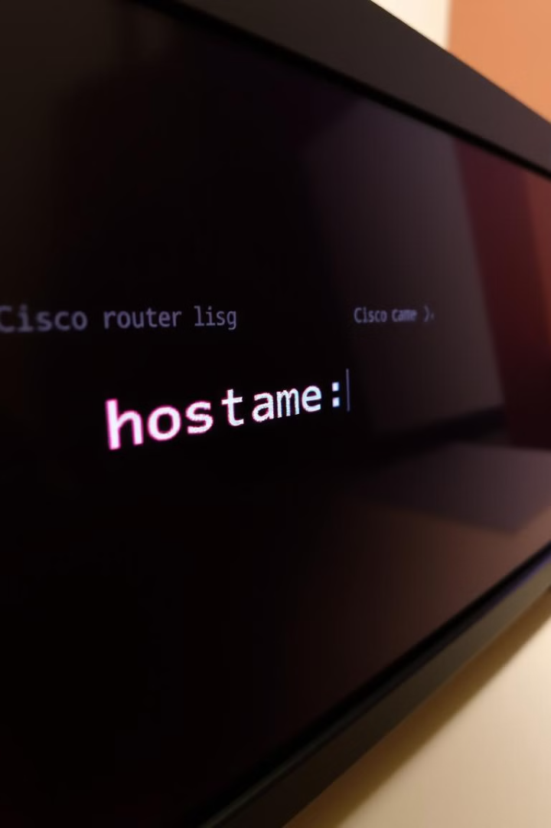
Setting a Hostname
The hostname is a unique identifier for your device. It's used to distinguish it from other devices on the network. Use the "hostname" command to set a hostname. You can choose a descriptive name that helps identify the device's function or location.

Slide 28
Configuring Ports
Cisco IOS devices have multiple ports, each with its own configuration. You need to assign appropriate roles to these ports, such as access, trunk, or management. This determines how the port interacts with the network. The configuration depends on the specific requirements of your network.
1
Access Ports
2
Trunk Ports
3
Management Ports
Connect to end devices and provide network access.
Connect to other switches or routers and carry multiple VLANs.
Used for remote management of the device, typically via SSH or Telnet.

Slide 29
Assigning IP Addresses
Each interface on your device needs an IP address. This address allows communication between devices on the network. Use the "ip address" command to assign an IP address to an interface. You should also configure a subnet mask to define the network segment.

Slide 30
Verifying Connectivity
After configuring your device, it's important to verify connectivity. Use the "ping" command to send test packets to other devices on the network. This helps ensure that your device can communicate with other devices.

Slide 31
Understanding VLANs
VLANs (Virtual Local Area Networks) segment your network into smaller broadcast domains. This improves security and efficiency. You can configure VLANs on your Cisco IOS device to separate different departments or groups of users.
VLAN ID
Name
Purpose
1
Default
Default VLAN for all interfaces
10
Marketing
VLAN for the marketing department
20
Finance
VLAN for the finance department

Slide 32
Troubleshooting Common Issues
Troubleshooting is an essential part of network management. Common issues include connectivity problems, incorrect configurations, and device failures. Use tools like "show" commands, logs, and debug options to diagnose and resolve these issues.

