Slide 1
Network Address Translation (NAT)

Slide 2
What is NAT?
NAT (Network Address Translation) is a process of changing the source and destination IP addresses and ports.
Address translation reduces the need for IPv4 public addresses and hides private network address ranges.
This process is usually done by routers or firewalls.
NAT was introduced to allow multiple devices on a private network to share a single public IP address
enabling seamless access to the internet without requiring every device to have a unique public IP.

Slide 3
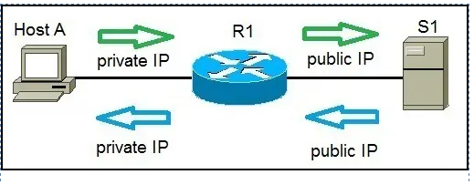

Slide 4
Key reasons we need NAT:
IPv4 Address Conservation: NAT reduces the demand for public IPv4 addresses.
Security: NAT hides internal IP addresses, offering a layer of protection by preventing direct access from external networks.
IP Address Reuse: Private IP ranges (defined in RFC 1918) can be reused within different networks without causing conflicts.

Slide 5
There are three types of address translation:
Static NAT – translates one private IP address to a public one. The public IP address is always the same.
Dynamic NAT – private IP addresses are mapped to the pool of public IP addresses.
Port Address Translation (PAT) – one public IP address is used for all internal devices, but a different port is assigned to each private IP address. Also known as NAT Overload.

Slide 6
Static NAT
Static NAT maps a single private IP address to a single public IP address.
This is a one-to-one mapping, meaning that a specific device on the internal network is always reachable from the outside using a consistent public IP address.
Static NAT is commonly used for:
Servers or devices that need to be accessible from the public internet, such as web or mail servers.
Increased security by exposing only specific devices while the rest of the network remains hidden.

Slide 7
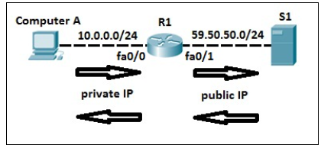
Key Characteristics:
One-to-one mapping: Fixed correspondence between private and public IP addresses.
Suitable for services that must be reachable from the internet (e.g., a web server).

Slide 8
How to configure static NAT.
To check NAT, you can use the
show ip nat translations command

Slide 9
Dynamic NAT
Dynamic NAT provides a temporary one-to-one mapping between private IP addresses and a pool of public IP addresses.
Dynamic NAT assigns public IP addresses from a pool dynamically when internal devices initiate traffic to the internet.
Once the session ends, the public IP becomes available for use by other devices.
This type of NAT is used when:
You have more devices on the internal network than available public IP addresses.
The internal devices do not need a permanent public address.

Slide 10
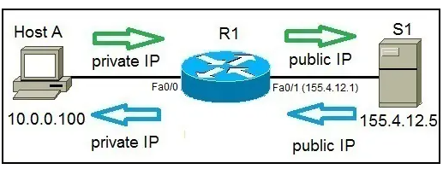
With dynamic NAT, you need to specify two sets of addresses on your Cisco router:
the inside addresses that will be translated
a pool of global addresses

Slide 11
Key Characteristics:
Many-to-many mapping: Private addresses are mapped to a pool of public addresses dynamically.
Public IPs are assigned only when needed, and the mappings are temporary.

Slide 12
Steps in configuring dynamic NAT
configure the router’s inside interface using the ip nat inside command
configure the router’s outside interface using the ip nat outside command
configure an ACL that has a list of the inside source addresses that will be translated
configure a pool of global IP addresses using the ip nat pool NAME FIRST_IP_ADDRESS LAST_IP_ADDRESS netmask SUBNET_MASK command
enable dynamic NAT with the ip nat inside source list ACL_NUMBER pool NAME global configuration command

Slide 13
