Slide 1
CYBER SECURITY
TOPIC 2.2: OVERVIEW OF CYBER SECURITY
DR. SAMALI V. MLAY

Slide 2
To Cover
Cyber security terminologies
Types of cyber attackers
Cyber security increasing threat landscape
Cyber terrorism Vs. Cyber warfare
Critical IT and National Critical Infrastructure
Case studies

Slide 3
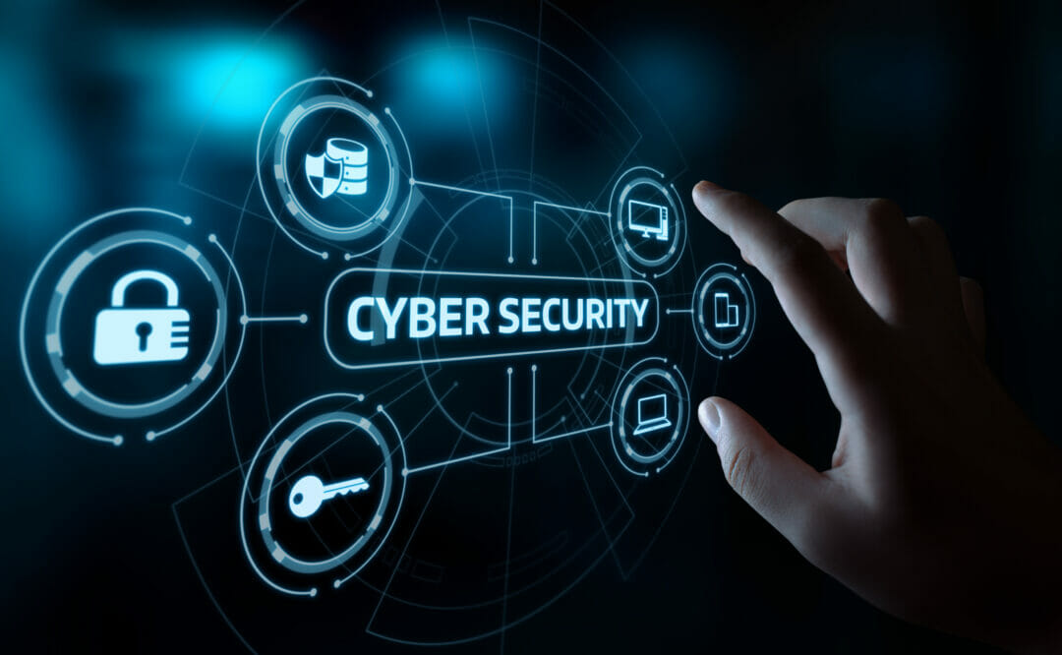
Cyber security
Cyber security - refers to every aspect of protecting an organization and its employees and assets against cyber threats.
It is the application of technologies, processes, and controls to protect systems, networks, programs, devices and data from cyber attacks.
It aims to reduce the risk of cyber attacks and protect against the unauthorised exploitation of systems, networks, and technologies.

Slide 4
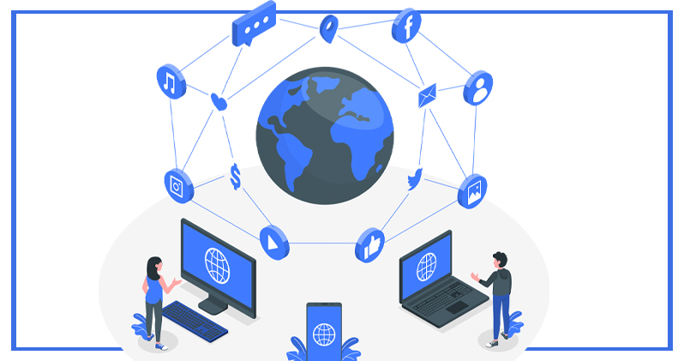
Terminologies
Cyberspace – the global domain within the information environment consisting of the interdependent network of IT infrastructures, including the Internet, telecommunications networks, computer systems, and embedded processors and controllers.
It is the environment of the Internet e.g. the home of Google, Facebook etc.
It is divided into 3 layers; the physical, logical, and persona.

Slide 5
Terminologies…
Attack - An attack, via cyberspace, targeting an enterprise's use of cyberspace for the purpose of disrupting, disabling, destroying, or maliciously controlling a computing environment/infrastructure; or destroying the integrity of the data or stealing controlled information.
It is an attempt by hackers to damage or destroy a computer network or system.
E.g. identity theft, fraud, malware attack, phishing attack, password attack, man in the middle, DOS etc.

Slide 6
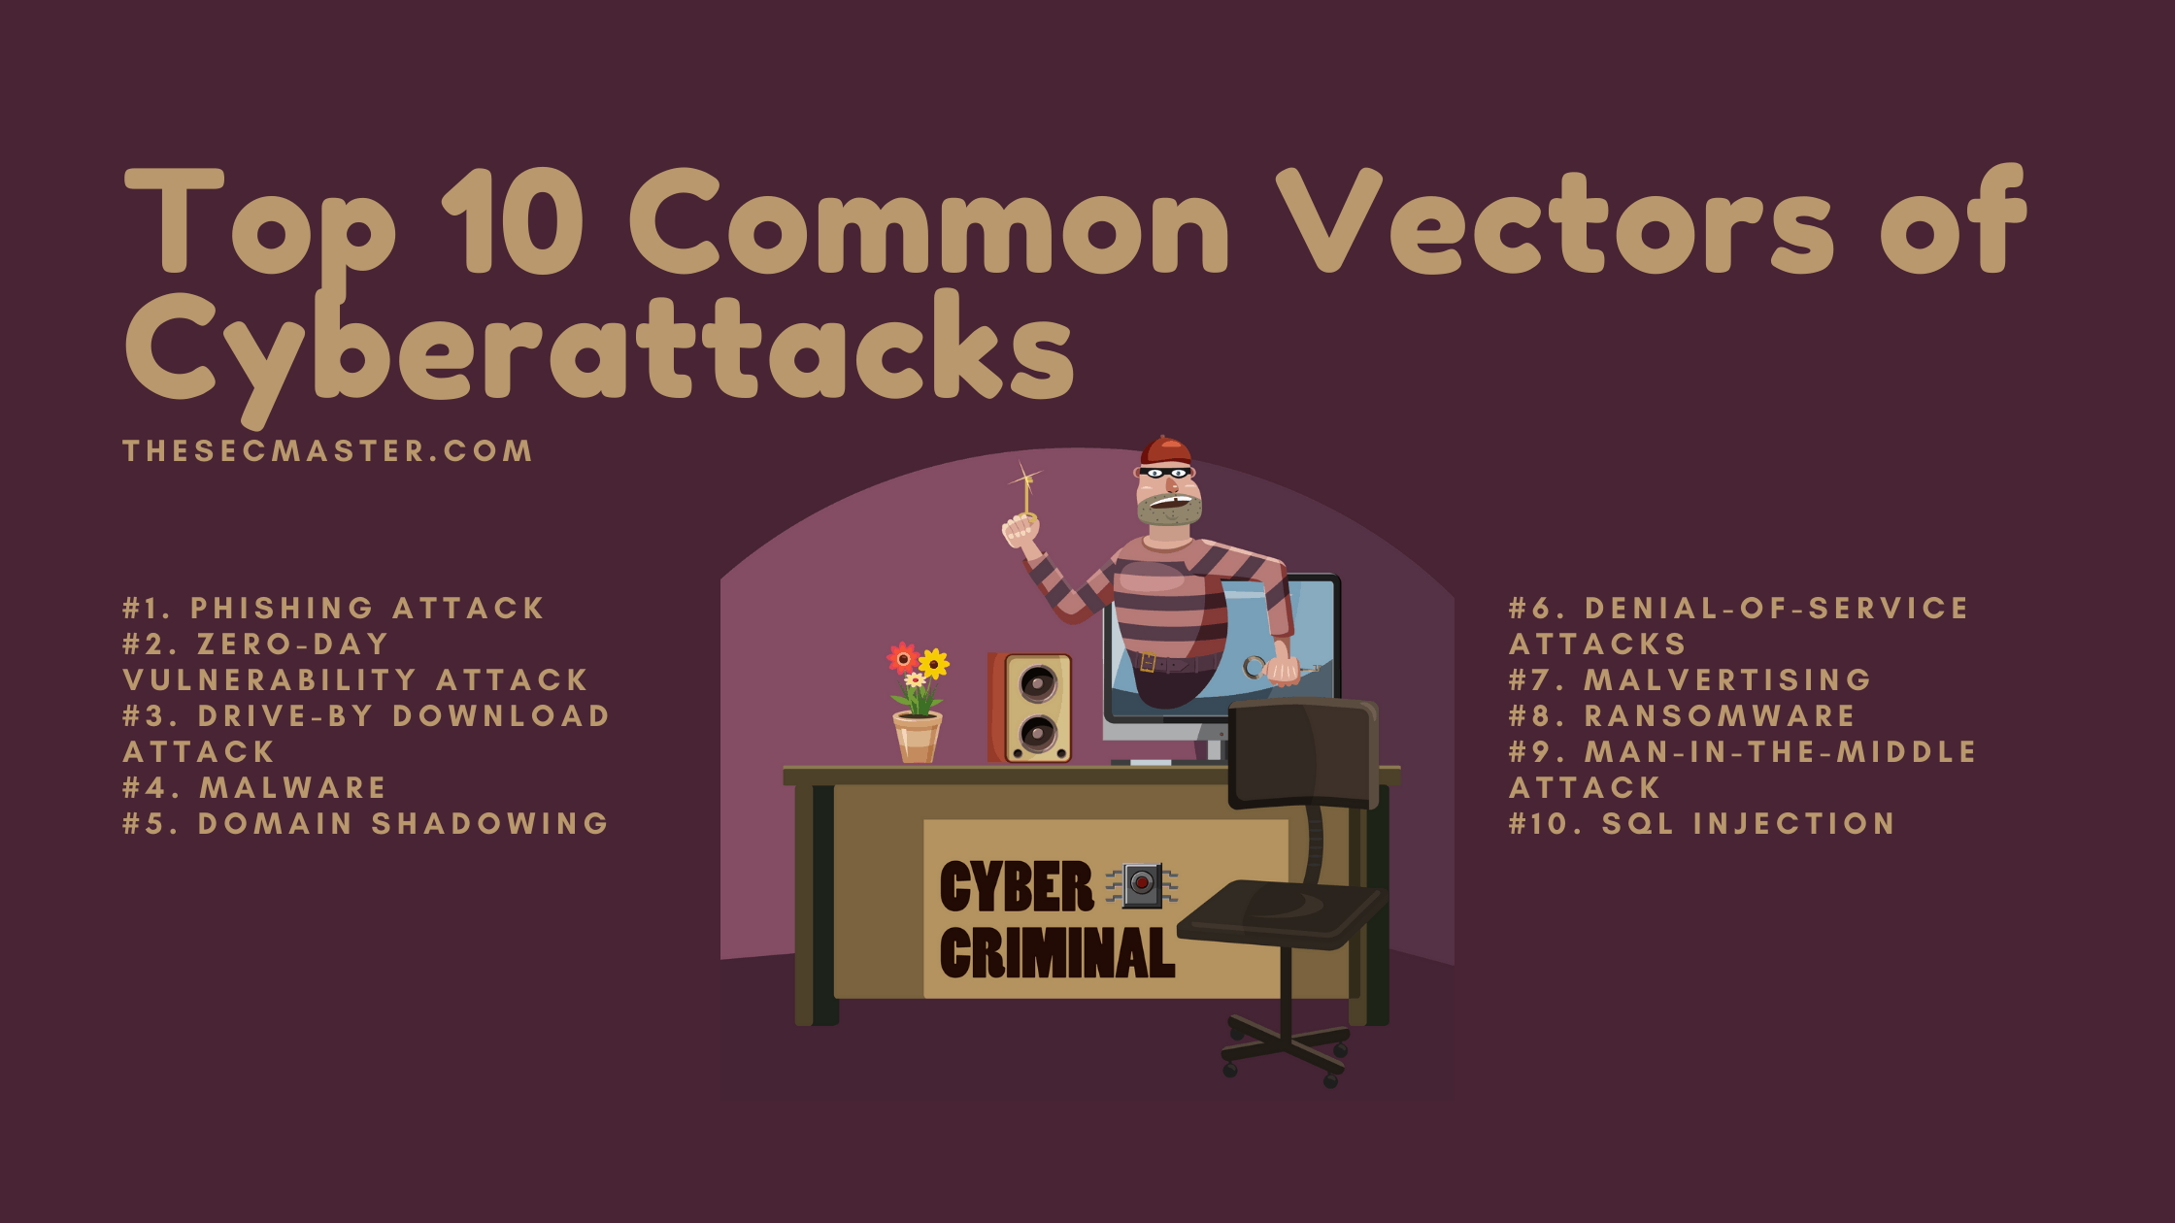
Terminologies….
Attack vector - a method of gaining unauthorized access to a network or computer system..

Slide 7
Terminologies….
Attack surface - the total number of attack vectors (vulnerabilities, pathways or methods) an attacker can use to manipulate a network or computer system or extract data.
Threat - a potential negative action or event facilitated by a vulnerability that can result in an unwanted impact to a computer system or application.
Risk - any risk of financial loss, disruption or damage to the reputation of an organisation from failure of its IT.

Slide 8
Terminologies….
Vulnerability - a weakness in a host or system that can be exploited by cybercriminals to compromise an IT resource and advance the attack path. Types are network, operating system, human and process vulnerabilities.
Exploit - a code that takes advantage of a vulnerability to cause unintended or unanticipated behavior on the computing resources. Exploits can be Known or Unknown.

Slide 9
Terminologies….
Exploitation - the act of monitoring and related espionage on computer systems and copying of data on these systems.
E.g. non-consensual distribution or publication of intimate photos or videos online.
It is different from cyber attack which intends to affect the normal functioning of the computer.

Slide 10
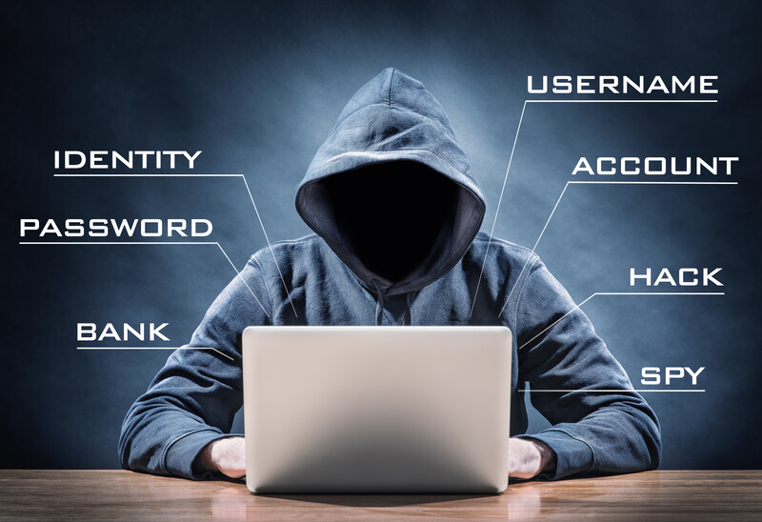
Terminologies….
Hacker - an individual with technical computer skills but often refers to individuals who use their skills to breach cybersecurity defenses.
They often use their technical knowledge to achieve a goal or overcome an obstacle by non-standard means
Read about Kevin David Mitnick, the World’s No.1 Hacker

Slide 11
Types/Pillars of Cyber Security
Network Security
Most attacks occur over the network. Network security solutions are designed to identify and block these attacks.
Cloud Security
As organizations increasingly adopt cloud computing, securing the cloud becomes a major priority.
Endpoint Security
Another point of attack can be on end-user devices such as desktops and laptops

Slide 12
Types/Pillars of Cyber Security…
Mobile Security
Mobile devices such as tablets and smartphones have access to corporate data, exposing businesses to threats from malicious apps, zero-day, phishing, and IM (Instant Messaging) attacks, jailbreaking (iOS) and rooting (Android).
IoT Security
While using Internet of Things (IoT) devices expose organizations to new cyber threats. Threat actors seek out vulnerable devices connected to the Internet as a pathway into a corporate network or for another bot in a global bot network.
Notes:
Jailbreaking or rooting means removing software restrictions that are intentionally put in place by the device manufacturer.
Rooting is the term used for modifying Androids while jailbreaking is the term used for iPhones.

Slide 13
Types/Pillars of Cyber Security…
Application Security
Web applications are targets for threat actors. Threats to critical web application security flaws include SQL injection, broken authentication, misconfiguration, and cross-site scripting etc.
Zero Trust
The traditional security model is perimeter-focused, building walls around an organization’s valuable assets.
This has several issues, such as the potential for insider threats and breakdown of the network perimeter.
Additionally people now work remotely.
Notes:
API - Application Programming Interface

Slide 14
Types of Cyber attackers
Cyber attackers present themselves in different forms based on their motivation and methodology of attack. They can be broadly classified as:
1. Recreational Cyber Attackers - the main motive behind them is fame and notoriety. They have limited resources and know which vulnerability to exploit.
2. Script kiddies Cyber Attackers - amateurs who learn from the internet and use available tools to crack a system. They are harmless with less skill and do not cause heavy damage to the system.

Slide 15
Types of Cyber attackers…
3. Cyber Criminals Cyber Attackers - constitute an individual or a group of individuals whose aim is to exploit sensitive information of the user. They either capture the system and/or the data for financial gains.
4. Hacktivists Cyber Attackers - perform malicious and fraudulent tasks to promote a political agenda. Hacktivism is a digital disobedience undertaken for a cause. Hacktivists fight for justice and do not go behind financial gains. Sometimes they pair up with malicious insiders to expose sensitive data.

Slide 16
Types of Cyber attackers…
5. State-sponsored Cyber Attackers - have specific goals associating with either the political or military origin of their country. They use unlimited resources and highly sophisticated technologies. They often cause advanced persistent threats. E.g.s are Cyberwars, industrial espionage, and leaking state secrets.
6. Insider threats Cyber Attackers - come from within an organization and pose a threat to the security company data. Mainly from disgruntled employees, former employees, temporary workers and customers.

Slide 17
Types of Cyber attackers…
Insider threats are of the following types: Malicious Insider Threats, Accidental Insider Threats and Negligent Insider Threats.
7. Organized Crime Cyber Attackers - cybercrime organisations with groups of hackers, programmers and other tech bandits who combine their skills and resources to commit major crimes that might otherwise be impossible when alone.

Slide 18
Types of Cyber attackers…
8. Hackers - possess the technical skills to breach the data by exploiting any vulnerability in the system or network. They have the skills to gain unauthorized access to your system. Classified into 3 types based on their intent:
White hat hackers – ethical hackers used to identify the weakness of the network.
Gray hat Hackers – crack the security without causing harm just to inform the organisation later.
Black hat Hackers - unethical hackers who hack the system and networks and misuse it for personal benefits.

Slide 19
Types of Cyber attackers…
9. Nation-State Actors or Cyberterrorists - work directly or indirectly for the government and other vital businesses that run critical infrastructures like power grids. They aim to steal highly sensitive information, damage opponent’s facilities, or launch an international incident. They employ sophisticated attacking techniques

Slide 20
How to deceive Cyber Attackers
Conceal valuable data in files to distract the attacker.
Camouflage your infrastructure by changing the address and topologies regularly.
Confuse the attacker with false information like fake assets to exploit.
Gain actionable insights from your cybersecurity advisory.
Make use of technologies like intrusion prevention systems and firewalls to safeguard the information.

Slide 21
Cyber security increasing threat landscape
The cyber threats of today are not the same as even a few years ago.
As the cyber threat landscape changes, organizations need protection against cybercriminals’ current and future tools and techniques.
As cyberattacks become more common and sophisticated and corporate networks grow more complex, a variety of cyber security solutions are required to mitigate corporate cyber risk.

Slide 22
Evolution of Cyber Attacks
Gen 1 – Late 1980s, Gen 2 – Mid 1990s, Gen 3 – Early 2000s, Gen 4 – Approx 2010, Gen 5 – Approx 2017
Notes:
IPS – Intrusion Prevention Systems
Sandboxing is the practice of isolating a piece of software so that it can access only certain resources, programs, and files within a computer system, so as to reduce the risk of errors or malware affecting the rest of the system.

Slide 23
Cyber security increasing threat landscape
Detection is no longer “good enough”. Focus must shift to prevention.
There is need for a Consolidated Cyber Security Architecture.
Sophisticated Attacks: no longer detected with legacy approaches to cyber security.
More in-depth visibility and investigation is necessary to identify campaigns by advanced persistent threats (APTs) and other sophisticated cyber threat actors.

Slide 24
Cyber security increasing threat landscape
Complex Environments: includes both on-premise infrastructure and multiple cloud environments.
Heterogeneous Endpoints: desktops, laptops and bring your own device (BYOD) policies.
Rise of Remote Work: now, organizations need solutions that allow them to effectively protect the remote workforce as well as.

Slide 25
Cyber warfare
It involves the actions by a nation-state or international organization to attack and attempt to damage another nation's computers or information networks.
The objective of cyberwarfare is to “weaken, disrupt or destroy” the target nation-state
It can cause electrical blackouts, failure of military equipment, and breaches of national security secrets, theft of valuable, sensitive data, disruption of phone and computer networks, death etc.

Slide 26
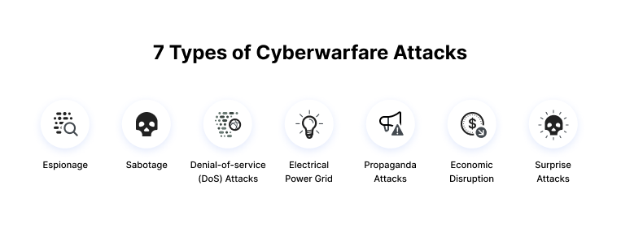
Types of Cyber warfare
Source: Imperva

Slide 27
Types of Cyber warfare…
Espionage: monitoring other countries to steal secrets e.g. through botnets or phishing.
Sabotage: using insider threats to attack.
Denial-of-service (DoS) Attacks: preventing legitimate users from accessing a website by flooding it with fake requests and forcing the website to handle these requests. Done to disrupt critical operations and systems and block access to sensitive websites by civilians, military and security personnel etc.

Slide 28
Types of Cyber warfare…
Electrical Power Grid attacks: allows attackers to disable critical systems, disrupt infrastructure, and potentially result in bodily harm.
Propaganda Attacks: Attempts to control the minds and thoughts of people living in or fighting for a target country. Propaganda can be used to expose embarrassing truths, spread lies to make people lose trust in their country, or side with their enemies.

Slide 29
Types of Cyber warfare…
Economic Disruption: target computer networks of economic establishments to steal money or block people from accessing the funds they need.
Surprise Attacks: to carry out a massive attack that the enemy isn’t expecting, enabling the attacker to weaken their defenses. This can be done to prepare the ground for a physical attack in the context of hybrid warfare.

Slide 30
Cyber terrorism
Often defined as any premeditated, politically motivated attack against information systems, programs and data that causes fear, threatens violence or results in violence.
Often done using Ransomware and Phishing attacks

Slide 31
Critical IT and National Critical Infrastructure
Every nation has some critical IT and national critical infrastructure that must remain running for the proper functioning of that nation.
Critical infrastructure security is the area of concern surrounding the protection of systems, networks and assets whose continuous operation is deemed necessary to ensure the security of a given nation, its economy, and the public's health and/or safety.

Slide 32
National Critical Infrastructure
Source: Huntsman Security

Slide 33
Critical Infrastructure Protection Process
It encompasses the physical, human and cyber layers.
Process entails
Identifying critical infrastructure
Identifying and assessing vulnerabilities
Analysing and prioritizing infrastructure
Implementing protective programs.
Measuring effectiveness

Slide 34
Critical IT and National Critical Infrastructure
It is prudent for nations to secure their IT infrastructure to ensure security of all the other national critical infrastructure

Slide 35
Cyber Resilience
Source: World Economic Forum

Slide 36
Case studies of Cyber warfare
A popular example of the economic disruption because of cyber warfare is the 2017 attack in Ukraine and on the UK National Health Service. The cyber warfare appeared to be ransomware but it caused high-scale damages to organizations

Slide 37
Case Studies…
Stuxnet Virus: Stuxnet was a worm that attacked the Iranian nuclear program. It is among the most sophisticated cyber attacks in history. The malware spread via infected Universal Serial Bus devices and targeted data acquisition and supervisory control systems. According to most reports, the attack seriously damaged Iran’s ability to manufacture nuclear weapons.

Slide 38
Case Studies…
Sony Pictures Hack: An attack on Sony Pictures followed the release of the film “The Interview”, which presented a negative portrayal of Kim Jong Un. The attack is attributed to North Korean government hackers. The FBI found similarities to previous malware attacks by North Koreans, including code, encryption algorithms, and data deletion mechanisms.

Slide 39
Case Studies…
Enemies of Qatar: Elliott Broidy, an American Republican fundraiser, sued the government of Qatar in 2018, accusing it of stealing and leaking his emails in an attempt to discredit him. The Qataris allegedly saw him as an obstacle to improving their standing in Washington. The brother of the Qatari Emir was alleged to have orchestrated a cyber warfare campaign, along with others in Qatari leadership. 1,200 people were targeted by the same attackers, with many of these being known “enemies of Qatar”, including senior officials from Egypt, Saudi Arabia, the United Arab Emirates, and Bahrain.

