Slide 1
Rendering Methods

Slide 2
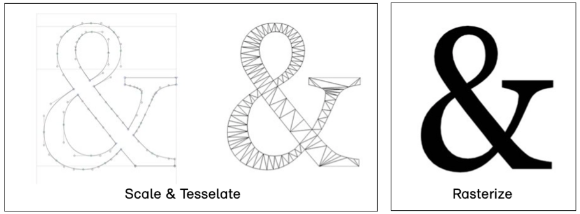
Rendering methods refer to the techniques and algorithms used to convert 3D models and scenes into 2D images that can be displayed on a screen or output as a final visual representation. Rendering is a fundamental process in computer graphics and is responsible for generating realistic and visually appealing images or animations.

Slide 3
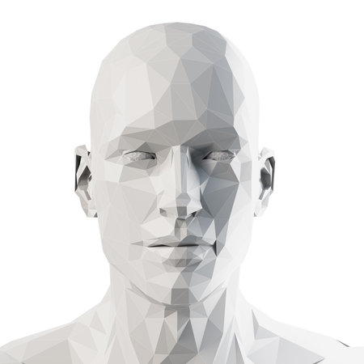
Rendering methods

Slide 4
Common Rendering Methods
Scanline Rendering: In scanline rendering, the 3D scene is rasterized one horizontal line (scanline) at a time. Each scanline is divided into small segments, and the renderer determines which objects or textures cover each segment.
Ray Tracing: Ray tracing simulates the behavior of light rays in the scene. Rays are cast from the camera through each pixel on the screen, and the renderer traces the paths of these rays to calculate the color and illumination of each pixel.

Slide 5
Common Rendering Methods..continu
Rasterization (Real-Time Rendering): Rasterization is a fast and efficient method used in real-time rendering, commonly used in video games. It involves projecting 3D objects onto a 2D screen space and determining the pixels covered by each object.
Global Illumination: Global illumination methods, such as radiosity and photon mapping, simulate indirect lighting and light interactions, creating more realistic and natural-looking scenes.
Volume Rendering: Volume rendering is used to visualize volumetric data, such as medical scans or scientific simulations, by sampling and rendering the 3D volume of the data.

Slide 6
Applications of Rendering Methods
Video Games: Rendering methods are essential for real-time rendering of video game graphics, creating immersive and interactive experiences for players.
Film and Animation: High-quality rendering methods are used in CGI (Computer-Generated Imagery) to produce realistic visual effects and animated scenes in movies and animations.
Architectural Visualization: Rendering methods are employed to create lifelike visualizations of architectural designs, allowing clients to visualize buildings before construction.

Slide 7
Applications of Rendering Methods..continu
Product Design: Rendering techniques are used to showcase product designs and prototypes with realistic lighting and materials for marketing and presentations.
Scientific Visualization: Rendering is used in scientific fields to visualize complex data and simulations, aiding researchers in understanding their results.

Slide 8
Advantages of Rendering Methods
Realism: Advanced rendering methods can produce highly realistic and visually appealing images, enhancing the quality of visual content.
Visualization and Communication: Rendering enables clear communication of complex ideas and designs through visual representations.
Creative Expression: Artists and designers can use rendering methods to bring their creative visions to life, exploring different lighting, materials, and styles.

Slide 9
Advantages of Rendering Methods..continu
Interactive and Real-Time: Real-time rendering methods allow for interactive and responsive experiences in video games and virtual environments.
Simulation and Analysis: Rendering can be used in scientific and engineering simulations to visualize data and analyze results effectively.

Slide 10
Disadvantages of Rendering Methods
Computational Complexity: Advanced rendering methods, such as global illumination or ray tracing, can be computationally intensive and require significant processing power.
Time-Consuming: High-quality rendering can take a long time, especially for complex scenes, animations, or high-resolution images.
Artifacts and Noise: Some rendering methods may produce visual artifacts or noise, which can require additional post-processing to clean up.

Slide 11
Disadvantages of Rendering Methods..continu
Learning Curve: Mastering advanced rendering techniques and software can be challenging and require specialized knowledge and training.
Hardware Requirements: High-quality rendering may necessitate powerful hardware, which can be costly.

