Slide 1
TRANPORT AND POLICIES ANALYSES

Slide 2
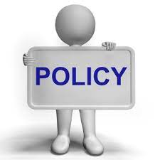
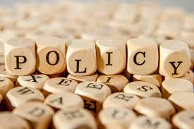
DEFINITION OF CONCEPTS
A policy refers to a plan of action adopted or pursued by an individual, government, party, business, etc ·

Slide 3
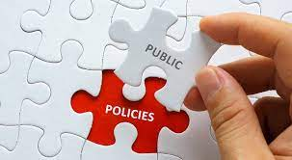
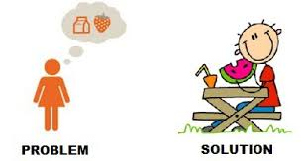
Public policy:- is what the government chooses to do (actual) or not do (implied) about a particular issue or problem.
Public policy is a collection of laws and regulations used to maintain order or solve a social problem.
Public policy is a set of laws, guidelines, and actions decided and taken by governments in order to work in favor of the public.

Slide 4
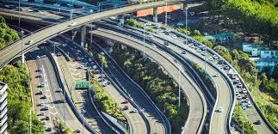
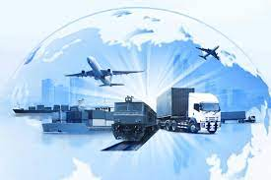
Transport Policy refers to a policy which decides the distribution of transport resources and plans their implementation.
Transport policy is about making decisions on how to use transportation resources.

Slide 5
Policy Analysis is the process of identifying potential policy options that could address a given problem and then comparing those options to choose the most effective, efficient, and feasible one.
Policy analysis refers to the process through which policy solutions to social problems and public health issues are identified, analyzed, and presented to policymakers for consideration.

Slide 6
Policy formulation involves coming up with solution that solves a problem.
Policy formulation is therefore;
reflects the values the society has towards the status of transport, environment etc.;
is a precondition for the evaluation of transport measures and transport investment.
NB: Strategy generally involves setting goals and priorities, determining actions to achieve the goals, and mobilizing resources to execute the actions.

Slide 7
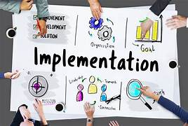
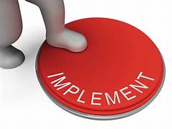
Policy implementation involves a series of activities/programmes undertaken by government and others to achieve the goals and objectives articulated in policy statements.
NB: It is essential that implementation also comprises the analysis of social and political acceptability of measures and the sensitivities of citizens, politicians, journalists and experts for objectives and programs before, during and after implementing transport measures.
Public awareness campaigns as well as the installation of a permanent marketing procedure may help to enhance the acceptability of transport policies or single measures.
NB:Sentivity means that you consider the feelings of others.

Slide 8
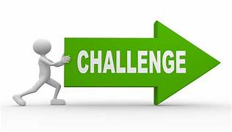
REASONS FOR DEFICIENCIES IN TRANSPORT POLICY IMPLEMENTATION
Lack of Political Will to fight Road Carnage
Poor Infrastructure especially for pedestrians
Motorcycles being used for Pubic Transport driven by untrained or ill-trained riders
Driver discipline (Lack of patience, inconsiderate use of the roads, outright defiance of all traffic rules)
Inadequate funding for all government departments tasked with policy implementation e.g managing road crashes.

Slide 9
Classification of transport policies
Transport Infrastructure investments:-Investments entail building new transport infrastructure (for example roads, railways, or airports), upgrading existing links and technology, or improving transport services.
Transport Price instruments:-Price incentives that include subsidies or taxes to influence mode choice and transport behavior more generally (for example, student fare reductions, tolls, parking fares, fuel taxes, and clean transport subsidies).
Transport Regulations:- The transportation sector is subject to varying degrees of government regulation depending on mode and geography.

Slide 10
FEATURED INVESTMENT PROJECTS
Kampala Capital City Authority is proposing the introduction of an Urban Cable Car (Ropeway Vehicle) system. This technology is envisioned to achieve high order objectives such as; reduction in pollution (air and noise), traffic decongestion, improvement in transit connectivity, beautification of the urban environments, and development of a reliable and highly profitable transportation means
KAMPALA CABLE CAR PROJECT

Slide 11
Bus rapid Transit (BRT) is a high quality mass public transport system based on buses using existing roads. BRT can be fast, reliable, frequent and comfortable; it has the characteristics of an urban railway service at a fraction of the cost.
KLA BUS RAPID TRANSIT

Slide 12
Ports around the world are currently dredging their ship channels and investing heavily in the necessary infrastructure in order to meet current and future demand on navigation. The potential benefit is characterized not only by increasing port competitiveness
PORT AT L.VICTORIA

Slide 13
LEVELS FOR POLICY FORMULATION
Policy Formulation is most important at higher strategic levels but has to be considered at each level of a transport planning process:
Strategic policies in transport cover a larger area and include long-term strategies. These policies have to be far sighted and consequently implemented.
Regional and local transport policies are applied on regions and small areas (towns, villages, etc.), following the overall principles of a general concept – however on a smaller scale.
NB: Strategic transport policy includes general ideas and principles and is therefore easily based on a consensus. It should, however, include goals which are to be met in the future as well as a set of measures to achieve these goals.

Slide 14
OBJECTIVES OF TRANSPORT POLICIES
(i) to stimulate growth (for example, through lower transport costs that improve trade and productivity).
(ii) to facilitate social inclusion (for instance, through better access to transport services, which can enhance economic opportunities for every one including the poor)
(iii) to improve sustainability (for example, through reduced environmental externalities).

Slide 15
TRANSPORT POLICY FRAMEWORK
The transport sector policy framework typically includes:
A national transport strategy
A national transport policy e.g the national transport and logistics policy
A transport master plan e.g National Transport Master Plan Including a Transport Master Plan for Greater. Kampala Metropolitan Area (NTMP/GKMA) s
These become operational through the implementation of a set of transport development programs and projects.

Slide 16
A national transport strategy
Involves Government developing a vision of where it wants the transport sector to be in the long term/future, and the strategic direction required to get there.
Strategic directions refers to actions that need to be taken in order to achieve the vision.
Or
Strategic direction is the set of activities and decisions required to be made in order to achieve the goals and objectives.

Slide 17
Where we want to see Kampala as per Vision 2040
(Source National Planning Authority)

Slide 18
Where we want to see Kampala as per Vision 2040
(Source National Planning Authority)

Slide 19
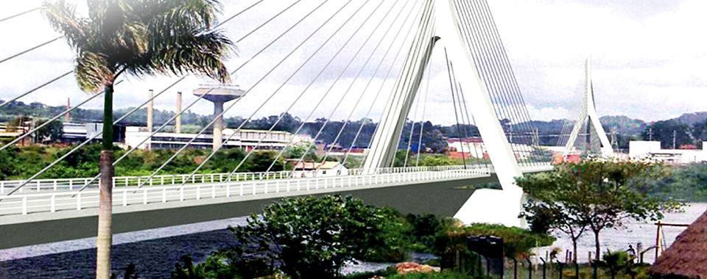
Modern bridges
(Source National Planning Authority)

Slide 20
Car factory
(Source National Planning Authority)

Slide 21
Masaka interchange

Slide 22
A national transport policy
National transport policy e.g National Transport and Logistics policy provides guidelines and principles that enable the achievement of the established transport vision.

Slide 23
Examples of Transport policies and action point(activities to be taken)
Policy Thrust 4: Advance towards a green transport ecosystem
Policy thrust 1:Advance towards a green transport ecosystem
Enforce compliance to acts/regulations and shift towards international environmental standards e.g ISO 14000 etc
Prioritize public transport network as fundamental structure in charting out sustainable spatial and transportation growth in urbanized areas
Accelerate implementation of low carbon mobility initiatives
Institute measures to control pollution, noise and waste from the transport sector
Develop effective communication, education and public awareness (CEPA) to create behavioral change towards practices of sustainable transport

Slide 24
Policy Thrust 2: Expand global foot print and promote internationalization of transport services
S1:Create an environment that facilitates local transport industry operators to become regional or global players
S2.Facilitate regional cooperation and agreements that improve the transport industry.
Policy Thrust3: Build and maintain the use of transport infrastructure, services and networks to maximise efficiency
S1.Increase the utilization of the various transport modes
S2. Continuous maintenance of the transport infrastructure

Slide 25
National Master Plan
A national master plan sets the medium term strategic direction, and development priorities.
NB: Strategic direction refers to a set of activities and decisions required to be made in order to achieve the goals and objectives.

Slide 26
CHARACTERISTICS OF GOOD POLICIES
Specific, relevant and applicable to the target audience e.g a policy targeting motorists e.g the traffic and road safety policy, hauling firms e.g load limit regulations e.t.c.
Policies need to be in plain and understandable language so that they are easy to read and understand.
Policies need to be in line with the latest laws and rules e.g the 1995 constitution, Local Government Act and Regulations, Kampala Capital City Authority Act 2010 and Regulations
Policies need to be clear on what the target audience can and cannot do e.g not driving when drank.
Etc

Slide 27
Common features of transport policies
Inclusion of all affected parties (transport operators, transport users, politicians, etc.);
Inclusion of all affected aspects (transport, modes of transport, health, environment, social policies, trade, etc.);
Approval of a majority (voters, experts, etc.);
Strategic view and their implementation is over longer term periods
Possibilities to (re)adjust the policies based on feedback and evaluation, etc.

Slide 28
THE END

