Slide 1
MAKERERE UNIVERSITY MAKERERE UNIVERSITY BUSINESS SCHOOL FACULTY OF COMPUTING AND INFORMATICS DEPARTMENT OF APPLIED COMPUTING AND IT
BACHELOR OF SCIENCE IN ACCOUNTING, YEAR ONE (BUC 1107)
SEMESTER: ONE, ACADEMIC YEAR: 2024/25.
PRINCIPLES OF INFORMATION COMMUNICATION TECHNOLOGY
Facilitators: Dr.Sumaya M Kagoya, and Mr. Nasser Wangubo.

Slide 2
Outline
Introduction to ICT and Key Concepts
ICT business Trends
ICT Hardware Components
ICT Software Components
Systems theory
The Internet

Slide 3
Introduction to ICT and Key Concepts
Definition of ICT, IS, IT:
Importance of ICT/IS/IT
Data and Information:
Data Processing:
Digital Literacy and Digital Citizenship
Uganda ICT Sector:
ICT for Sustainable Development Goals (ICT4SDGs):

Slide 4
Introduction to ICT and Key Concepts
Definition of ICT, IS, IT
Data and Information
Data Processing
Digital Literacy and Digital Citizenship
Uganda ICT Sector
ICT for Sustainable Development Goals (ICT4SDGs)

Slide 5
ICT defined
ICT is being defined by many scholars & technology specialists as consisting of hardware, software, telecommunications, database management, & other information processing technologies used in computer-based information systems.
It involves the dynamic interaction of computer based information systems while telecommunications forms the backbone of ICT.
Why is telecommunications considered the backbone of ICT?
Notes:
ICT is concerned with the storage, retrieval, manipulation, transmission or receipt of digital data

Slide 6
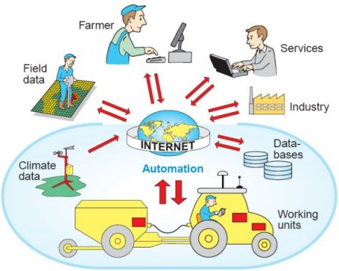
ICT

Slide 7
ICT Consists of…
IT
telephony,
broadcast media,
all types of audio and video processing and transmission and network based control and monitoring functions.

Slide 8
Information Technology (IT) Defined
An acronym that stands for information technology
IT is the use of computer hardware and computer software to convert, store, protect, process, transmit, and retrieve information.
IT involves the acquisition, processing, storage and dissemination of vocal, pictorial, textual and numerical information.

Slide 9
Information System (IS) defined
Information system is defined as any organized combination of people, hardware, software, communications network, and data resources to perform the activities of input, processing, output, and control activities that collect, transform data resources into information products in an organization or disseminates information in an organization.
Just visualize the types of IS in your locality.

Slide 10
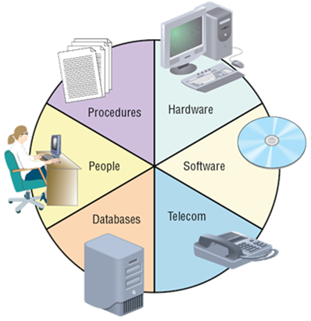
Information Systems

Slide 11
Introduction to ICT and Key Concepts
Definition of ICT, IS, IT:
Importance of ICT/IS/IT
Data and Information:
Data Processing:
Digital Literacy and Digital Citizenship
Uganda ICT Sector:
ICT for Sustainable Development Goals (ICT4SDGs):

Slide 12
Importance of IT in different Business/ Reasons for studying ICT in the University
To ensure ICT supports the organization’s corporate strategy.
To identify strategic competitive advantage opportunities.
Ensure linkage between business and ICT.
Provide leadership for ICT projects.

Slide 13
Strategic Uses of ICT / IS
Improving Business Processes and Cost Reduction.
Promote Business Innovation.
Locking in Customers and Suppliers.
Creating Switching Costs.
Raising Barrier to Entry.
Leveraging a Strategic IT Platform.
Developing a Strategic Information Base.
Training. Aids in training and retaining workers using multimedia.

Slide 14
Strategic Uses of IT
Improving
Business
Process
Promote
Business
Innovation
Locking in
Customers
and Suppliers
Strategy
IT Role
Use IT to reduce costs of doing business
Use IT to create new products or services
a)Use IT to improve quality
b)Use IT to link business to customers and suppliers
Create New
Business
Opportunities
Maintain Valuable
Customers and
Relationships
Outcome
Enhance
Efficiency

Slide 15
Strategic Uses of IT Cont’
Raise
Barriers
to Entry
Build a
Strategic IT
Platform
Build a
Strategic
Information Base
Strategy
IT Role
Increase amount of investment or complexity of IT needed to compete
Leverage investment in IS resources from operational uses to strategic uses
Use IT to provide information to support firm’s competitive strategy
Create New
Business
Opportunities
Enhance
Organizational
Collaboration
Outcome
Increase
Market Share

Slide 16
Introduction to ICT and Key Concepts
Definition of ICT, IS, IT
Data and Information
Data Processing
Digital Literacy and Digital Citizenship
Uganda ICT Sector
ICT for Sustainable Development Goals (ICT4SDGs)

Slide 17
Data defined
Data are raw facts, unprocessed facts or observations, typically about physical phenomena or business transactions.
Data can be stored, transmitted, and presented in an infinite variety of forms and formats, including numeric, alphabetic, alphanumeric, image, audio, video and electronic pulses etc.
Examples of data might include; registration numbers of students at MUBS, account balances of a company’s debtors etc

Slide 18
Why Data is Critical
TPS for gathering about internal operations and corporate data bases to support planning and control activities.
Data and information about each transaction has to be recorded so that the business can be properly managed.
At the planning stage, data and information is important as a key ingredient in decision making.

Slide 19
Cont’ Why Data is Critical
Organizations engage in EDI. These data become input to the TPS and may be used to update corporate databases.
Data is used as the main way of measuring performance in order for a business to succeed.
In order to monitor progress against the plan and control resources, we need data.

Slide 20
Information defined
Information can be defined as data that have been converted into meaningful and useful context for specific end users.
It is processed data which has been placed in a context that gives it value for specific end users.
Data are raw facts, unprocessed facts or observations, typically about physical phenomena or business transactions.
Examples of data and information in business/Office environment.
Notes:
Data is the collection of raw facts and figures. It is without any proper meaning. Data may be collection of words, numbers, graphics or sounds.
Students data on admission, Data of Citizens, Survey Data, Students Examination Data.
Information: Processed data is called information. When raw facts and figures are processed and arranged in some order then they become information. Information has proper meanings. Information is useful in decision-making.
Student results slip, Census report, survey reports etc

Slide 21
Information Products & Information Quality
Information product: Information product is the degree to which information has the appropriate information that is useful for users e.g. messages, reports, forms, & graphic images.
Information quality: Information quality is the degree to which information has content, form, and time characteristics that gives it value to specific end users.

Slide 22
Characteristics/Attributes of Information
Time Dimension: Timeliness; currency; frequency and time period.
Content Dimension: accuracy; relevance; completeness; auditability; conciseness and performance.
Form Dimension: clarity; detail; order; presentation and media.

Slide 23
Elements/Aspects of Information Quality or Characteristics / Qualities of a good information.
Accurate for purpose; managers rely on information to effectively manage their 'value-adding' activities and free of errors.
Currency, that is, information should be up-to-date when it is provided.
Communicated in an appropriate channel; for a manager to use information effectively it must be transmitted in the communication process.

Slide 24
Qualities Cont’
Understandable; managers can only use information to good effect if they understand its purpose.
Relevance for purpose; information should always be relevant to the issue being considered.
Auditability; that is, auditability of data refers to the ability to verify the accuracy and completeness of the data.

Slide 25
Qualities Cont’
Timely; for effective decisions to be taken, information needs to be reported to management on a timely basis.
Ease to understand or clarity, that is, information should be provided in a form that is easy to understand.
Completeness; it is desirable that all information required for decision making is made available.

Slide 26
Qualities Cont’
Communicated to the right person; managers have a clear & defined level of responsibility & must achieve their predetermined objectives.
Cost-effective; the costs of providing the information must not outweigh the 'value-added' benefits derived from its use.
Others include: frequency, reputable source, volume, conciseness, performance, detail, order, presentation, scope and media etc.

Slide 27
Introduction to ICT and Key Concepts
Definition of ICT, IS, IT
Data and Information
Data Processing
Digital Literacy and Digital Citizenship
Uganda ICT Sector
ICT for Sustainable Development Goals (ICT4SDGs)

Slide 28
Data Processing defined
Data processing is the process of producing meaningful information by collecting all items of data together and performing operation on them to extract the required information about them.
The major types of data processing modes today are batch processing, distributed, centralized and real-time or online processing modes.

Slide 29
Data Processing Cycle / Process
Origination of data which looks at the sources of data e.g. customer orders; goods received notes, price lists, etc.
Preparation of data; that is, getting the data ready for input e.g. thru sorting, editing, etc.
Input of data which is the act of passing the data to the processor in the processing stage. This could be by the clerk on the computer through the use of the keyboard.

Slide 30
Data Processing Cycle / Process Cont’
Processing which includes all the necessary operations to arrive at the end-product (information) and to keep data up to-date.
Lastly, output which involves the production of the end product e.g. annual reports, financial statements, payroll, etc.

Slide 31
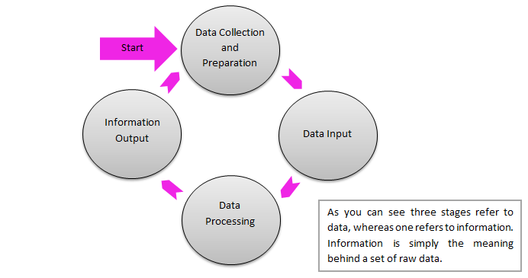
Data Processing Cycle / Process diagram

Slide 32
Introduction to ICT and Key Concepts
Definition of ICT, IS, IT
Data and Information
Data Processing
Digital Literacy and Digital Citizenship
Uganda ICT Sector
ICT for Sustainable Development Goals (ICT4SDGs)

Slide 33
Digital Literacy
An individual's ability to find, evaluate, and compose clear information through writing and other mediums on various digital platforms.
Gilster (1997) defined Digital Literacy as “ability to understand and use information in multiple formats from a wide range of sources when it is presented via computers”

Slide 34
The American Library Association's digital-literacy task force offers this definition: "Digital literacy is the ability to use information and communication technologies to find, evaluate, create, and communicate information, requiring both cognitive and technical skills.
Digital literacy involves digital reading and writing techniques across multiple media forms such as words, texts, visual displays motion graphics, audio, video, and multimodal forms.,

Slide 36
Spires and Bartlett (2012) have divided the various intellectual processes associated with digital literacy into three categories: (a) locating and consuming digital content, (b) creating digital content, and (c) communicating digital content

Slide 39
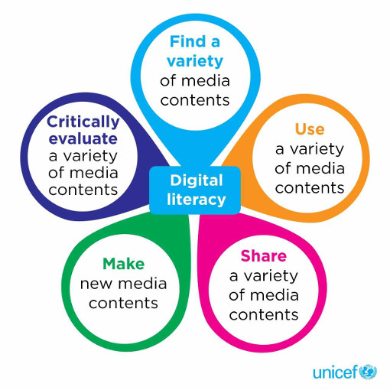

Slide 40
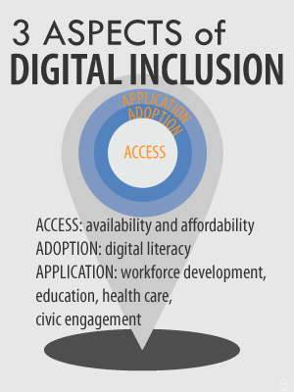
Application of Digital Literacy

Slide 41
In Education:
Schools and Higher Institutions of Learning are continuously updating their curricula to keep up with accelerating technological developments
Schools use of eLearning platforms to teach curricula, and course materials being made available to students online
Students are taught how to verify credible sources online, cite web sites, and prevent plagiarism.

Slide 42
Digital Writing
Digital writing is a pedagogy being taught increasingly in universities.
The goal of teaching digital writing is that students will increase their ability to produce a relevant, high-quality content

Slide 43
In society
Digital literacy is necessary for the correct use of various digital platforms.
With the emergence of social media, digital literacy ushered in a new type of journalism that is subjective, personal, and "represents a global conversation that is connected through its community of readers."

Slide 44
In the workforce
Those who are digitally literate are more likely to be economically secure, as many jobs require a working knowledge of computers and the Internet to perform basic tasks.
Many jobs today require proof of digital literacy to be hired or promoted.

Slide 45
Digital citizenship
Digital citizenship can be defined as the norms of appropriate, responsible behavior with regard to technology use.
A digital citizen refers to a person utilizing information technology (IT) in order to engage in society, politics and government.
K. Mossberger, et al (2008) define digital citizens as "those who use the Internet regularly and effectively".

Slide 46
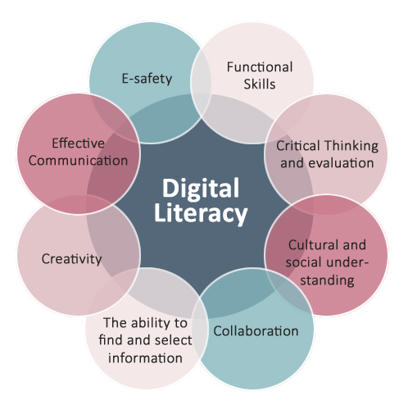

Slide 47
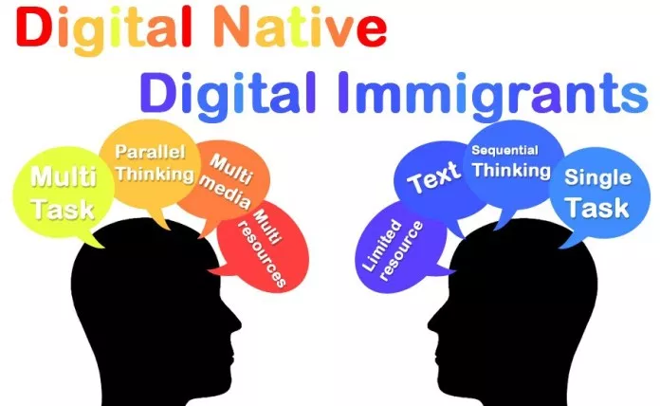
Digital natives and digital immigrants
Digital Native: An individual born into the digital age
Digital immigrant: An individual who adopts technology later in life.

Slide 48
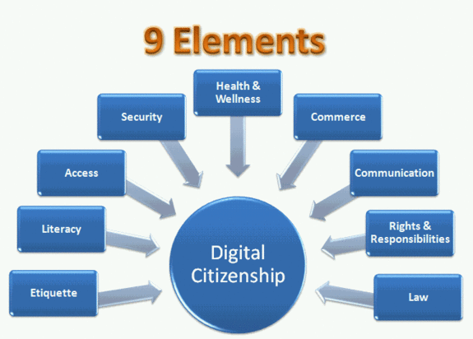
Nine Themes of Digital Citizenship

Slide 49
1. Digital Access: Full electronic participation in society
Technology users need to be aware that not everyone has the same opportunities when it comes to technology (Digital Exclusion).
Helping to provide and expand access to technology should be goal of all digital citizens.

Slide 50
2. Digital Commerce: Electronic buying and selling of goods
A large share of market economy is being done electronically, both legal and illegal
Users need to learn about how to be effective consumers in a new digital economy.
Digital citizenship encourages people to embrace digital commerce and continue to strive for safe and secure utilization of shopping, banking, and engaging in other commercial transactions.

Slide 51
3. Digital Communication: electronic exchange of information.
In the 21st century, communication options have exploded to offer a wide variety of choices (e.g., e-mail, cellular phones, instant messaging etc..).
Now everyone has the opportunity to communicate and collaborate with anyone from anywhere and anytime.

Slide 52
4. Digital Literacy: Process of teaching and learning about technology and the use of technology.
As new technologies emerge, learners need to learn how to use that technology quickly and appropriately.
Digital Citizenship involves educating people in a new way— these individuals need a high degree of information literacy skills.
As digital citizens, it is our responsibility to develop and continually enhance our technological knowledge.

Slide 53
5. Digital Etiquette: Electronic standards of conduct or procedure.
This is a real weakness among many users of today's technology.
Often rules and regulations are created or the technology is simply banned to stop inappropriate use.
It is not enough to create rules and policy, we must teach everyone to become responsible digital citizens in this new society.

Slide 54
6. Law
Digital citizens have laws that apply to behavior and interaction. There should be no stealing, no plagiarism, no abuse of others.
Many intellectual information laws are violated in this new digital age, i.e. copyright infringement and trademark abuse.

Slide 55
7. Rights and Responsibilities
The global and instantaneous nature of digital age puts enormous power into the hands of everyday citizens.
In order to keep the right to digital access, we must strive to always use it in responsible ways.
Digital Citizens must take their rights seriously and their responsibilities even more seriously, setting positive examples and helping guide the integration of technology into new areas.

Slide 56
8. Health and Wellness
The physical and psychological well being of children in the digital world is a critical issue that keeps many parents awake at nigh
It is the responsibility of parents and educators to understand the world in which children live, play and study, and they must guide them in being responsible digital citizens.

Slide 57
9. Security
Digital security is basically protecting yourself in the digital world - protecting your identity, your data, your money, etc.
Simple steps can safeguard cyber security.
Backup data regularly.
Create strong passwords
change passwords regularly.
Be aware of internet scams and do not share information with anyone that you don't know.

Slide 58
Introduction to ICT and Key Concepts
Definition of ICT, IS, IT
Data and Information
Data Processing
Digital Literacy and Digital Citizenship
Uganda ICT Sector
ICT for Sustainable Development Goals (ICT4SDGs)

Slide 59
Uganda Vision 2040
National Vision Statement, “A Transformed Ugandan Society from a Peasant to a Modern and Prosperous Country within 30 years”.
Uganda Vision 2040 aspirations are to change the country from a predominantly low income to a competitive upper middle income country within 30 years with a per capita income of USD 9,500.
Knowledge and ICT Sector is one of the opportunities targeted under Uganda Vision 2040.

Slide 60
Knowledge and ICT Sector Opportunities
ICT and ICT Enabled Services (ITES)
Job Creation
Accelerated economic growth
Increased productivity
Improved national productivity by making government and businesses more competitive.
Digital Content, e-Products, Automation, inter Agency Connectivity, innovation, commercialization etc.
Manufacturing of IT Products
Increased proportion of ICT goods to total Exports
Employment opportunities and GDP growth
Mainstreaming ICT in Education to take advantage of ICT Enabled Learning

Slide 61
ICT Opportunities con’t
Modern ICT Infrastructure all over the country
Business Process Outsourcing to promote ICT-ITES Outsourcing Businesses
Government will encourage innovation to harness the full potential of the digital economy and technology Innovation (Private & National innovation Hubs)

Slide 62
ICT Opportunities con’t
Effective interoperability of processes and/or systems across government, private sector and civil society
Government will develop platforms on which private sector can co-create with government offering new value-added services to the public
Better delivery of services, open engagement of Government and significant improvement of Government Operations

Slide 63
ICT Opportunities con’t
Development of High-tech Industry (High Tech City)
Government to attract the Worlds leading Corporations
Government will create a facility to provide specialized banking/Financing services to the technology companies based in the hubs
Legal and Regulatory framework in ICT Sector to allow for efficient operationalization, enforcement and Improvement of cyber laws, and enhance Information Security

Slide 64
Assignment:
To read Uganda Vision 2040, Section 4.1.7: Knowledge and ICT Opportunities and answer the following questions.
What challenges may hinder the attainment of Knowledge and ICT Opportunities in Uganda.
Discuss the possible solutions to the identified challenges

Slide 65
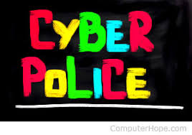
Cyber Law: What it is
Cyber law is any law that applies to the internet and internet-related technologies.
Cyber law is the area of law that deals with the Internet's relationship to technological and electronic elements, including computers, software, hardware and information systems (IS).
Also known as Internet Law.

Slide 66
Cyber Law: What it is Con’t
Cyber law is one of the newest areas of the legal system. This is because internet technology is s recent development.
Cyber Law has also been referred to as the "law of the internet.

Slide 67
Why is it important
Cyber law is important because it touches almost all aspects of transactions and activities on and concerning the Internet, the World Wide Web and Cyberspace.

Slide 68
Uganda Cyber Laws.
Computer Misuse Act 2011 (Act No. 2 of 2011)
Electronic Transactions Act 2011 (Act No. 8 of 2011)
Electronic Signatures Act 2011 (Act No. 7 of 2011)

Slide 69
Computer Misuse Act 2011 (Act No. 2 of 2011)
This makes provision for the safety and security of electronic transactions and information systems;
Prevent unlawful access, abuse or misuse of information systems including computers (and electronic devices like mobile phones)
Make provision for securing the conduct of electronic transactions in a trustworthy electronic environment

Slide 70
Importance of Computer Misuse Act
All computer operations are susceptible to computer crimes and yet the existing (2011) legal system did not recognize computer crimes thus the importance of a legislation to provide for computer crimes.
It creates several computer misuse offences e.g. unauthorized modification of computer material
Lays down mechanisms for investigation and prosecution of the offences.

Slide 71
Uganda Cyber Laws.
Computer Misuse Act 2011 (Act No. 2 of 2011)
Electronic Transactions Act 2011 (Act No. 8 of 2011)
Electronic Signatures Act 2011 (Act No. 7 of 2011)

Slide 72
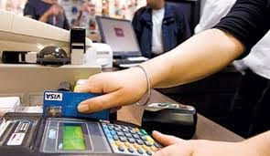
Electronic Transactions Act 2011 (Act No. 8 of 2011)
Provides for the use, security, facilitation and regulation of electronic communications and transactions;
Encourage the use of e-Government services and provide for related matters;

Slide 73
Importance of Electronic Transactions Act
The Act creates a light handed regulatory regime for electronic transactions.
It facilitates the development of e-commerce in Uganda by broadly removing existing legal impediments that may prevent a person from transacting electronically because of omission in the traditional laws.
It makes provision for functional equivalence, thus paper transactions and electronic transactions are treated equally before the law.

Slide 74
Importance Con’t
Establishes rules that validate and recognizes contracts formed through electronic means
Sets default rules for contract formation and governance of electronic contract performance
Defines the characteristics of a valid electronic writing and an original document
Supports the admission of computer evidence in courts and arbitration proceedings

Slide 75
Uganda Cyber Laws.
Computer Misuse Act 2011 (Act No. 2 of 2011)
Electronic Transactions Act 2011 (Act No. 8 of 2011)
Electronic Signatures Act 2011 (Act No. 7 of 2011)

Slide 76
What is an electronic Signature
An electronic signature, or e-signature, refers to data in electronic form, which is logically associated with other data in electronic form and which is used by the signatory to sign
An e-signature (electronic signature) is a digital version of a traditional pen and ink signature
According to current U.S. legislation and the Electronic Signature & Records Association (ESRA), eSignatures are defined as: “an electronic sound, symbol or process that is attached to or logically associated with a record and executed or adopted by a person with the intent to sign the record.”

Slide 77
Electronic Signatures Act 2011 (Act No. 7 of 2011)
This makes provision for and regulating the use of electronic signatures and provide for other related matters;

Slide 78
Importance of Electronic Signatures Act
The Act makes provision for the use of electronic signatures in order to ensure that transactions are carried out in a secure environment.
It establishes a public key infrastructure for authenticity and security of documents
Recognizes the different signature creating technologies
Provides effective administrative structures e.g. establishment of Certification Authorities

Slide 79
Assignment
Discuss the difference between Electronic Signature and Digital Signature
Discuss examples of common Cyber Crimes in Uganda.

Slide 80
Introduction to ICT and Key Concepts
Definition of ICT, IS, IT
Data and Information
Data Processing
Digital Literacy and Digital Citizenship
Uganda ICT Sector
ICT for Sustainable Development Goals (ICT4SDGs)

Slide 81
ICT for Sustainable Development Goals (ICT4SDGs)
The Sustainable Development Goals (SDGs)/Global Goals, are a universal call to action to end poverty, protect the planet and ensure that all people enjoy peace and prosperity.

Slide 82
These 17 Goals are based on the Millennium Development Goals, with additional emphasis on climate change, economic inequality, innovation, sustainable consumption, peace and justice.

Slide 84
ICT4SDGs
ICTs form the backbone of today's digital economy and have enormous potential to fast forward progress on the SDGs and improve people's lives in fundamental ways.
“ICTs are the main enablers that will accelerate the achievement of all 17 Sustainable Development Goals (SDGs), and the voices of people must be included”, Majed Sultan Al Mesmar, 2018.

Slide 85
Through digital financial services, many unbanked people are participating in the digital economy for the first time; and access to financial services has proven to be a pivotal step in helping people lead out of poverty. In addition, timely and accurate information services will help ensure equal rights to economic resources and market insights that can benefit all.​

Slide 86
To feed a growing population, agriculture is increasingly knowledge-intensive. ICTs help farmers improve crop yields and business productivity through better access to market information, weather forecasts, training programmes, and other online content tailored to their needs.

Slide 87
​ICTs have the potential to deliver benefits across the global healthcare ecosystem. Patients can contact health care services remotely regardless of their proximity to a healthcare centre. Health care workers can, for example, learn and prepare for disease outbreaks, identify patient symptoms, follow established treatment protocols, perform remote diagnostics, access expert support and so on. Big Data analytics can help produce snapshots, analyze trends, and make projections about disease outbreaks, health service usage, and patient knowledge, attitudes, and practices.

Slide 88
ICTs are powering a revolution in digital learning, which has become one of the world's fastest-growing industries. Mobile devices now allow students to access learning assets anytime, anywhere. Teachers are now using mobile devices for everything from literacy and numerical training to interactive tutoring. Indeed, mobile learning has the ability to help break down economic barriers, divides between rural and urban, as well as the gender divide.

Slide 89
ICTs can provide great opportunities for gender equality by enabling everyone to have access to the same online resources and opportunities. They enable women to gain a stronger voice in their communities, their government and at the global level. ICTs can also provide new opportunities for women’s economic empowerment by creating business and employment opportunities for women as owners and managers of ICT-accessed projects, as well as employees of new business ventures. Yet, over 250 million fewer women are online than man. The gender gap in access to ICTs needs to be urgently addressed if the benefits of ICTs to gender equality and gender empowerment are to be achieved.

Slide 90
More than 800’000 deaths are caused each year by unsafe water and poor sanitation. ICTs are particularly important for smart water management, facilitating the measurement and monitoring of water supplies as well as necessary interventions, and enabling practitioners at the local level to ensure the equitable and sustainable extension of water, sanitation and hygiene (WASH) services. As the costs of ICTs continues to fall, governments will be able to better integrate ICTs into monitoring and evaluation frameworks to optimize operations and improve the quality of service.​

Slide 91
ICTs and energy efficiency can be connected in two ways: ‘Greening of ICTs’ and ‘Greening through ICTs’. In the first case, ICTs are being transformed and developed to be more environmentally sound and less carbon-intensive. In the second case, ICT-enabled solutions (for example smart grids, smart buildings, smart logistics and industrial processes) are helping to transform the world towards a more sustainable and energy efficient future. These green technologies and processes have the potential to play a significant role in significantly reducing global greenhouse gas emissions.​

Slide 92
​ICT skills have already become a prerequisite for almost all forms of employment, and ICT capacity-building must therefore be prioritized in national youth employment and entrepreneurship strategies in all countries. It is not simply that most jobs and businesses now require ICT skills, but also that ICTs themselves are transforming the way that business is being done everywhere and creating new employment opportunities.

Slide 93
To “significantly increase access to ICT and strive to provide universal and affordable access to Internet in the LDCs (least-developed countries) by 2020”. Without the digital infrastructure that powers our wireless world and forms the backbone of our digital economy, the world would not be able to deliver the ICT applications that enable scalable solutions to the SDGs. ITU believes broadband must be considered essential infrastructure for the 21st-century due to its capacity to power industry and innovation. And ITU’s role in the adopt­ing of globally harmonized spectrum and standards is essential to facilitate the development of transformative digital infrastructure, such as 5G systems, that will drive scalable solutions to all 17 SDGs..

Slide 94
ICTs have the potential to help reduce inequality both within and between countries by enabling access to information and knowledge to disadvantaged segments of society – including those living with disabilities, as well as women and girls. However, by the end of 2016, more than half of the world's population – 3.9 billion people – were not yet using the Internet and access was uneven between genders and geographically. Reducing inequalities cannot be achieved without addressing these underlying issues.​

Slide 95
With more than half the world’s population already living in urban environments, ICTs will be essential in offering innovative approaches to managing cities more effectively and holistically – through applications such as smart buildings, smart water management, intelligent transport systems, and new efficiencies in energy consumption and waste management. Using ICTs to make cities more eco-friendly and sustainable is vital – not just for the well-being of urban inhabitants, but also for the sustainability of the planet..

Slide 96
ICTs and responsible consumption and production are linked in two ways: increased dematerialization and virtualization as well as innovative ICT applications enabling sustainable production and consumption. Cloud computing, smart grids, smart metering, and reduced energy consumption of ICTs all have a positive impact on reducing our consumption. However, ICTs themselves require energy consumption. Therefore, effective policies are needed to ensure the negative impacts of ICTs, such as e-waste, are minimized.​

Slide 97
ICTs, including satellite monitoring, play a crucial role in earth monitoring, sharing climate and weather information, forecasting, and early warning systems. ICTs therefore enable both the global monitoring of climate change as well as strengthen resilience by helping mitigate the effects of climate change through forecasting and early warning systems. ​

Slide 98
ICTs can play a significant role in the conservation and sustainable use of the oceans – notably through improved monitoring and reporting which leads to increased accountability. Satellite-based monitoring delivers timely and accurate data on a global basis, while local sensors deliver on the spot updates in real-time. Big data can be used to analyse short- and long-term trends in terms of biodiversity, pollution, weather patterns and ecosystem evolution, and to plan mitigation activities.​

Slide 99
ICTs can play a significant role in the conservation and sustainable use of terrestrial ecosystems and the prevention of the loss of biodiversity – notably through improved monitoring and reporting which leads to increased accountability. Satellite-based monitoring delivers timely and accurate data on a global basis, while local sensors can deliver on the spot updates in real-time. Big data can be used to analyse short- and long-term trends in terms of biodiversity, pollution, weather patterns and ecosystem evolution, and to plan mitigation activities.​

Slide 100
ICTs can play an important role in crisis management, humanitarian aid and peace building, and have proved to be a powerful aid in areas such as electoral monitoring. The growing use of open data by governments increases transparency, empowers citizens, and helps to drive economic growth. ICTs are also essential in terms of record-keeping and tracking government data and local demographics. When natural or man-made disasters occur, ICTs are crucial in obtaining, communicating and transmitting accurate and timely crisis information, allowing appropriate responses to be made. In the future, big data analysis and data mining should allow better use to be made of the vast amount of data that is already openly accessible online.

Slide 101
ICTs are specifically mentioned as a means of implementation under SDG17, highlighting the cross-cutting transformative potential of ICTs. Indeed, ICTs are crucial in achieving all of the SDGs, since ICTs are catalysts that accelerate all three pillars of sustainable development – economic growth, social inclusion and environmental sustainability – as well as providing an innovative and effective means of implementation in today’s inter-connected world.

