Slide 1
Networks Architecture

Slide 2
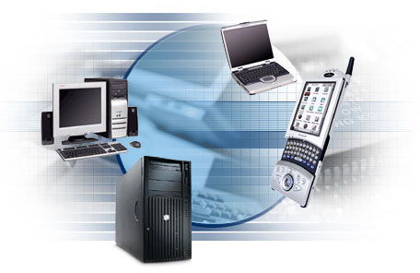
Computer Networks COMPUTING KILLS 2022 Makerere University Business School

Slide 3
Computer Networks:
DEFINITION OF A NETWORK
A computer network is a group of computers and other computing hardware devices that are linked in order to share resources, exchange files, or allow electronic communications between network nodes while using a set of common communication protocols. The computers on a network may be linked through cables, telephone lines, radio waves, satellites, or infrared light beams.

Slide 4
BASIC NETWORK CONCEPTS
Network nodes
A network node is an electronic device that is connected to a network and is capable of creating, receiving or transmitting information over a communication channel. For example, if a network connects a file server, five computers, and two printers, there are eight nodes on the network. Each device on the network has a network address, which uniquely identifies each device. This helps to keep track of where data is being transferred to and from on the network.

Slide 5
BASIC NETWORK CONCEPTS
Network address
A network address is any logical address that uniquely distinguishes a network node or host on a network. It is numeric and has two parts, the network ID and the host ID. Examples; Telephone number (in the public switched telephone network), MAC (Media access control) address (in Ethernet), IP (Internet Protocol) address (in IP networks including the internet), IPX address (in Netware)

Slide 6
BASIC NETWORK CONCEPTS
Communication channels
A communication channel refers either to a physical transmission medium such as a wire, or to a logical connection over a multiplexed medium such as a radio channel that can be used to transmit data from one network device to another. Communication channels can be wired or wireless. Wired communication channels use of cables to directly connect the communication devices with each other. Examples; Coaxial cable, fiber Optics, twisted pair. Wireless communication channels use wireless signals to directly connect the communication devices with each other. Examples; Radio frequency, Microwave system, Infrared, communication satellite, Bluetooth, Wi-Fi.

Slide 7
BASIC NETWORK CONCEPTS
Network protocols
Network protocols are a set of rules, conventions, and data structures that dictate how devices exchange data across networks. Essentially, it allows connected devices to communicate with each other, regardless of any differences in their internal processes, structure or design. Protocols may be implemented by hardware, software or a combination of both.

Slide 8
Types of protocols include:
Hyper Text Transfer Protocol (HTTP): Used over the world wide web (shows information in web pages).
Transmission Control Protocol(TCP): Used for communication over a network.
Internet Protocol(IP): An addressing protocol (Makes sure data/signals are transmitted to the right address.
File Transfer Protocol (FTP): Used to transfer files to different networks.
Simple Mail Transfer Protocol(SMTP): Manages the transmission and outgoing e-mails over the internet.

Slide 9
USES OF COMPUTER NETWORKS
Sharing Resources: Computer networks allow businesses and organizations to have a number of computers that share data and resources even if they are not in the same physical location. Users of these computers can share information (for example; business documents, multimedia (audio/video), graphics, images, e-books etc.), software (such as Anti-virus, operating systems, enterprise software, executable software etc.), and even hardware (like printers, CD-ROM drives, hard disk drives, scanners, copiers etc.), because the computers are linked through the network.

Slide 10
USES OF COMPUTER NETWORKS
Facilitate User communication: Computer networks enable fast interpersonal communication within an organization. People can communicate efficiently and easily. Various communication means such as emails, instant messaging, online chats, voice/video telephone calls and video conferencing, allow people to communicate and share texts photos, videos, ideas remotely.

Slide 11
USES OF COMPUTER NETWORKS
Client- Server Configurations: Through a computer network, the employees of an organization can access the organization’s databases remotely. In a client-server configuration, the organization’s data is stored in servers, which are powerful computers that can hold massive amounts of data and are managed by system administrators. The employees use the simpler computers on their desks, called clients, to access the data from the server remotely. The client server model works best for organizations that have different branches but need to share information.

Slide 12
USES OF COMPUTER NETWORKS
E-commerce: Computer networks have paved way for a variety of businesses and commercial transactions online, popularly called e-commerce. Users and organizations can pool funds, buy or sell items online, pay bills, manage bank accounts, pay taxes, transfer funds and handle investments electronically. Online business platforms have been created and these come with convenience of doing business with customers over the internet. The recent pandemic has even pushed more businesses to launch online. Without the computer networks, many businesses would not have been able to.

Slide 13
BENEFITS OF COMPUTER NETWORKS
Cost reduction: With computer networking, costs are cut through sharing of resources (hardware & software) between multiple users Two or more users are able to access shared application or software over the network with the help of the client/server application. In hardware, sharing users on the network can access hardware devices like printer, hard disk, Ram etc. with the help of a centralized computer or device. For example, you can purchase one printer rather than five, saving you the purchase price as well as the ongoing maintenance costs.

Slide 14
Efficiency and Collaboration: Networks make it far easier for employees to share information and collaborate on work. Carrying papers from office to office, or even a portable storage device of some kind is just not as efficient as storing the information on a centralized server for access by all who are authorized to access it.
Centralized storage and back up: Networks allow you to store the data centrally and ensure that all critical data gets backed up on a pre-determined schedule.

Slide 15
Increased productivity: Computer networks allow employees to be more productive. They can deal with more customers in less time since they have instant access to shared customer and product databases.
Optimize convenience and flexibility: Computer networks enable flexible operations. The data is not stored in a local server making it accessible with internet connectivity. You can access your data from any device. This enhances free movement while accessing your data wherever you may be.
Improved quality of output: Since all employees work from a single source of information, errors can be reduced and inconsistencies controlled.

Slide 16
LIMITATIONS OF COMPUTE NETWORKS
Security issues: One of the major drawbacks of computer networks is the security issues involved.
Rapid spread of computer viruses & malware: If any computer system in a network gets infected with a virus, there is a possible threat of other devices on the network getting infected too.
Expensive to set up: The initial set up cost of a computer network can be high depending on the number of computers to be connected. Costly devices like routers, switches, hubs etc., can add up to the bills of a person trying to install a computer network
Dependency on the main file server: In case the main file server of a computer network breaks down, it will bring the entire network to a standstill hence disrupting business operations

Slide 17
LIMITATIONS OF COMPUTE NETWORKS
Needs an Efficient Handler: Managing a big network is complex, it involves advanced configuration and complicated installations
Lack of Independence: As networks generally have a centralized server and dependent clients, the client users usually do not have any control whatsoever. Centralized decision making can occasionally hinder how a client user desires to use his computer.
Lack of Robustness: If the core file server of a computer network fails, the entire system may become useless
Accessibility: Even though most of the modern computers provide free access, there are still connectivity issues in some countries.

Slide 18
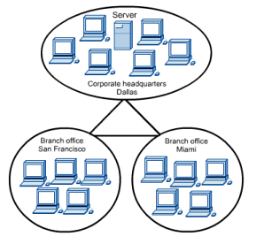
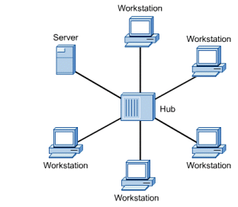
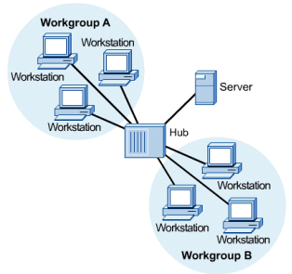
TYPES OF COMPUTER NETWORKS
Computer networks can be classified into different categories. The classifications help to explain the types of networks in use today, and what they’re used for. The following are the criteria widely used;
Classification based on Scale (geographical spread/physical size)
Classification based on Functional relationships (Network architecture)
Classification based on network topology
CLASSIFICATION BASED ON SCALE
Based on geographical spread, networks can be classified into the following three categories;
Local Area Network (LAN)
Metropolitan Area Network (MAN)
Wide Area Network (WAN)

Slide 19
CLASSIFICATION BASED ON FUNCTIONAL RELATIONSHIPS (NETWORK ARCHITECTURE)
Network architecture describes how tasks are located to all of the computers in the network. Computer networks can be classified according to the functional relationships which exist between the elements of the network. This classification is also called network architecture and there are two types;
Client-Server network
Peer-to-Peer network

Slide 20
CLIENT-SERVER NETWORK:
CSN (Client/Server Network) is type of computer network in which a centralized and powerful computer (server) provides resources other personal computers that are less powerful or workstations (as clients) connected on the network.
CHARACTERISTICS OF THE CLIENT-SERVER NETWORK
It works with a system of request and response. The client sends a request to the server and the server responds with the desired information.
The client and server should follow a common communication protocol so they can easily interact with each other.
A server can only accommodate a limited number of client requests at a time. So it uses a system based on priority to respond to the requests.

Slide 21
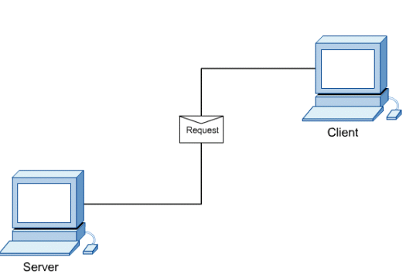
PEER-TO-PEER NETWORK:
A peer-to-peer (P2P) network is created when two or more PCs are connected and share resources without going through a separate server computer.
CHARACTERISTICS OF PEER-TO-PEER NETWORK
P2P networks have decentralized resources because every computer can function as both a server and a client i.e. one computer might assume the role of server for one transaction while acting as a client for another transaction.
P2P networks can share resources such as files, equipment (printers) among network devices without the use of a dedicated server. So if the nodes increase then the resource sharing capacity of the P2P network increases. This is different than client server networks where the server gets overwhelmed if the nodes increase.
All the computers on the network store their data using individual security but share data with all the other nodes.

