Slide 1
CONVERGENCE OF EMERGING TECHNOLOGIES TO ADDRESS THE CHALLENGES OF THE 21st CENTURY
BOIM I

Slide 2
INTRODUCTION
Numerous technologies are advancing at an unimaginable rate and it is not possible to cover all of them during the course of this presentation . This presentation will focus on :
Intelligent Sensors and Wireless Sensor Networks
Intelligent Cars and Smart Highways
Tele-Health (Wireless Healthcare)
Microelectromechanical Systems (MEMS)
Nanotechnology
Clean Technology
Robotics and Automation

Slide 3
INTELLIGENT SENSORS AND WIRELESS SENSOR NETWORKS
Opportunities in:
Medical Instrumentation
Factory & Office Automation
Automotive & Transportation
Telecommunications
Structural Fatigue Monitoring

Slide 4
INTELLIGENT SENSORS AND WIRELESS SENSOR NETWORKS (Continued)
Typical Examples:
Cell Phones and Mobile Networking.
Multi-Criterion, Multi-Path, Robotic SoS.
Bridges & structural monitoring-seismic measurements/simulations.
Wide-range motion tracking system for augmented reality applications.
Gait analysis for athletics, neurological exams, knee replacements, cardio-vascular health, etc.
Hand gesture recognition(with acceleration sensing glove) in medical virtual reality (VR) surgery diadactic and training applications.
Machinery operation monitoring system.
Inventory & status check on factory floors.

Slide 5
INTELLIGENT SENSORS AND WIRELESS SENSOR NETWORKS (Continued)
Typical Examples (continued):
Monitoring & control of refrigeration in grocery stores.
Impact measuring for transit audit trail of cargo in freight industry.
Oil-field pipeline equipment-continuous unattended health monitoring. Measurement-while-drilling surveying system.
Inertial navigation/global position system for control feedback in driverless agricultural equipment.
Drive-through automobile service stations- check fluids & servicing needs while refueling or washing vehicle.

Slide 6
INTELLIGENT CARS & SMART HIGHWAYS
Typical Examples:
Safety Critical Systems ( e.g. Anti-Lock Braking Systems).
Electronic Stability Control.
Rollover Prevention.
Autonomous Predictive Cruise Control.
Intelligent Speed Adaptation.
Lane-change assist.
Child safety seats to prime airbags based on the child’s weight.
Drowsy driver detection & prevention.
Drunk driver detection & prevention.
Integrated Safety Management.

Slide 7
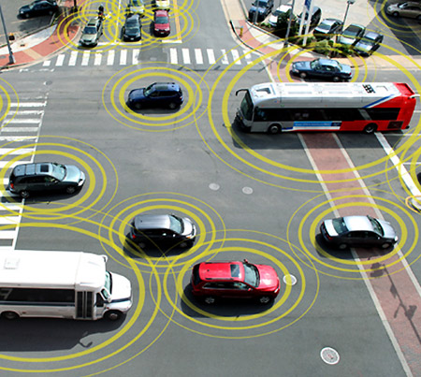
Study: Intelligent Cars Could Boost Highway Capacity by 273%
Tue, September 04, 2012 IEEE Spectrum Inside Technology
Highway Capacity Benefits from Using Vehicle-to-Vehicle Communication and Sensors for Collision Avoidance, by Patcharinee Tientrakool, Ya-Chi Ho, and Nicholas F. Maxemchuk from Columbia University, was presented last year at the IEEE Vehicular Technology Conference.

Slide 8
TELE-HEALTH (WIRELESS HEALTHCARE MONITORING)
Typical Examples:
Wearable Sensors for monitoring vital body signals: Heart rate, blood pressure, blood sugar level, cholesterol levels, etc.
Wireless interface for data transfer to PC, cell-phone, doctors office with real-time indication of any abnormal behavior and recommended action.
Kiosks with real-time capability to monitor vital body signs and interact with individual as well as doctor’s office.
Provide real-time vital body signs information to coaches in deciding whether to leave a player in or pull him out (e.g. basketball, football, boxing and other endurance sports).
Wirelessly monitor condition of vehicles (tire pressure, engine heat, rpm, etc.,) to determine servicing schedule.

Slide 9
Micro-electromechanical Systems (MEMS)
What is MEMS ?
Imagine a machine so small that it is imperceptible to the human eye.
Imagine working machines with gears no bigger than a grain of pollen.
Imagine these machines being batch fabricated tens of thousands at a time, at a cost of only a few pennies each.
Imagine a realm where the world of design is turned upside down, and the seemingly impossible suddenly becomes easy – a place where gravity and inertia are no longer important, but the effects of atomic forces and surface science dominate.
Source: Sandia National Laboratories, Intelligent Micromachine Initiative (www.mdl.sandia.gov/mcormachine)

Slide 10
MEMS THE ENGINE OF INNOVATION AND NEW ECONOMIES
“These micromachines have the potential to revolutionize the world the way integrated circuits did”.
Linton Salmon, National Science Foundation
“Micromachining technology has the potential to change the world in some very important ways, many of which are not possible to foresee at this time, in the same way that standard IC technology has so revolutionized our lives and economies”.
Ray Stata, Chairman and CEO, Analog Devices, Inc.

Slide 11
MEMS TECHNOLOGY
Creates Integrated Electromechanical Systems that merge computing with sensing and actuation.
Mechanical components have dimensions in microns and numbers in millions.
Uses materials and processes of semiconductor electronics.
Wide applications in commercial, industrial and medical systems :
Automobiles
Wearable Sensors to Monitor Vital Biological Functions
Cell Phones
Printers
GPS/Navigation Systems etc.,
Key Characteristics: Miniaturization (small size and weight), Multiplicity (batch processing), Microelectronics, Small Cost, High Reliability.

Slide 12
APPLICATIONS OF MEMS
Inertial Measurement:
Automotive Safety
Aircraft Navigation
Platform Stabilization
Personal/Vehicle Navigation
Distributed Sensing and Control:
Condition-Based Maintenance
Situational Awareness
Miniature Analytic Instruments
Environmental Monitoring
Biomedical Devices
Active Structures
Information Technology:
Mass Data Storage & Displays

Slide 13
APPLICATIONS OF MEMS
Automotive: Industrial:
Yaw Sensors Factory Automation
Gyroscopes Office Automation
Accelerometers Process Control
Airbag Sensors
Telecommunications : Medical:
Antenna Stabilization Blood Analysis
GPS/Navigation DNA Analysis
Wireless Communication Virtual Reality

Slide 14
NANOTECHNOLOGY
The NNI defines Nanotechnology as consisting of all of the following:
Research & technology development at the 1-to-100nm range.
Creating & using structures that have novel properties because of their small size.
Ability to control/manipulate at atomic scale.
Reference: Nanotechnology for Dummies by Richard Booker and Earl Boysen, Wiley Publishing, Inc.

Slide 15
NANOTECHNOLOGY (Continued)
KEY Elements of Nanotechnology:
Buckyball- A soccer-ball shaped molecule made of 60 carbon atoms. Applications: Composite reinforcement, drug delivery.
Carbon Nanotube: A sheet of graphite rolled into a tube. Applications: Composite reinforcement, conductive wire, fuel cells, high-resolution displays.
Quantum Dot: A semiconductor nanocrystal whose electrons show discrete energy levels, much like an atom. Applications: Medical imaging, energy-efficient light bulbs.
Nanoshell: A nanoparticle composed of a silica core surrounded by a gold coating. Applications: Medical imaging, cancer therapy.
Reference: Nanotechnology for Dummies by Richard Booker and Earl Boysen, Wiley Publishing, Inc.

Slide 16
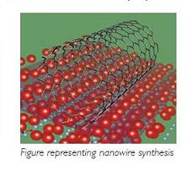

Slide 17
NANOTECHNOLOGY (Continued)
Typical Applications of Nanotechnology:
Single-electron transistor (SET): Uses a single electron to indicate whether it represents a 1 or a 0, thereby greatly reducing the energy required to run a processor and limiting the heat levels generated during operation.
Magnetic random-access memory (MRAM): Non-volatile electronic memory that is faster & uses less energy than conventional Dynamic RAM.
Spintronics: “Spin-based electronics,” uses electron’s spin & its charge to represent binary 1s & 0s.
Quantum Computing: Unlike a conventional computer it uses quantum mechanical properties of superposition & entanglement to perform operations on data & will rely on probability (in effect, “it is highly likely that the answer is….”). The QC will run in parallel, performing many operations at once.
Reference: Nanotechnology for Dummies by Richard Booker and Earl Boysen, Wiley Publishing, Inc.

Slide 18
NANOTECHNOLOGY (Continued)
Typical Applications of Nanotechnology (contd)
Quantum cryptography: Based on traditional key-based crypt., using unique properties of quantum mechanics to provide a secure key exchange.
Photonic crystals: Nano crystals that guide photons according to structural properties (optical router for Internet info. exchange).
Other: Cell phones with longer battery life, smaller & more accurate GPS, faster & smaller computers, smaller & more efficient memory, smart materials, fast & accurate DNA fingerprinting, medical diagnostics & drug delivery, etc.
Reference: Nanotechnology for Dummies by Richard Booker and Earl Boysen, Wiley Publishing, Inc.

Slide 19
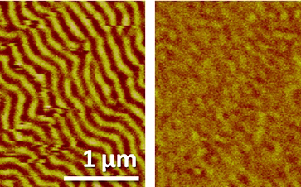
Translational Applications of Nanoscale Multiferroic Systems
The NSF-funded multimillion-dollar program, based on a new approach to electronics, could lead to tiny devices once considered fantasy
●Electromagnetic devices operate by passing an electric current through a wire.
● Works extremely well in large scale but fails in the small scale (limits miniaturization). Like water flowing through a pipe, as wire diameter decreases, so does amount of current flowing through it, limiting the ability to create and control electromagnetic energy.

Slide 20
●TANMS seeks to solve this problem by taking advantage of multiferroic {1} materials, which use electric fields to intrinsically switch the magnetic state of a material, similar to switching a light bulb on and off.
●The grant, worth up to $35 million over 10 years, will fund a new center headquartered at UCLA's School of Engineering & Applied Science.
● Research aimed at developing highly efficient and powerful electromagnetic systems roughly the size of a biological cell — systems that can power a range of devices, from miniaturized consumer electronics and technologies important for national security to as-yet unimagined machines, like nanoscale submarines that can navigate through the human blood stream.
"TANMS could spur a true paradigm shift for new devices that were once thought of as science fiction but now appear just over the horizon," Vijay K. Dhir, dean of UCLA Engineering.
{1} Multiferroics have been defined as materials that exhibit more than one primary ferroic order parameter (ferromagnetism, ferroelectricity, ferroelasticity, ferrotoroidicity (?)simultaneously (i.e. in a single phase).

Slide 21
CLEAN TECHNOLOGY (Cleantech)
Typical Applications of Cleantech:
Alternate energy sources: solar, wind, etc.
Fuel cells
Smart grid : Architecture, sensors, software, middleware, interface, etc.
Smart meters: Monitoring, comparing, optimizing.

Slide 22
ROBOTICS AND AUTOMATION
Expected Advances:
Advances in artificial intelligence and soft computing techniques (artificial neural networks, fuzzy logic, genetic algorithms, etc.,) will permit robots and advanced machines to better deal with chaos and uncertainty.
Intelligent sensors, actuators and signal processing will provide robots and machines with unprecedented capabilities and accuracies.
Advances in wireless sensor networks and system of systems technologies will allow robots and machines to work in teams to accomplish higher level tasks.

Slide 23
ROBOTICS AND AUTOMATION (Continued)
Typical Applications:
Robotic system of systems applications:
Search and rescue
Search and destroy
Fire detection and prevention
Biological threat detection
Chemical spill/threat detection
Medical instrumentation
Assistive and rehabilitative applications
Home automation and applications
Factory and industrial automation

Slide 24
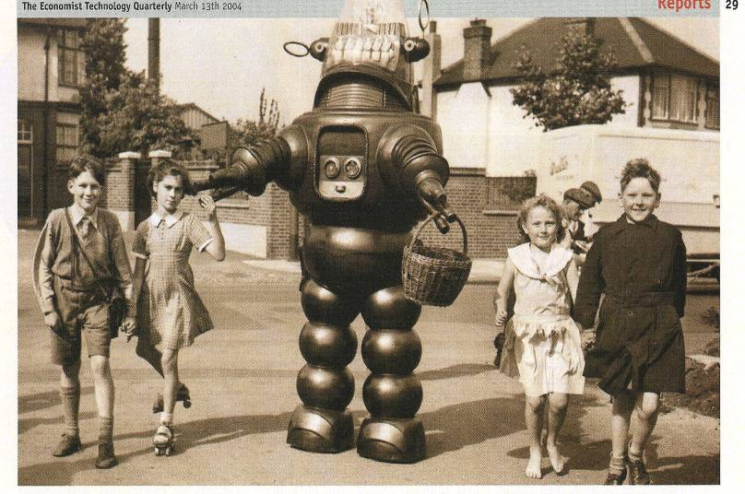
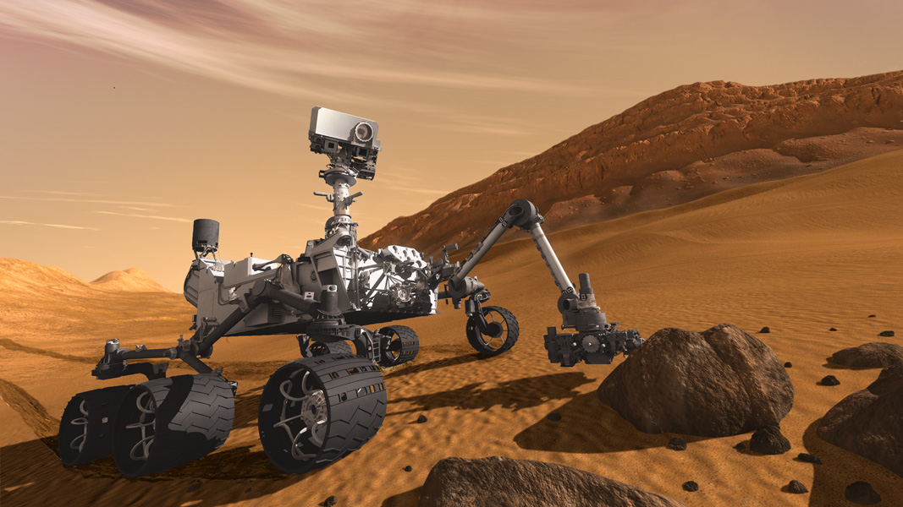
1956 —Those were the days!
2012 — MARS CURIOSITY

Slide 25
CONCLUDING REMARKS
Technology will change our lives and the way we conduct our day to day activities.
Major technological breakthroughs will be interdisciplinary & occur at the fringes of classical disciplines (e.g. bio-info-nanotechnology).
Engineers, scientists & technologists will need to be trained with depth as well as breadth.
Learning to work in teams will be of paramount importance.
Verbal & written communication skills will be indispensible.
Cost effective & efficient manufacturing techniques & processes will play a pivotal role in determining whether a technology is merely a laboratory curiosity or whether it can be commercialized.
Mass Customization
Technology will affect our future in as yet unimagined ways.
The best way to predict the future is to invent it.

Slide 26
THANK YOU

