Slide 1
MAKERERE UNIVERSITY BUSINESS SCHOOL
FACULTY OF BUSINESS ADMINISTRATION
Business Communication Skills
FOR BACHELORS STUDENTS
©2024 - DEPARTMENT OF COMMUNICATION

Slide 2
BUSINESS COMMUNICATION
SKILLS

Slide 3
Why the Business Communication Skills Course
Communication is the lifeblood of any organisation in the modern world.
It facilitates organizational functions and relations with the internal and external stakeholders.
It enables employees to fit in a highly competitive and technologically advanced world.
It facilitates interpersonal relations for career advancement in the 21st Century.

Slide 4
Course Learning Outcomes
At the end of this course, students shall be able to;
Explain the key concepts in business communication
Plan for communication
Develop appropriate messages that suit the audience
Apply the principles of communication
Relate well with people of different personalities
Prepare business correspondences like letters, memos and reports
Listen effectively
Make winning public presentations
Hold successful meetings
Use and interpret the non-verbal cues

Slide 5
TOPIC ONE: INTRODUCTION
TO
SKILLS

Slide 6
Topic Outline
Introduction
Learning Outcomes
Definition of Business Communication
Methods, Forms, Characteristics of Communication
Trends in Communication
Factors to consider when choosing the method of communication

Slide 7
Communication is part of all personal, professional and organisational aspects of life.
It influences relationships, decisions and all personal and business operations.
Ensuring understandability of the message is a must for personal and work excellence.
This calls for developing Business Communication Skills.

Slide 8
Topic Learning Outcomes
At the end of this topic, students should be able to:
Define communication
Explain the methods of communication and their respective forms
Choose the appropriate method and form of communication in a given scenario.

Slide 9
Definition of Communication
It is the process of giving, receiving or exchanging (sharing) information, opinions (views, thoughts) or ideas (facts about something) by writing, speaking or acting so that the message communicated is understood ( by the recipient/ audience.
Pay attention to the denotative (dictionary/ actual) and connotative (implied/ intended) meaning of messages.

Slide 10
Importance of Communication
Aids decision making
Promotes relationships among people
Basis to analyze the performance of organizations
Solves problems
Motivates staff
Liaise with external stakeholders
Facilitates teamwork
Organize human and other resources in the most effective way
Aids planning in organizations
Inform members in the organization

Slide 11
Methods / Types of Communication
Verbal Communication: Use of words when communicating
Non-Verbal communication: Non-use of words when communicating

Slide 12
Verbal Communication
Oral communication - Communication by word of mouth.
Written Communication – Communication through writing

Slide 13
Oral Communication
Communication by word of mouth.
Success of oral communication is dependent on the audience’s ability to listen
Forms of Oral Communication
Phone calls, face-to-face discussions, interviews, presentations, meetings, seminars, video conferencing … etc.
Characteristics
Interactive, non - restricted audience, any time any place, immediate feedback

Slide 14
Written Communication
This is when a message being sent is displayed in writing.
Its success depends on the audience’s ability to read.
Forms of Written Communication
E-mails, letters, faxes, notices, reports, memos, questionnaires, newsletters, employee handbooks, magazines, brochures, minutes, written messages using online platforms, etc.
Characteristics
More detailed, records, non-interaction, restrictive in use, no immediate feedback.
NB: Advantages and disadvantages (Students’ assignment and this applies to all three methods of communication)

Slide 15
Non-verbal Communication
This is sending and receiving wordless messages.
It can be used alone or together with oral and written.
Forms: These are divided into the following categories
Environmental (Design and Layout, Territory, Time)
Social (Distance, Status and Symbols)
Physical (facial expressions, appearance, smell, gesture, etc.)
Characteristics: Widely used, unconscious communication, interpretation varies from culture to culture

Slide 16
Technology Aided Communication
With technological advancement, verbal and non-verbal communication are entwined to form visual and audio communication.
Visual communication- Information is displayed in various ways that require the use of sight e.g. tables, graphs, charts, photographs, drawings etc.
Audio –Messages are transmitted only through sounds
Audio- Visual- Messages are sent through sounds and require the use of sight e.g. using Televisions

Slide 17
Trends in Communication
The evolving developments in communication from the past to the present;
Ancient Times
Oral tradition (storytelling)
Written communication (hieroglyphics, papyrus)
Messengers and homing pigeons
Medieval Period
Handwritten letters
Town criers and public announcements
Printing press (1450s)
Early Modern Period
Postal services (1635)
Newspapers (1605)
Telegraphy (1794)
Industrial Age
Telegraph (1837)
Telephone (1876)
Radio (1895)
20th Century
Television (1927)
Computers and email (1960s)
Mobile phones (1973)
Internet and World Wide Web (1990s)

Slide 18
Cont’… Trends in Communication
21st Century
Social media and online platforms
Instant messaging and texting
Video conferencing and virtual meetings
Artificial intelligence and chatbots
Remote work and virtual teams
Podcasting and voice assistants
Augmented reality and virtual reality
Current Trends
Personalization and targeted communication
Visual and interactive content
Automation and AI-powered communication
Mobile-first and voice-first strategies
Virtual and hybrid events
Inclusive and accessible communication
Data-driven and measurable communication

Slide 19
Assignment
Research on the trends in communication in Uganda specifying:
Current Trends
Advantages
Limitations

Slide 20
Factors to Consider when Choosing a Method of Communication
Recipient/ audience- his/her status, nature and relationship
Time of communication
Urgency/ speed-urgency of feedback
Cost-affordability of the cost.
Confidentiality
Safety and security
Availability of means
Nature of the message (size)
Knowledge of the sender
Influence

Slide 21
Scenario Exercise
Using an email, a Senior Administrator invited members of the Faculty of Business Administration to attend the Faculty Board Meeting and Examiners Board Meeting that was held on 23rd July 2024. Faculty members attended the meeting chaired by the Dean of the Faculty. In the meeting, members listened to the communication from their Dean and Heads of Departments then later members reacted to the communication. They were also able to share different ideas and grievances. The Secretary of the meeting wrote minutes of what transpired in the meeting, in the process, she highlighted the actions to be taken that would guide in making important decisions and solving problems raised.

Slide 22
Scenario Questions
Explain with evidence the extent to which communication took place.
Articulate the methods of communication that were used in the case study.
For each method of communication, determine the forms of communication used.
Based on current trends in communication evidenced in the scenario, analyse the advantages and limitations of using such communication.
Analyse the factors of communication that could have been considered when choosing the method of communication by the Senior Administrator, Dean and members.

Slide 23
References
Courtland, B. & Thill, J.V. (2017). Business Communication Today (14th ed.): Prentice Hall
Guffey, M. E. & Loewy, D.(2018) Business Communication Essentials: Fundamental Skills for the Mobile-Digital-Social Workplace (What's New in Business Communication), (8th ed). Pearson.
McLean, S. (2010). Business communication for success. Boston, MA: Flat World Knowledge.
Thill, J. V., & Bovée, C. L. (2021). Excellence in business communication. Pearson Higher Ed.

Slide 24
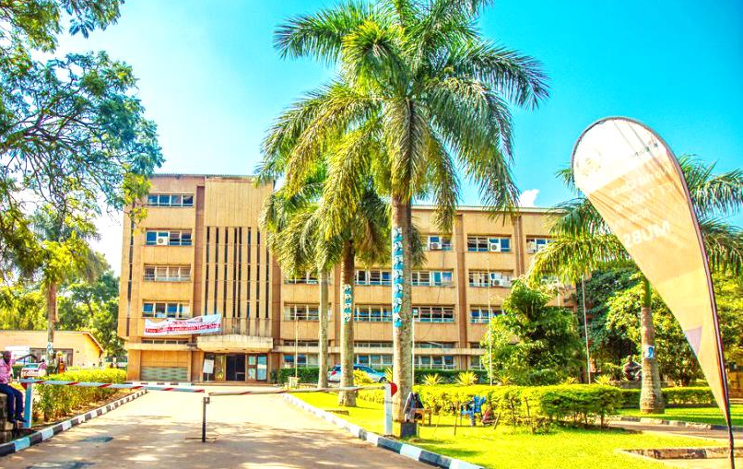
Thank you for being a great audience
Address
Main building , first floor Room 1.0
Contacts
Facilitator:
Team Leader: +256-772-156-003
Email
hodcommunication@mubs.ac.ug/ jodiya@mubs.ac.ug
©2024 - FACULTY OF BUSINESS ADMINISTRATION, Department of Communication

