Slide 1
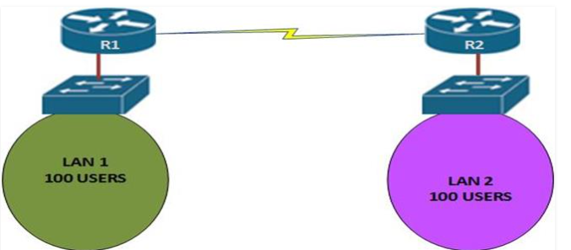
DHCP (Dynamic Host Configuration Protocol)

Slide 2
What is DHCP?
Dynamic Host Configuration Protocol (DHCP) is a client-server protocol that automatically assigns IP configuration to hosts on a network​.
Instead of configuring IP addresses manually, devices request their network settings from a DHCP server.
DHCP provides key network parameters to clients, including:
IP address and subnet mask
Default gateway (router) address
DNS server addresses
Other settings (domain name, lease time, etc.)
DHCP uses a centralized server to manage IP address pools, ensuring each client gets a unique address and preventing conflicts.

Slide 3
Benefits of DHCP
• Centralized IP management
• Reduces configuration errors
• Enables flexible IP allocation
• Efficient use of IP addresses

Slide 4
DHCP Operation
It accomplishes these tasks in one of three ways:
Manual IP allocation
Automatic IP allocation
Dynamic IP allocation

Slide 5
DHCP DORA Process (IPv4)
Discover: A new client (or one that needs an IP) broadcasts a DHCPDISCOVER message to find any DHCP servers​.
Offer: A DHCP server replies with a DHCPOFFER, offering an available IP address and other network parameters to the client
Request: The client responds with a DHCPREQUEST message, indicating it accepts the offer and requests that IP address from the server
Acknowledge: The chosen DHCP server sends a DHCPACK (Acknowledgement) confirming the lease of the IP address to that client.

Slide 6
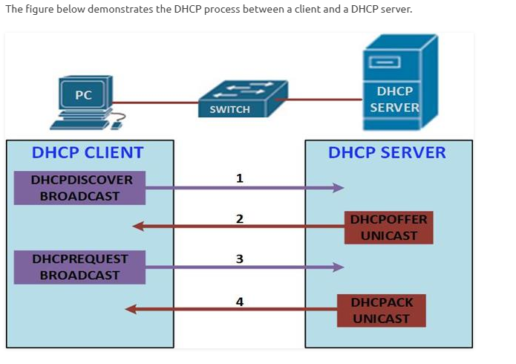

Slide 7
parameters needed to communicate fully on the network.

Slide 8
Configuring DHCP
You will configure a DHCP server using a CISCO router and see how it assigns addresses to clients as we discussed in the previous section.
The router’s interfaces as well as the HTTP server will be configured with static ip addresses. The HTTP server is also acting as the DNS server.

Slide 9
SENARIO: You have a router that needs to assign IP addresses to devices in VLAN 10 using DHCP. The network for VLAN 10 is 10.1.10.0/24, and the router's subinterface for this VLAN is GigabitEthernet0/0.10, with IP 10.1.10.1.
Router(config)# interface GigabitEthernet0/0.10
Router(config-subif)# encapsulation dot1Q 10
Router(config-subif)# ip address 10.1.10.1 255.255.255.0
Router(config-subif)# exit
Router(config)# ip dhcp pool VLAN10
Router(dhcp-config)# network 10.1.10.0 255.255.255.0
Router(dhcp-config)# default-router 10.1.10.1
Router(dhcp-config)# dns-server 8.8.8.8
Router(dhcp-config)# exit

Slide 10
DHCPv6 Overview
DHCPv6 communicates over UDP port 546 (client) and 547 (server)​
DHCPv6 uses IPv6 multicast addresses to reach servers (e.g., ff02::1:2 for all DHCP agents on the local link)​
DHCPv6 does not provide the default gateway so routers use ICMPv6 Router Advertisements to inform hosts of the local router’s presence (the default route). DHCPv6 focuses on addresses and options like DNS.
Use Cases: Networks might use stateless DHCPv6 when they want to use SLAAC for addresses but still need to send DNS server info to clients.
Stateful DHCPv6 is used when administrators want central control of IPv6 addressing (similar to DHCPv4), or for things like IPv6 Prefix Delegation to assign subnets to downstream routers

Slide 11
DHCPv6 Process (Stateful SARR)
Solicit: An IPv6 client that needs configuration sends a DHCPv6 Solicit message, typically to the all-DHCP-servers multicast address, to find available DHCPv6 servers​
Advertise: One or more DHCPv6 servers respond with an Advertise message
Request: The client typically receives one or multiple Advertises.
Reply: The DHCPv6 server, upon receiving the Request, will allocate the address for that client and reply with a DHCPv6 Reply message​.
(If the server cannot honor the request, it would send a decline message; also, clients can Renew and Release leases similarly with DHCPv6 specific messages.)

Slide 12
DHCPv6 Configuration (Cisco IOS)
Create Pool: On the router acting as DHCPv6 server, define an IPv6 DHCP pool with a name. Within the pool, specify the IPv6 network prefix to be handed out (e.g., a /64 prefix) and any options like DNS servers and domain name​
ipv6 dhcp pool VLAN10_IPV6
address prefix 2001:db8:10:1::/64 (prefix to delegate to clients)
dns-server 2001:4860:4860::8888 (DNS IPv6 address)
domain-name example.com
Interface Setup: On the interface that will serve the clients (e.g., the VLAN interface or physical interface facing the client network), enable DHCPv6.
Assign the interface a static IPv6 address for the subnet, and use the ipv6 dhcp server <pool-name> command to link the previously created pool to that interface​
configure IPv6 RA flags: for stateful DHCPv6, set ipv6 nd managed-config-flag on the interface (this tells clients via RA to use DHCPv6 for addresses)​

Slide 13
DHCPv6 Configuration (Cisco IOS)
4. DHCPv6 Client Configuration: On an IPv6 client (could be a router interface or a host), configure the interface to use DHCPv6. In Cisco IOS, this is done with ipv6 address dhcp on the interface, along with ipv6 enable​
5. When the interface comes up, it will send a DHCPv6 Solicit. The client will receive an address from the DHCPv6 server if all is set up correctly.
6. You can verify on the client with show ipv6 interface brief (to see the assigned IPv6 address) and on the server with show ipv6 dhcp binding (to see active leases).

Slide 14
DHCPv6 Configuration Example
! On Router R1 (DHCPv6 Server for VLAN 10)
R1(config)# ipv6 dhcp pool VLAN10_IPV6
R1(config-dhcpv6)# address prefix 2001:db8:10:1::/64
R1(config-dhcpv6)# dns-server 2001:4860:4860::8888
R1(config-dhcpv6)# domain-name example.com
R1(config-dhcpv6)# exit
R1(config)# interface GigabitEthernet0/0.10
R1(config-if)# ipv6 address 2001:db8:10:1::1/64
R1(config-if)# ipv6 dhcp server VLAN10_IPV6
R1(config-if)# ipv6 nd managed-config-flag
R1(config-if)# no shutdown
! On Router R2 (DHCPv6 Client)
R2(config)# interface GigabitEthernet0/0
R2(config-if)# ipv6 address dhcp
R2(config-if)# ipv6 enable
R2(config-if)# no shutdown

Slide 15
comparing DHCPv4 and DHCPv6
Feature | DHCPv4 | DHCPv6
Communication | Uses IPv4 broadcasts (e.g., 255.255.255.255) to discover and offer IP addresses. | Uses IPv6 multicast (e.g., ff02::1:2) for discovery and communication.
Message Names | DORA: Discover → Offer → Request → Acknowledge | SARR: Solicit → Advertise → Request → Reply
Default Gateway | Provided by DHCP as an option to clients. | Not provided by DHCPv6; clients learn the gateway via Router Advertisements (RA).
Optional Addressing | Address comes from DHCP server (only one mode). | Can operate in stateless (only options) or stateful (full address + options) modes.
Ports Used | UDP 67 (server), UDP 68 (client) | UDP 547 (server), UDP 546 (client)
Protocol Response | DHCPv4 will not respond to DHCPv6 messages and vice versa. | Separate protocol; only responds to DHCPv6 messages.

Slide 16
The “Power of 2”
In IP addressing, the number of available IP addresses in a subnet must always be a power of 2:
We subtract 2 IPs from each subnet: 1 for Network Address (e.g. 192.168.1.0) 1 for Broadcast Address (e.g. 192.168.1.63)
Power of 2 | Number of IPs | Usable Hosts (IPs - 2)
2² = 4 | 4 | 2
2³ = 8 | 8 | 6
2⁴ = 16 | 16 | 14
2⁵ = 32 | 32 | 30
2⁶ = 64 | 64 | 62
2⁷ = 128 | 128 | 126

Slide 17
Match Your Hosts to the Right Power
Let’s say you need to support 58 devices in a network (like in your Subnet A):
Start checking which power of 2 gives you enough usable IPs:
2⁵ = 32 → ❌ too small (only 30 usable)
2⁶ = 64 → ✅ perfect (62 usable IPs)
So, we go with 2⁶ = 64 IPs

Slide 18
Convert IP Count to Subnet Mask
Now, how do we know what subnet mask gives 64 IPs?
IPv4 has 32 bits total.
Subnet mask length (like /26, /27, etc.) tells you how many bits are used for the network portion.
32 = 2^(32 - x)
→ 32 - x = 6
→ x = 27
✅ Therefore, /26 gives you 64 IPs.

Slide 19
Last Octet Values for Common Subnet Masks
CIDR | Last Octet Binary | Decimal
/24 | 00000000 | 0
/25 | 10000000 | 128
/26 | 11000000 | 192
/27 | 11100000 | 224
/28 | 11110000 | 240
/29 | 11111000 | 248
/30 | 11111100 | 252

Slide 20
Subnet the network 192.168.1.0/24 to meet the following requirements:
a. One subnet, “Subnet A”, supporting 58 hosts (the client VLAN at R1). Subnet A:
network :192.168.1.0/26
available ip address 192.168.1.1-192.168.1.62
network address:192.168.1.0
broadcast address:192.168.1.63

Slide 21
One subnet, “Subnet B”, supporting 28 hosts (the management VLAN at R1).
Subnet B:
network :192.168.1.64/27
available ip address 192.168.1.65-192.168.1.94
network address:192.168.1.64
broadcast address:192.168.1.95

Slide 22
One subnet, “Subnet C”, supporting 12 hosts (the client network at R2).
Subnet C:
network :192.168.1.96/28
available ip address 192.168.1.97-192.168.1.110
network address:192.168.1.96
broadcast address:192.168.1.111

