Slide 1
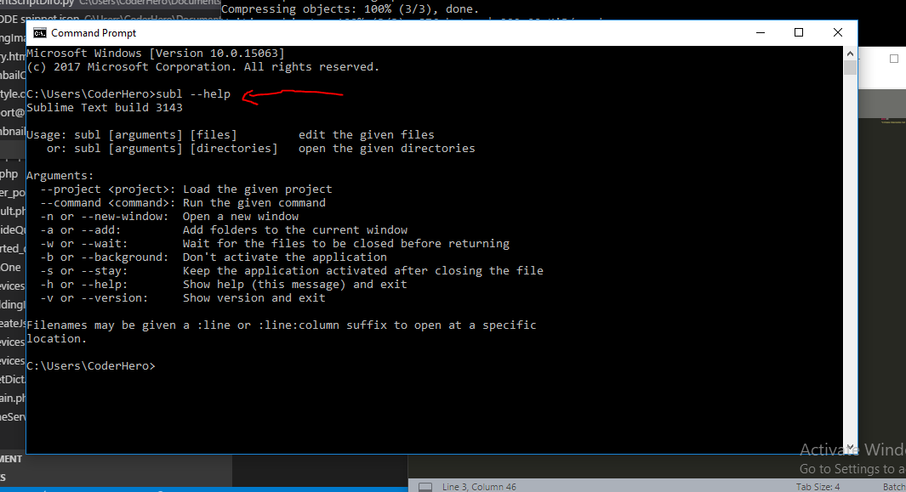
Command Prompt and Text Editors
Topic 4
Notes:
NOTE:
To change the image on this slide, select the picture and delete it. Then click the Pictures icon in the placeholder to insert your own image.

Slide 2
Command Prompt
Introduction
interpreter application available in most Windows operating systems. It allows users to execute commands to perform various tasks.
Basic Commands
1. Navigation:
cd [directory]: Change directory.
cd Documents
dir: List directory contents.
dir

Slide 3
File Operations:
copy [source] [destination]: Copy files.
copy file1.txt D:\Backup
del [file]: Delete files.
del file1.txt
rename [oldname] [newname]: Rename files.
rename file1.txt file2.txt

Slide 4
Directory Operations:
mkdir [directory]: Create a new directory.
mkdir NewFolder
rmdir [directory]: Remove a directory.
rmdir OldFolder

Slide 5
Advanced Commands
System Information:
systeminfo: Display system information.
ipconfig: Display network configuration.
Ipconfig
2. Disk Operations:
chkdsk: Check disk for errors.
chkdsk C:
diskpart: Manage disk partitions.
diskpart
Process Management:
tasklist: List all running processes.
Tasklist
taskkill /PID [pid]: Kill a process by PID.
taskkill /PID 1234

Slide 6
Batch Files
Batch Files (.bat): Scripts that can execute a series of command prompt commands.
bat
Copy code
@echo off
echo Hello World
pause

Slide 7
Text Editors
Notepad: A simple text editor included with Windows.
Notepad++: An advanced text editor with additional features.
Vim: A highly configurable text editor built to enable efficient text editing.
SUBLIME TEXT, Visio Code

Slide 8
Navigating Directories and File Management
Navigating Directories
Directory Structure
Root Directory: The topmost directory in a hierarchy.
Subdirectory: A directory inside another directory.
Path: The location of a file or directory in the filesystem.
Absolute Path: Full path from the root directory.
Relative Path: Path relative to the current directory.

Slide 9
Commands
1. Change Directory:
cd [directory]: Change the current directory.
2. List Contents:
dir: List files and directories in the current directory.

Slide 10
File Management
Creating and Deleting Files
1. Create a File:
echo [text] > [file]: Create a new file with text.
echo Hello World > myfile.txt
2. Delete a File:
del [file]: Delete a file.
del myfile.txt

Slide 11
Copying and Moving Files
Copy a File:
copy [source] [destination]: Copy a file to another location.
copy myfile.txt D:\Backup
Move a File:
move [source] [destination]: Move a file to another location.
move myfile.txt D:\Backup

Slide 12
Renaming Files and Directories
Rename a File:
rename [oldname] [newname]: Rename a file.
rename oldfile.txt newfile.txt
Rename a Directory:
rename [olddir] [newdir]: Rename a directory.
rename OldDir NewDir

Slide 13
Viewing File Contents
Type:
type [file]: Display the contents of a file.
type myfile.txt
More:
more [file]: View file contents page by page.
more myfile.txt

Slide 14
Examples on Navigating and Managing Files
Create and Navigate Directories:
To change to separate root Directory use cd\ with backward slash
Type drive letter with full colon eg D:
mkdir Projects
cd Projects
mkdir MyProject
cd MyProject
Create and Manage Files:
echo Project Description > README.txt
copy README.txt D:\Backup
rename README.txt PROJECT_README.txt
del PROJECT_README.txt

Slide 15
END

