Slide 1
Introduction to HTML Basics

Slide 2
1. Declaring the DOCTYPE of an HTML Document
Every HTML document begins with a DOCTYPE declaration. This tells the browser what version of HTML is being used.
In HTML5, the DOCTYPE declaration is
<!DOCTYPE html>
This declaration ensures that the browser renders the page in standards mode instead of quirks mode (which can cause inconsistent display across browsers).

Slide 3
2. Defining the Head and Body of an HTML Document
The <head> Section
The <head> section contains meta-information about the page that is not displayed directly on the webpage.
It includes: The page title (shown in the browser tab)
Metadata such as character encoding
Links to CSS stylesheets and JavaScript files
<head>
<meta charset="UTF-8">
<title>My First HTML Page</title>
</head>

Slide 4
b) The <body> Section
The <body> section contains all the visible content of the webpage, such as text,
images,
links,
lists, and
other elements.
<body>
<h1>Welcome to My Page</h1>
<p>This is an HTML document with a head and a body.</p>
</body>

Slide 5
Our Very First HTML Page
A simple HTML page consists of:
The DOCTYPE declaration
The <html> root element
The <head> section
The <body> section

Slide 6
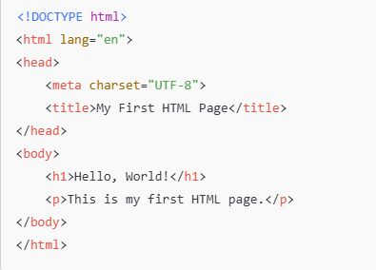

Slide 7
4. Paragraph Elements (<p>)
The <p> element is used to define paragraphs of text.
By default, browsers add some spacing before and after each paragraph.
<p>This is the first paragraph.</p>
<p>This is the second paragraph.</p>

Slide 8
5. Heading Elements (<h1> to <h6>)
HTML provides six levels of headings, from <h1> (largest) to <h6> (smallest).
<h1>Main Heading</h1>
<h2>Subheading</h2>
<h3>Sub-subheading</h3>

Slide 9
6. List Elements (Ordered and Unordered Lists)
Unordered List (<ul>)
<ul>
<li>Apple</li>
<li>Banana</li>
<li>Cherry</li>
</ul>
b) Ordered List (<ol>)
<ol>
<li>Step 1: Open the browser</li>
<li>Step 2: Type the URL</li>
<li>Step 3: Press Enter</li>
</ol>

Slide 10
7. Anchor Elements (<a>)
Link to an External Page
<a href="https://www.google.com">Visit Google</a>
b) Link to an Internal Section on the Same Page
<a href="#section2">Jump to Section 2</a>
<h2 id="section2">Section 2</h2>

Slide 11
c) Dead Links (#)
<a href="#">Click here</a>
d) Link Within a Paragraph
<p>Learn more about <a href="https://www.w3schools.com">HTML</a> here.</p>

Slide 12
8. Adding Images (<img>)
The <img> tag is used to embed images in an HTML page.
Example with an absolute URL:
<img src="https://example.com/image.jpg" alt="Example Image">
Example with a relative URL (image stored in the same folder as the HTML file):
<img src="image.jpg" alt="Local Image">

Slide 13
Attributes of <img>
src → Specifies the image source (URL or file path)
alt → Provides alternative text (displayed if the image doesn’t load)
width and height → Define image dimensions
Example with size adjustment:
<img src="logo.png" alt="Company Logo" width="200" height="100">

Slide 14
Download
MySql Workbench
WampServer

Slide 15
Activity
In your groups select a project and create a web page having at least 5 tabs on the home page linking to one another on clicking(One of the pages should allow Capturing/ input of data)

Slide 16
THANK YOU

