Slide 1
By Mr. Timothy Kimera Marketing & Media Studies (Dept) tkimera@mubs.ac.ug (0776756298)

Slide 2
Types video Ads
https://www.youtube.com/watch?v=4k0oYFQS0f0

Slide 3
Topic | Learning Outcomes
Video Marketing | Video content strategy Step-by-step video production Video Promotion

Slide 7
TIPS FOR AN EFFECTIVE VIDEO CONTENT STRATEGY
Work on the video title
Use relevant keywords
Write video descriptions
Use a thumbnail image concisely
Use video transcripts

Slide 8
Conclusion
Video marketing is the need of the hour and making a video marketing strategy is the way of excelling in it.
There are many things involved in making a video strategy - how to produce videos, where to publish them, how to optimize them, what type of videos to publish and how to organize all the video ideas.
This piece of content along with the free content calendar template will help you get started immediately.

Slide 9
The practice whereby a digital publisher or website promotes an online retailer and earns a commission based on the sales or leads that the advertising generates for that online retailer.

Slide 10
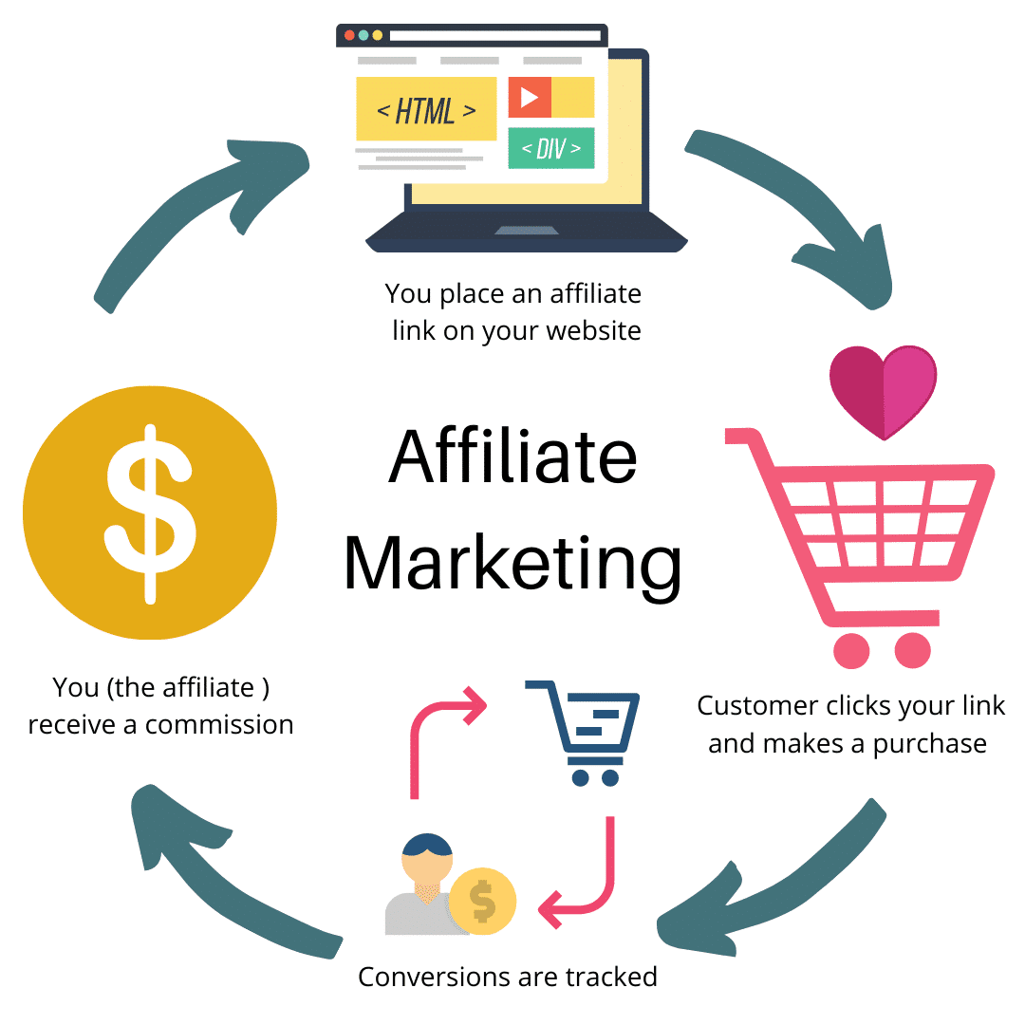
How Affiliate marketing works?

Slide 11
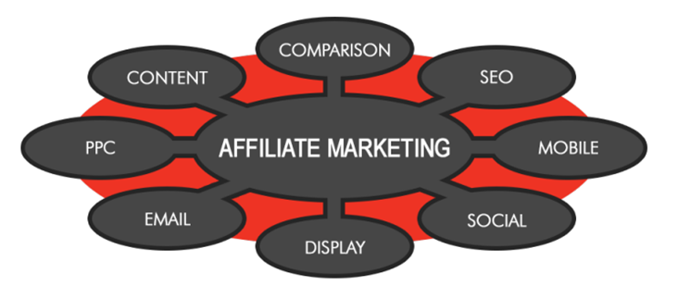

Slide 12
TYPES OF AFFILIATES / STRATEGIES
Reward sites
Emails
Content sites and blogs
Retargeting Affiliates
Comparison websites
PPC Affiliate
Voucher and deal sites
Social Affiliates

Slide 13
In the traditional sense, PPC marketing, ‘sponsored listing’ usually found at the top and down the right hand side of search engines, Is an auction-based system that allows businesses to display adverts based on search terms entered by prospective customers.

Slide 15
Google Analytics

Slide 16
End of presentation

