Slide 1
Human-Computer Interaction

Slide 2
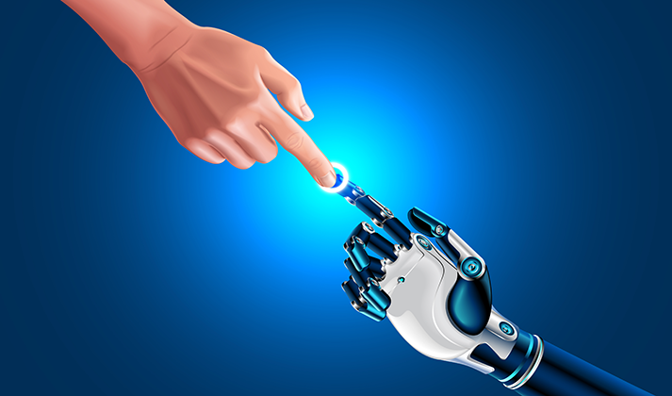
Human-Computer Interaction (HCI) is a multidisciplinary field that focuses on the design, study, and evaluation of interactive systems and interfaces between humans and computers. It involves understanding how users interact with technology and aims to create user-friendly and efficient interfaces that facilitate effective communication and interaction.

Slide 3
Aspects of Human-Computer Interaction
User Interface Design: HCI encompasses the design of graphical user interfaces (GUIs) and other interaction elements that enable users to interact with computer systems.
Usability: Usability refers to how easily and efficiently users can interact with a system and accomplish their tasks with minimal errors and frustrations.
User Experience (UX): UX involves considering the emotional and cognitive aspects of users' interactions with a system to create a positive and satisfying overall experience.

Slide 4
Accessibility: HCI includes ensuring that computer systems and interfaces are accessible to users with disabilities, providing equal opportunities for all users to interact effectively.
Human Factors: This aspect involves studying the psychological, cognitive, and physical characteristics of users to design interfaces that accommodate their needs and preferences.

Slide 5
Applications
Software Development: HCI principles are applied in developing user-friendly software applications, ensuring better user adoption and satisfaction.
Web Design: Web designers use HCI principles to create intuitive and engaging websites that offer a positive user experience.
Mobile Applications: HCI plays a significant role in designing user interfaces for mobile apps, considering the constraints of small screens and touch-based interactions.

Slide 6
Applications…continu
Human-Robot Interaction: HCI is crucial in developing interfaces for robots to interact with humans safely and effectively in various settings.
Healthcare and Medical Devices: HCI is applied in designing medical interfaces and devices to ensure easy operation by healthcare professionals and patients.

Slide 7
Importance
User-Centered Design: HCI emphasizes understanding and addressing users' needs, preferences, and limitations, leading to more user-centric products and systems.
Improved Usability: HCI techniques contribute to creating interfaces that are easy to learn, efficient to use, and minimize user errors, enhancing overall usability.
Enhanced User Experience: By considering user emotions and cognitive processes, HCI aims to create positive and enjoyable interactions between users and technology.

Slide 8
Importance…continu
Increased Productivity: Well-designed interfaces and systems streamline tasks and workflows, increasing user productivity and efficiency.
Ethical Considerations: HCI incorporates ethical considerations, ensuring that technology respects user privacy, autonomy, and dignity.

Slide 9
Challenges
Diverse User Base: Meeting the needs of diverse user groups with varying backgrounds, abilities, and preferences can be challenging.
Rapid Technological Advancements: Keeping up with the rapidly evolving technology landscape poses challenges in designing adaptable and future-proof interfaces.
Complex Systems: Designing interfaces for complex systems, such as advanced software applications or large-scale information systems, requires careful consideration and testing.

Slide 10
Challenges…continu
Limited Resources: HCI projects may face constraints in terms of time, budget, or access to representative user groups for testing.
Balancing Aesthetics and Usability: Striking a balance between visually appealing design and functional usability can be a challenge in HCI.

