Slide 1
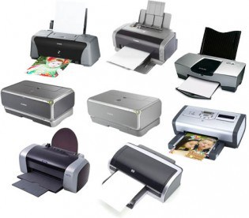
Printers and Scanners
Topic 9
Notes:
NOTE:
To change the image on this slide, select the picture and delete it. Then click the Pictures icon in the placeholder to insert your own image.

Slide 2
Printers and Scanners
A printer is a device that produces physical copies of digital documents or images, typically on paper ( also on cloth/wood/metal etc)
A scanner is a device that converts physical documents, photos, or images into digital formats. It captures the content of the original item and translates it into a digital file that can be stored, edited, or shared.

Slide 3
Types of Printers
Inkjet Printers
Definition: Printers that use liquid ink sprayed through tiny nozzles onto the paper.
Advantages: Good quality color prints, relatively low cost.
Disadvantages: Ink can be expensive, slower than laser printers.

Slide 4
Types of Printers Cont’d
Laser Printers
Definition: Printers that use a laser beam to produce an image on a drum, which is then transferred to paper using toner.
Advantages: High speed, high quality, cost-effective for large volume printing.
Disadvantages: Higher initial cost, larger and heavier than inkjet printers.

Slide 5
Types of Printers Cont’d
Dot Matrix Printers
Definition: Impact printers that use a matrix of small pins to create dots on the paper.
Advantages: Can print on multi-part forms, low running costs.
Disadvantages: Noisy, lower print quality, and slower.

Slide 6
Types of Printers Cont’d
Thermal Printers
Definition: Printers that produce images by heating specially coated paper.
Advantages: Quiet operation, no need for ink or toner.
Disadvantages: Paper is more expensive, prints can fade over time.

Slide 7
Types of Printers Cont’d
3D Printers
Definition: Printers that create three-dimensional objects by laying down successive layers of material.
Advantages: Can create complex shapes and prototypes.
Disadvantages: Slow printing process, high cost of materials and printers.

Slide 8
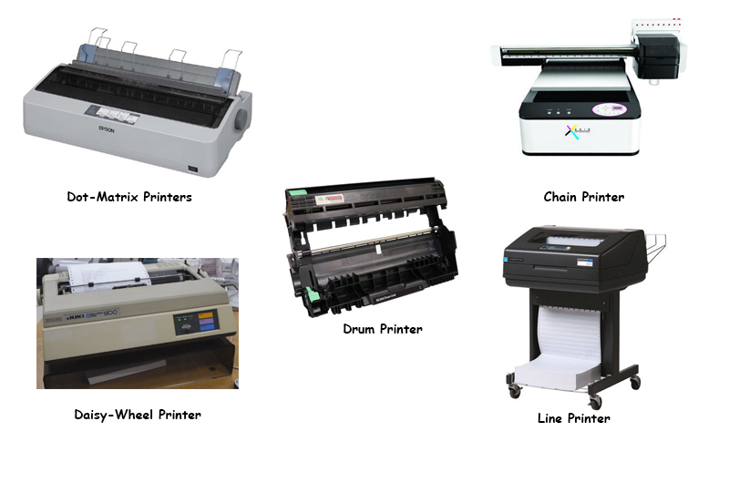

Slide 9
Printer Components
Print Head: The component that applies ink or toner to the paper.
Paper Feed Mechanism: Feeds paper into the printer and moves it through the printing process.
Ink/Toner Cartridges: Contain the ink (liquid for inkjet) or toner (powder for laser) used for printing.
Imaging Drum (Laser Printers): Attracts the toner particles to form the image that is transferred to the paper.
Control Panel: Allows users to interact with the printer and adjust settings.
Connectivity Ports: Interface for connecting the printer to a computer or network (e.g., USB, Ethernet, Wi-Fi).

Slide 10
Installation, Configuration & Sharing of Printers & Scanners

Slide 11
Steps for Installing a Printer
1. Unpack and Setup: Remove packaging and place the printer in the desired location.
2. Connect Power and Network: Plug in the power cord and connect to the network if applicable.
3. Install Ink/Toner: Follow the instructions to install ink or toner cartridges.
4. Load Paper: Place paper in the input tray and adjust guides to fit. Watch the videos Below
https://youtu.be/ge_GBaiURw0
https://youtu.be/rqXAZdXM5Wc

Slide 12
Driver Installation
1. Download Drivers: From the manufacturer's website or use the provided installation media.
2. Run Installation Software: Follow on-screen prompts to install drivers and software.
3. Connect to Computer: During installation, connect the printer via USB or network as instructed.

Slide 13
Printer Configuration
1. Access Printer Settings: Through the computer's control panel or settings menu.
2. Set Preferences: Adjust print quality, paper size, orientation, and other preferences.
3. Test Print: Print a test page to ensure the printer is working correctly.

Slide 14
Sharing a Printer
1. Enable Sharing: Go to printer properties and enable sharing options.
2. Set Permissions: Configure who can access and use the shared printer.
3. Connect Other Devices: Add the shared printer to other devices on the network. Watch Video below
https://youtu.be/tg1soEWNcFg

Slide 15
TYPES OF SCANNERS
Flatbed Scanners: The most common type, featuring a flat glass surface where you place the document. They are versatile and can scan a variety of media.
Sheet-fed Scanners: These automatically feed documents through the scanner, making them faster for multi-page documents.
Handheld Scanners: Portable devices that you manually slide over the document. They're useful for quick scans on the go.
3D Scanners: Capture the shape and appearance of a physical object to create a 3D model.

Slide 16
Installing and Configuring a Scanner
1. Connect the Scanner: Use USB or network connections.
2. Install Drivers: Follow similar steps as with printers.
3. Configure Settings: Adjust resolution, color depth, and file formats for scanning.

Slide 17
PRINTERS Maintenance & Troubleshooting

Slide 18
Printer Maintenance
1. Regular Cleaning: Clean print heads, rollers, and paper feed mechanisms.
2. Replace Consumables: Regularly replace ink/toner cartridges and paper.
3. Firmware Updates: Keep the printer firmware up to date for optimal performance.

Slide 19
Troubleshooting Common Issues
1. Paper Jams: Open the printer and carefully remove jammed paper. Check for obstructions in the paper path.
2. Poor Print Quality: Clean print heads, check ink/toner levels, and ensure correct paper type.
3. Connectivity Issues: Verify cables, check network settings, and ensure drivers are correctly installed.
4. Error Messages: Refer to the printer manual or manufacturer's website for specific error codes and solutions.

Slide 20
Thank you

